Slide 1

DURGA MAHAVIDYALAYA, RAIPUR (C.G.)
YEAR – 2018-2023
DEPARTMENT OF EDUCATION

Slide 2
KEY POINTS
Introduction
Department Overview
Objectives of the Department
Faculty Excellence
Program Outcome and Course Outcome (Academic Programs)
Alumni Success Stories
Amenities and Resources
Extra Curricular Activities
Teaching learning Methods
Forward Looking Plans

Slide 3
INTRODUCTION
Durga Mahavidyalaya endeavors to attain merit in every enterprises-education, research, training and other co-curricular activities.
Department of Education Established in year 2010.
We strive to make continuous improvement in pedagogical tools to ensure a conductive environment wherein the students unravel their potential and develop their inherent insight and skills.

Slide 4
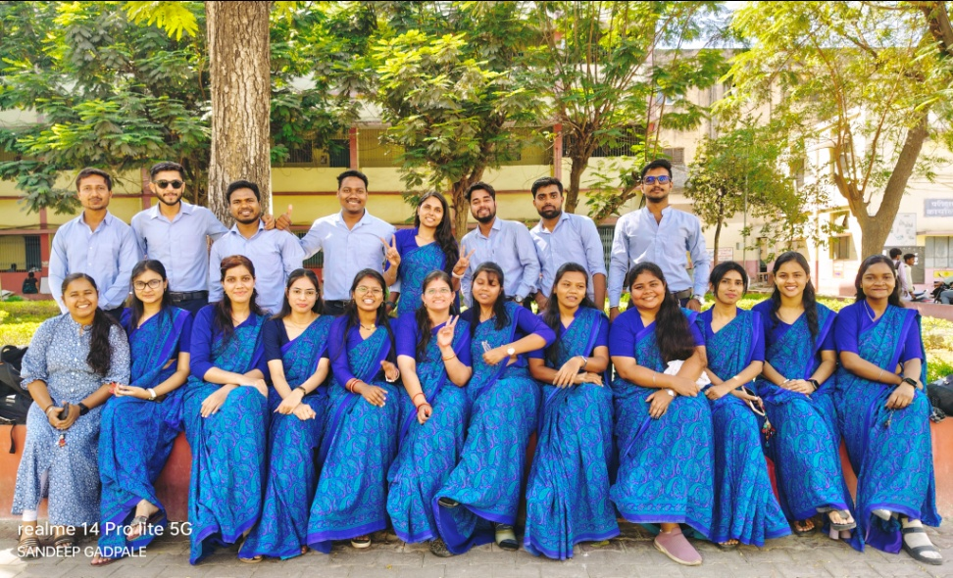
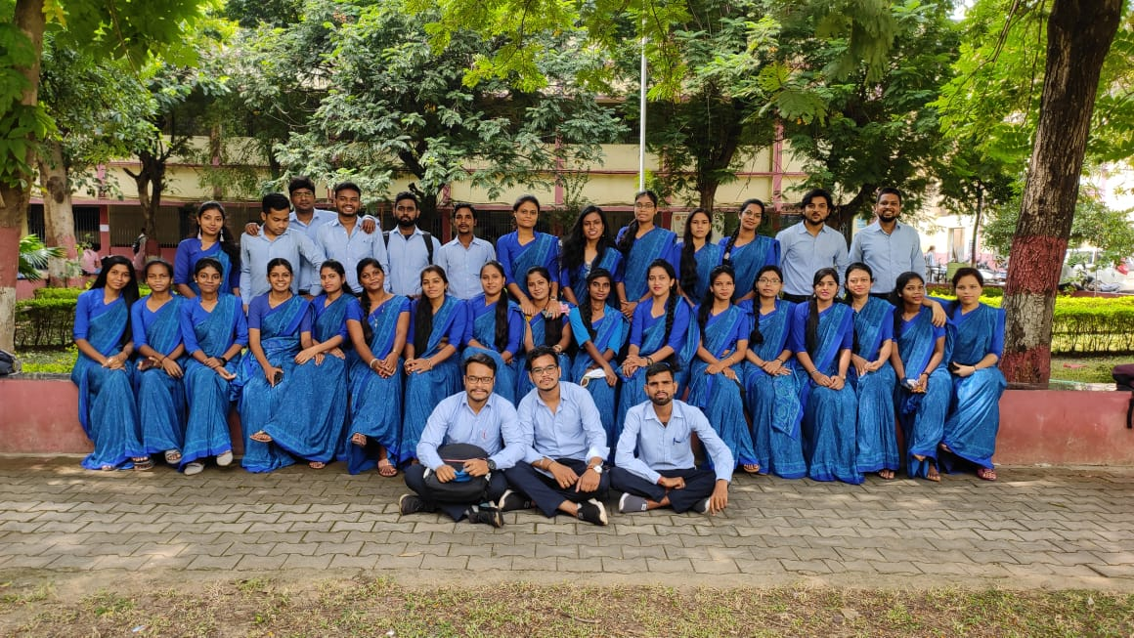
DEPARTMENT OF EDUCATION

Slide 5
KEY VALUES OF EDUCATION
To bring out the inherent values, of Truth, Right Action, Peace, Love and Non-Violence, in the children and to guide them to practice these values in their daily life.
To help teachers, parents and children to re-focus on these five basic positive values that underlie all aspects of a moral society

Slide 6
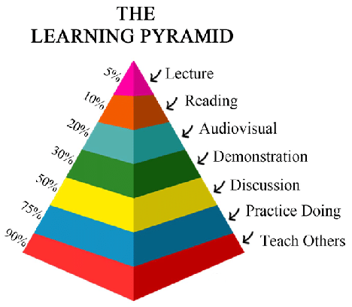

Slide 7

GOAL OF OUR EDUCATION

Slide 8

OBJECTIVES OF THE DEPARTMENT

Slide 9
VISION & MISSION
To be the leading center of higher education.
To excel in teaching and research through creativity and productivity.
To Inculcate competitive spirit among students with a global vision.
To strive constantly to achieve high standards in teaching and research.
To carve out a niche for the University imparting higher quality teaching with a holistic approach.
To encourage interdisciplinary teaching and research programs.
To design publish and disseminate relevant literature to strengthen higher education, social and cultural integration.

Slide 10
TEACHING STAFF
Sr. No | Name | Tenure | Qualification
1. | Dr. Sanjivani Thakur | 2010- Till Date | M.A, M.Ed, Ph.d (Hindi & Education)
2. | Dr. Pragati Dubey | 2010- Till Date | M.Hsc, M.Ed, Ph.D (Education)
3. | Dr. Archana Gomasta | 2010- Till Date | M.A, M.Phil, Ph.D (Political Science & Education)
4. | Ms. Kusum Rathore | 2010- Till Date | M.A, M.Phil
5. | Dr. Pratibha Khandelwal | 2014- Till Date | M.A, M.Ed, Ph.D (Education)
6. | Dr. Iti Banerjee | 2014- Till Date | M.A, M.Phil, Ph.D(Education)

Slide 11
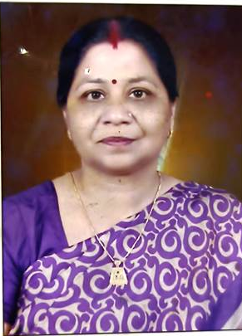
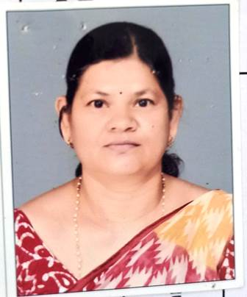
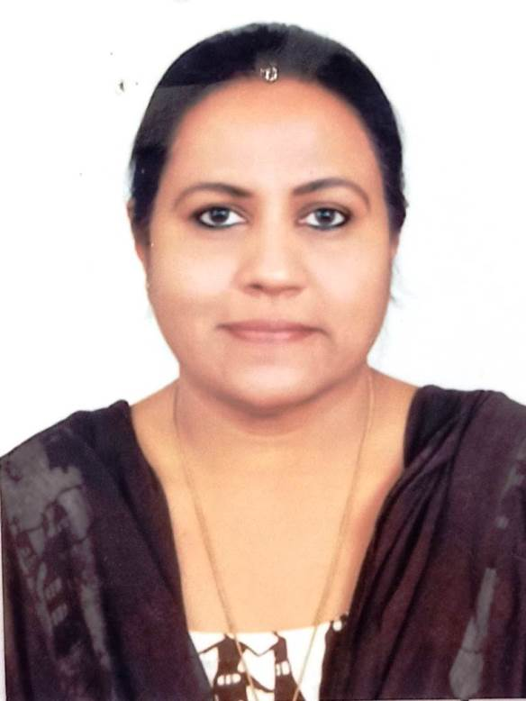
DETAIL OF FACULTY MEMBERS
Dr. Sanjivani Thakur
HOD
Qualification:- M.A. Hindi, M.Ed.
Ph.D.. (Hindi Education)
Experience:- 24 years
Dr. Pragati Dubey
Assistant Professor
Qualification – MSc., M/.Ed., M.A. (Sociology), Ph.D. (Education), PG Diploma in Guidance in Counseling,
Experience:- 15 Years
Dr. Archana Gomasta
Assistant Professor
Qualification:- M.A. M.Phil., Ph.D. (Political Science), M.Ed. Ph.D.. (Education), NCC In charge
Experience:- 15 Years

Slide 12
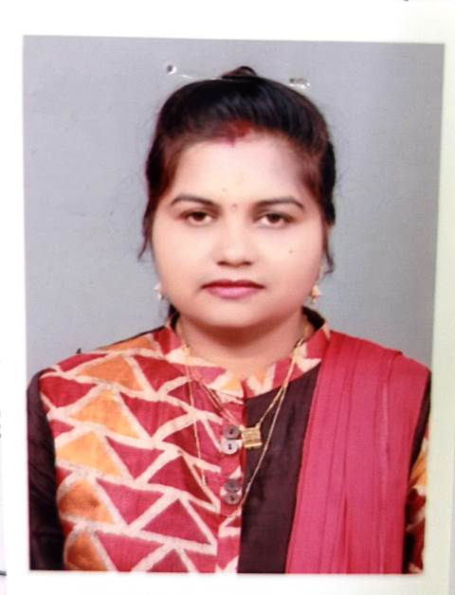
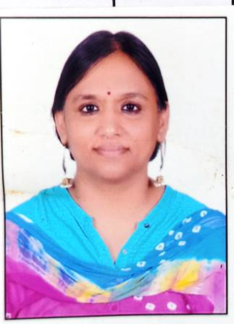
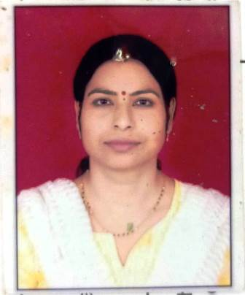
Prof. Kusum Rathore Assistant Professor
Qualification:- M.A., MPhil.(Political Science) M.Ed.
Experience:- 15Year
Dr. Pratibha Khandelwal
Assistant Professor
Qualification-M.A.(English), M.Ed., Ph.D.(Education), NET
Experience:- 10 Years
Dr. Iti Banerjee Assistant Professor
Qualification:- M.A. (Hindi, Philosophy), M.Ed. M.Phil. Ph.D.. (Education)
Experience:- 10 Years.

Slide 13
LIST OF PUBLICATION
Sr. No. | Name | Name of Book | ISBN Number | Level/Chapter | Page No. | Year
1. | Dr. Sanjivani Thakur | Introduction to Research Methodology in Education | ISBN-978-93-92568-15.2 | 9 | 92 | 2022
 |  | Nai Talim on Experiential & Skill Based Learning | ISBN 978-93-92568-28.2 | 10 | 72 | 2022
 |  | Shiksha ke Manovigyanik Paripaksh | ISBN978-93-92568-43.5 | 7 | 76 | 2023
2. | Dr. Pragati Dubey | Introduction to Research Methodology in Education | ISBN 978-93-92568-15.2 | 11 | 116 | 2022

Slide 14
 |  | Shiksha ke Manovigyanik Paripaksh | ISBN 978-93-92568-43.5 | 14 | 189 | 2023
3 | Kusum Rathore | Shiksha ke Manovigyanik Paripaksh | ISBN978-93-92568-43.5 | 9 | 104 | 2023
4 | Dr. Pratibha Khandelwal | Introduction to Research Methodology in Education | ISBN 978-93-92568-15.2 | 16 | 203 | 2022
5 | Dr. Iti Banerjee | Introduction to Research Methodology in Education | ISBN 978-93-92568-15.2 | 2 | 6 | 2022

Slide 15

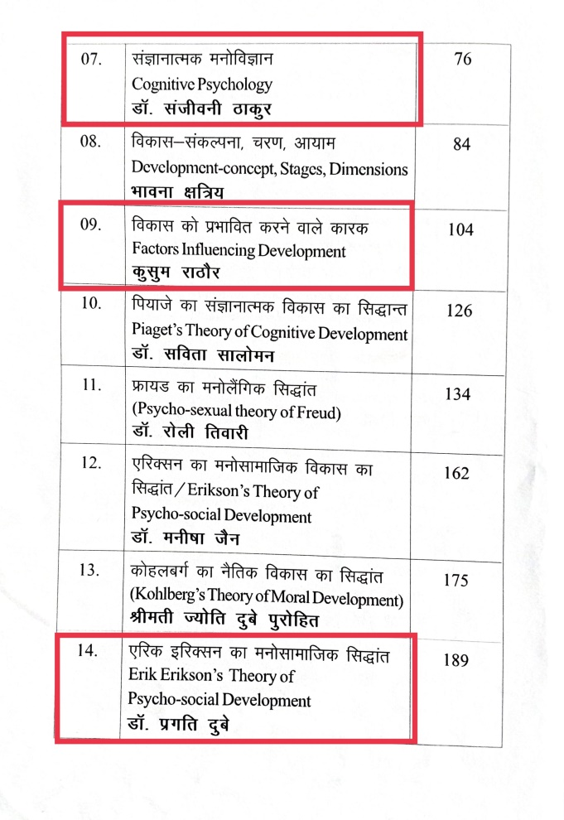
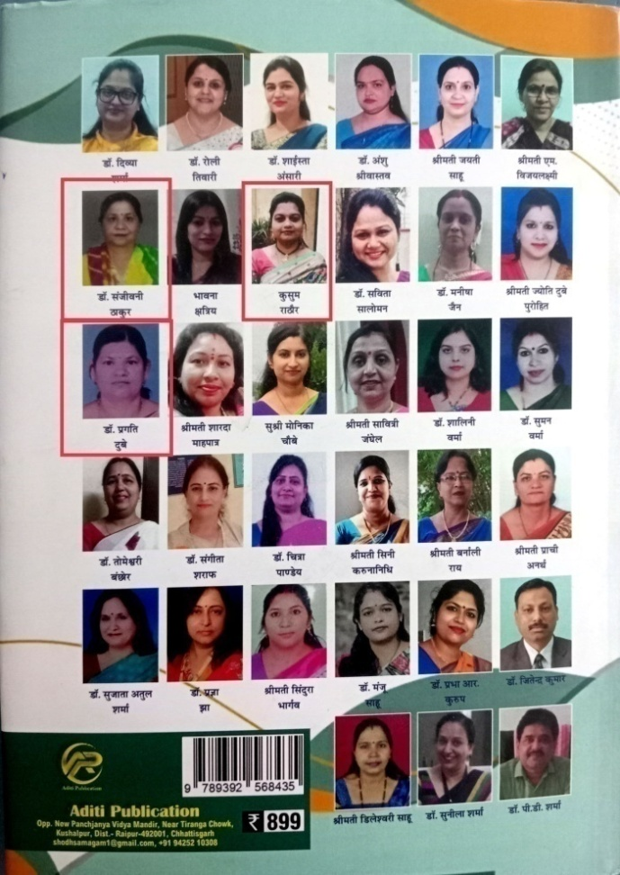
Book Writing and Publishing
(1) Philosophical Perspective of Education
Dr. Sanjivani Thakur, Dr. Pragati Dubey,Prof. Kusum Rathor

Slide 16

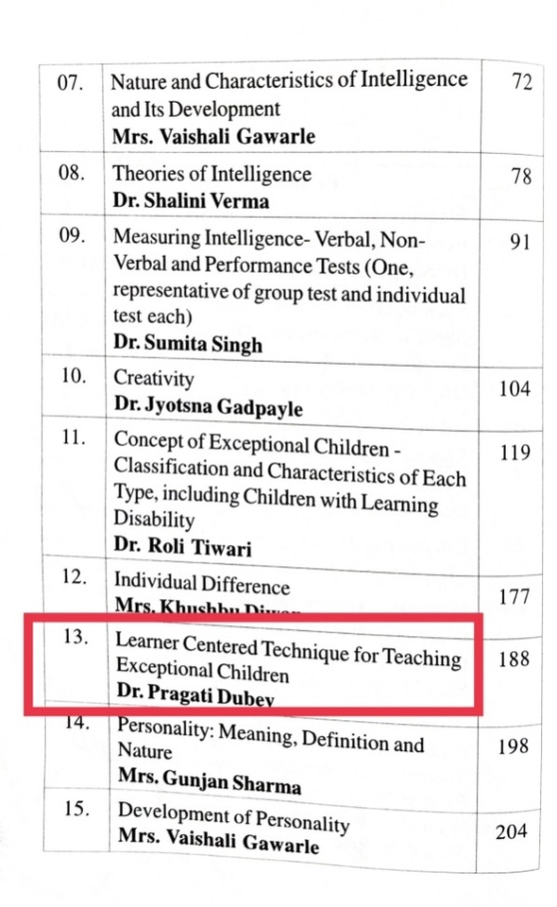
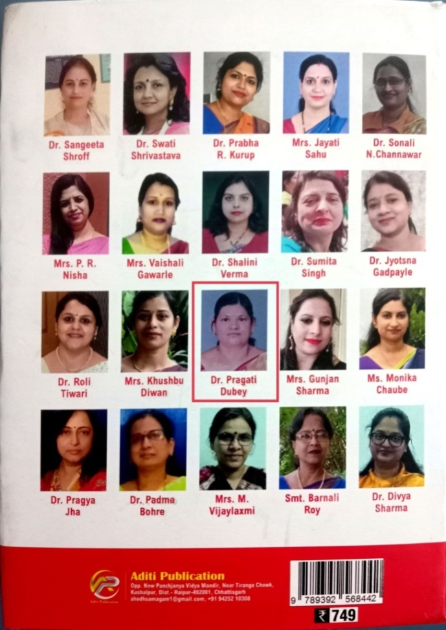
(2) Learner and Learning Process by
Dr. Pragati Dubey

Slide 17

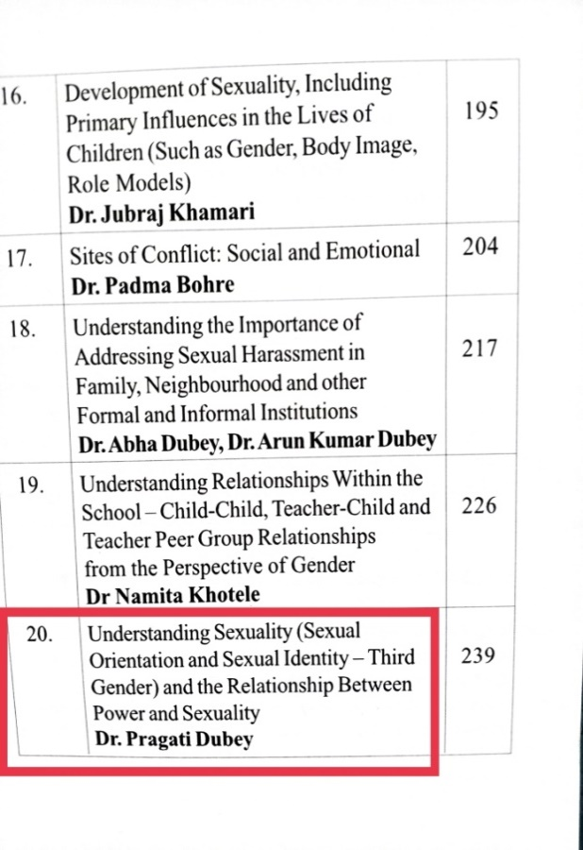
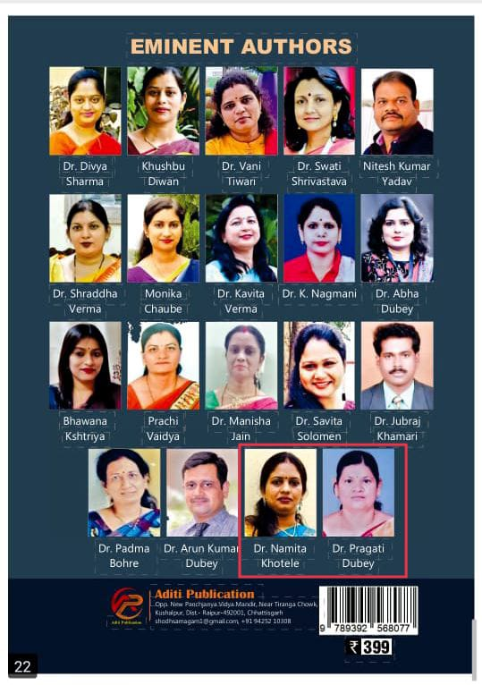
(3) Gender Perspectives in Education by
Dr. Pragati Dubey & Dr. Namita Khotele
.

Slide 18
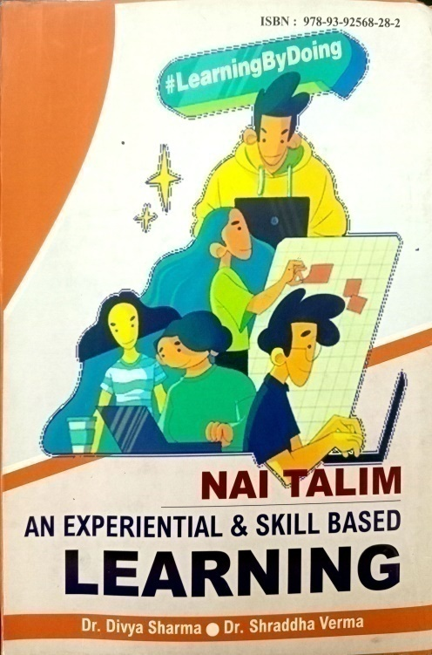
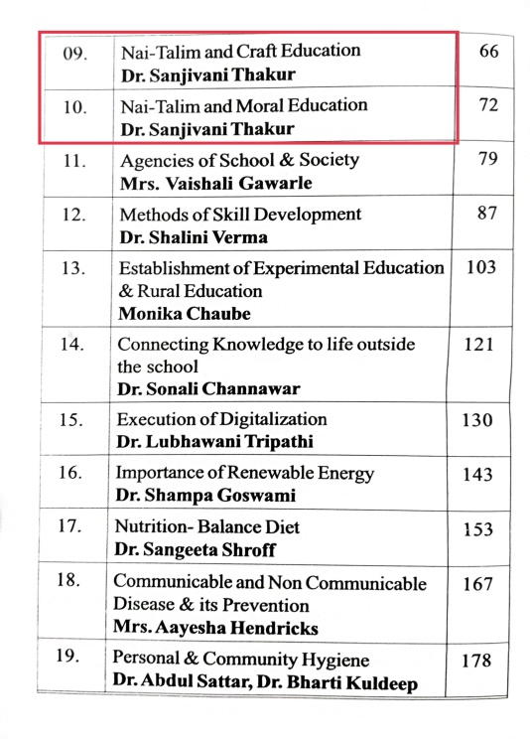
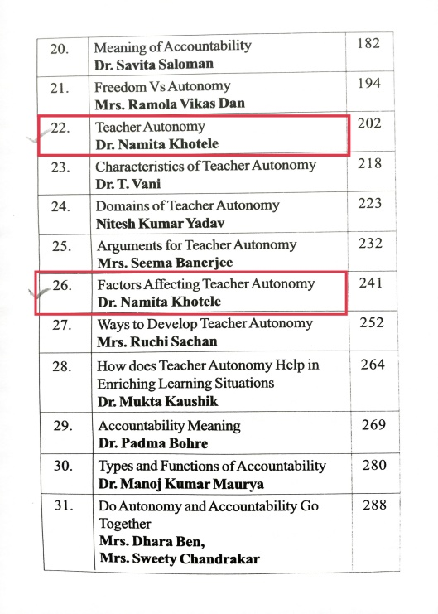
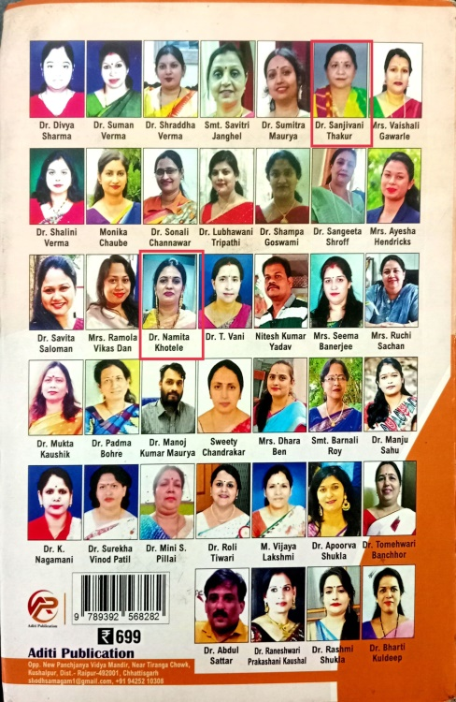
(4) NAI TALIM: An experiential & Skill Based Learning by
Dr. Sanjivani Thakur
.

Slide 19

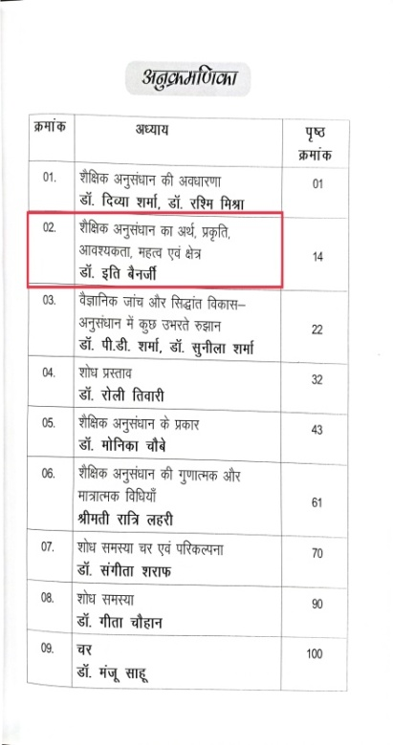
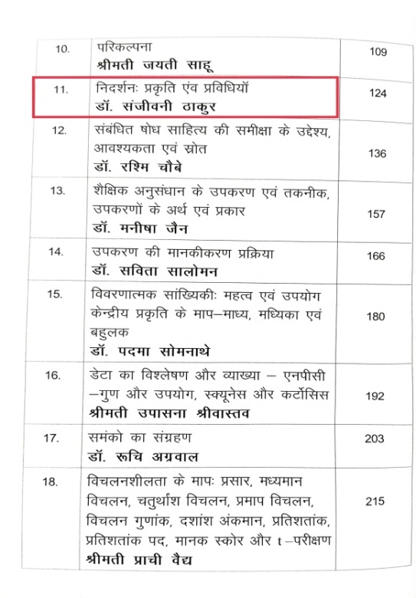
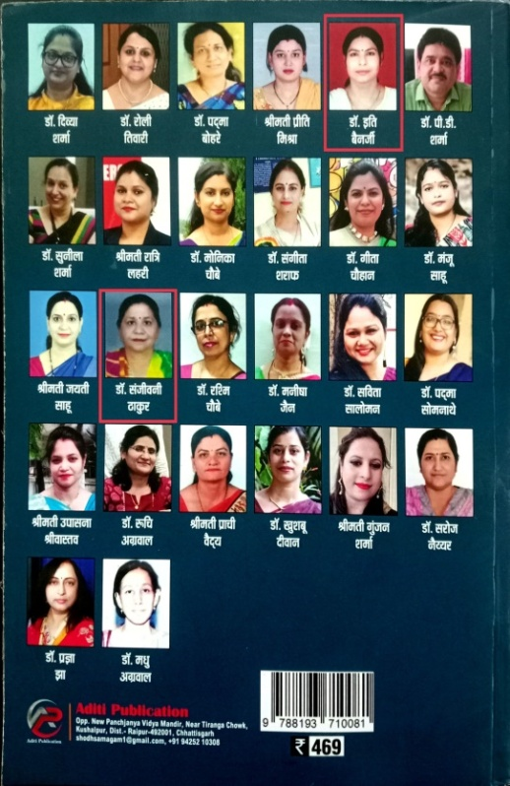
f”k{kk esa vuqla/kku
MkW. bfr csuthZ ] MkW. lathouh Bkdqj

Slide 20
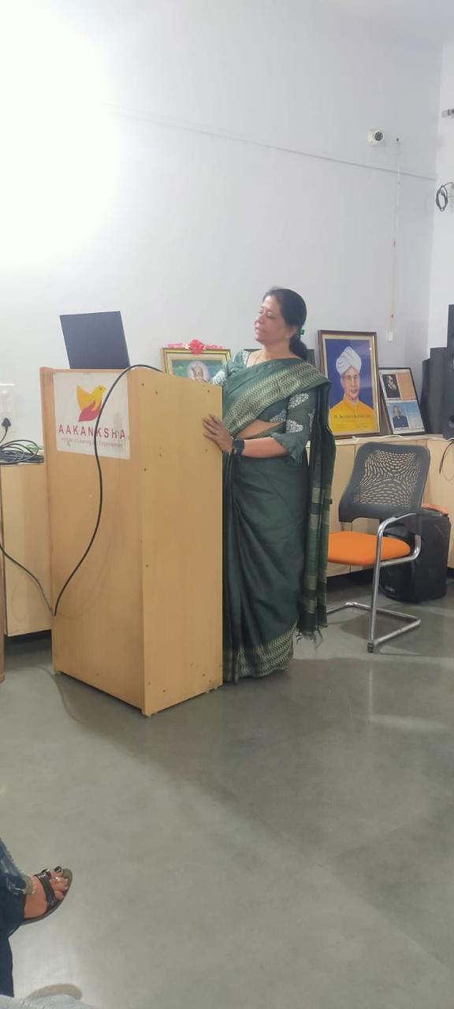
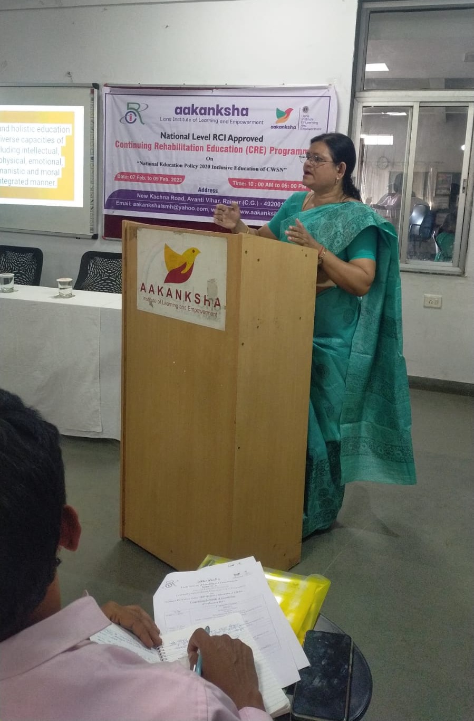
FACULTY EXCHANGE
.
Guest Speaker :- (Seminar – National Level RCI Seminar) Aakanksha Lions Institute of learning & Empowerment, Avanti Vihar, Raipur (C.G.)
Dr. Sanjivani Thakur
Dr. Pragati Dubey

Slide 21
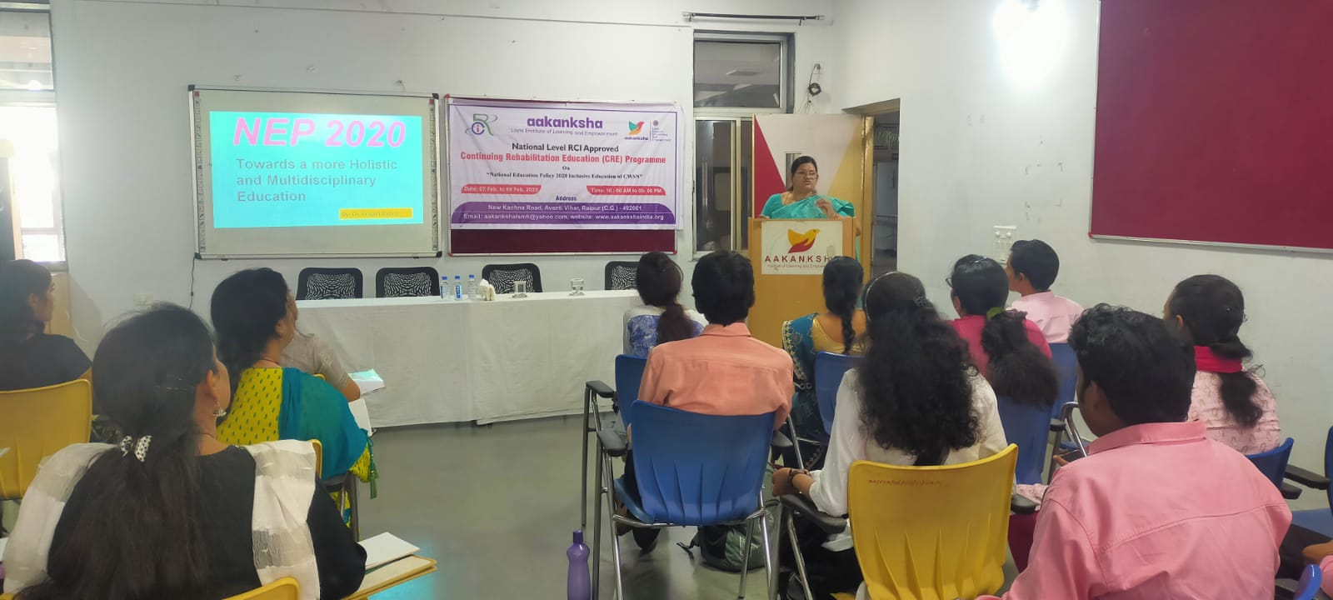
Guest Speaker :- (Seminar – National Level RCI Seminar)

Slide 22
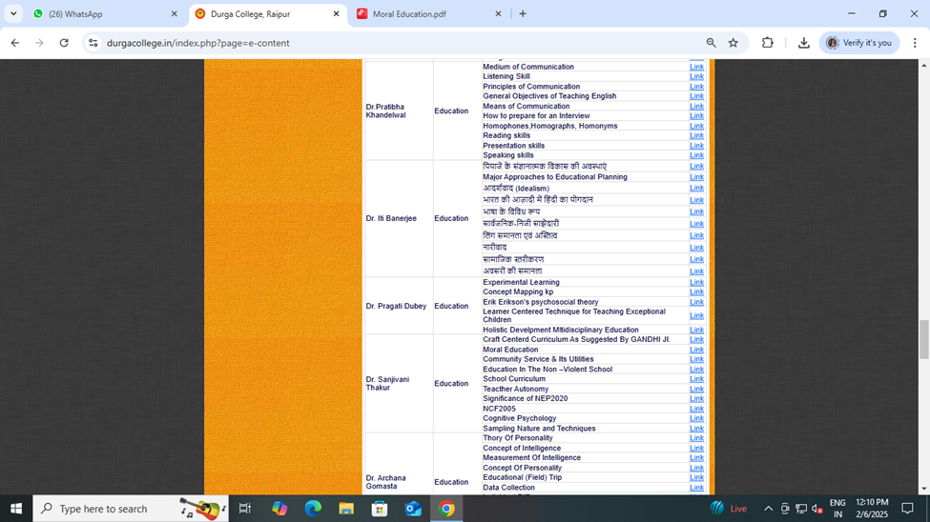
DETAILS OF E-CONTENT DEVELOPED
.

Slide 23
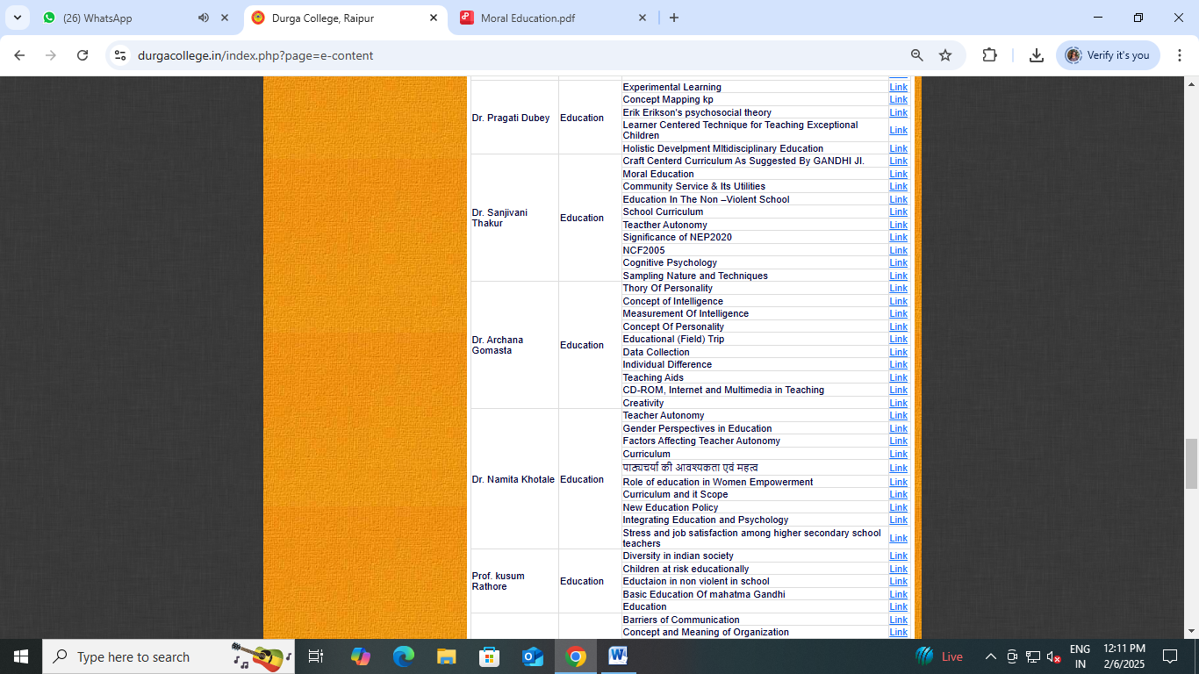

Slide 24
TOTAL STRENGTH OF STUDENT
YEAR | Total Student | MALE | FEMALE | General | OBC | SC | ST | OTHER STATES
2018 | 100 | 24 | 76 | 27 | 34 | 15 | 21 | 3
2019 | 100 | 53 | 47 | 11 | 48 | 14 | 24 | 1
2020 | 100 | 26 | 74 | 23 | 36 | 16 | 25
2021 | 100 | 39 | 61 | 21 | 39 | 14 | 24 | 2
2022 | 100 | 21 | 35 | 35 | 36 | 17 | 19 | 3

Slide 25
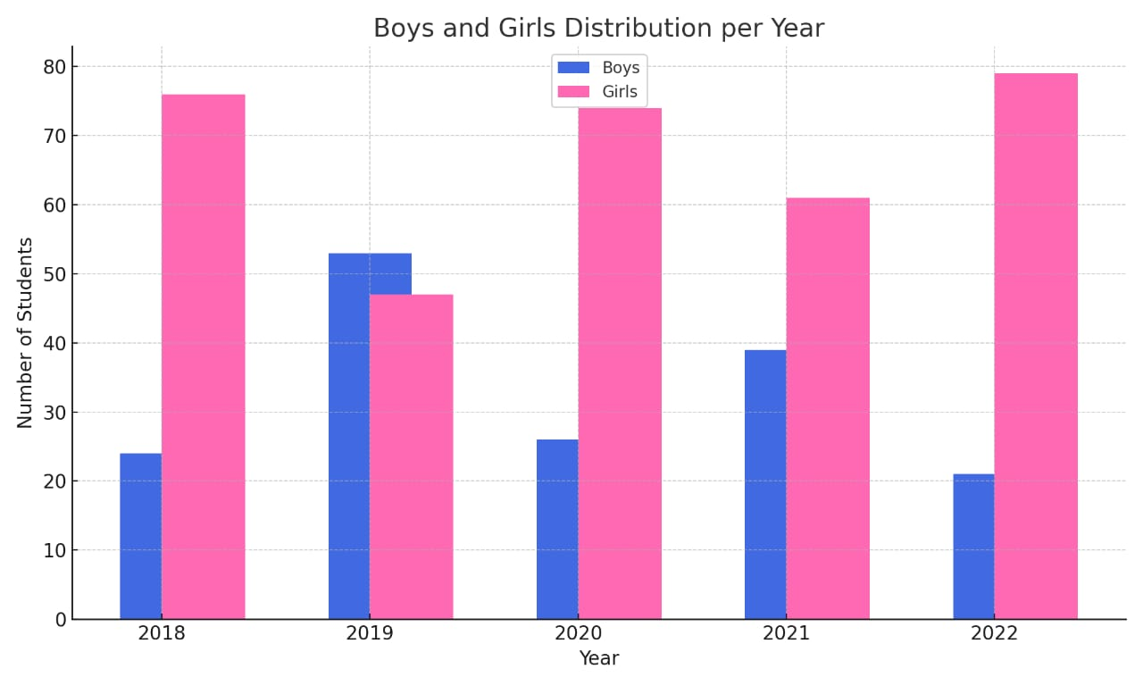

Slide 26
STUDENT RESULT ANALYSIS

Slide 27
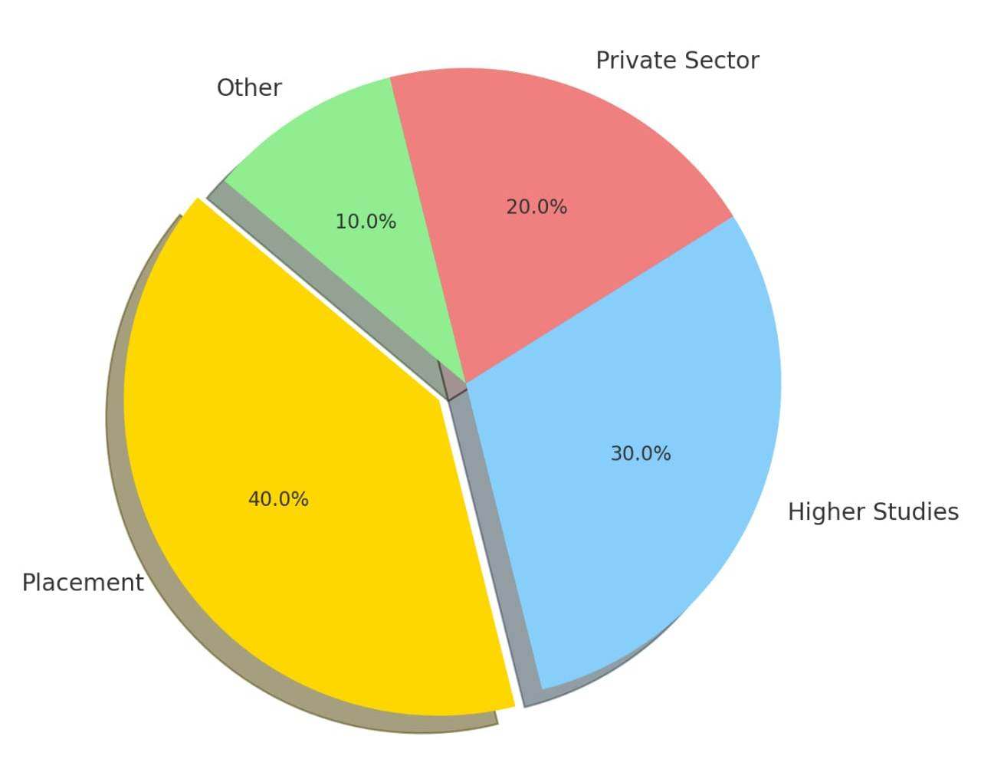
STUDENT ACHIEVEMENTS

Slide 28
GUEST LECTURES
S.No | NAME OF GUEST | TOPIC
1. | Dr. Madhu Kamra | Skill Development Lecture
2. | Dr. Ranjana Sharma | Manavtavad
3. | Mamta Banarjee | Pyramid Yoga
4. | Neeta Bhojwani | Pyramid Yoga
5. | Hemlata | Yoga
6. | Pyarelal Sahu | Indoor Sports Lecture
7. | Nivedita Panda | Art & Craft
8. | Virendra Singh | Maths Lecture
9. | Avinash Kumar | Amity University
10. | Amrita Ojha | Suyash Hospital

Slide 29
PROGRAMME OUTCOME
Encourage Understanding of the concept of education with reference to the policies and program.
Examine the different theories and principal of educational management and resources.
Appreciate the linkage between education and society for National development.
Identify the role of agencies, national policies, ICT and Innovative practices in teachers education.
Demonstrate coherent understanding of the various perspective of education.

Slide 30
PROGRAM OUTCOME & COURSE OUTCOME
( ACADEMIC PROGRAMS)
PO1 : Understand and use formal and informal assessment strategies to evaluate and ensure the continuous intellectual social, emotional and physical development of the learners.
PO2 : Recognize self-identity as a ‘teacher’ through school based learning experiences and reflective practices that continually evaluate the effects of their choices and actions.
PO3 : To change the behavior, attitude and values of teacher trainees so that they shape into responsible and accountable agents of change in the society, in the perspective of local, national and global concerns and issues vital for human survival, progress and development

Slide 31
PROGRAM SPECIFIC OUTCOME
PSO1 : To enable students to understand the central concepts, tools of inquiry and structures of the disciplines of Education in general and teacher education in particular.
PSO2 : To provide opportunities to teacher trainees that enable learning experiences to make meaningful.
PSO3 : To make the student teachers understand how children learn and develop, how they differ in their approaches to learning and create learning opportunities.
PSO4 : To develop the skills of student teachers to plan learning experiences in and outside the classroom that are based on learners’ existing proficiency, interests, experiences and knowledge, and enable them to understand how students come to view, develop, learn and make sense of subject matter contained in the curriculum.
PSO5 : To develop the capacity among student teachers to use knowledge of effective verbal, non-verbal and media communication techniques to foster active enquiry, collaboration and supportive interaction in the classroom.

Slide 32
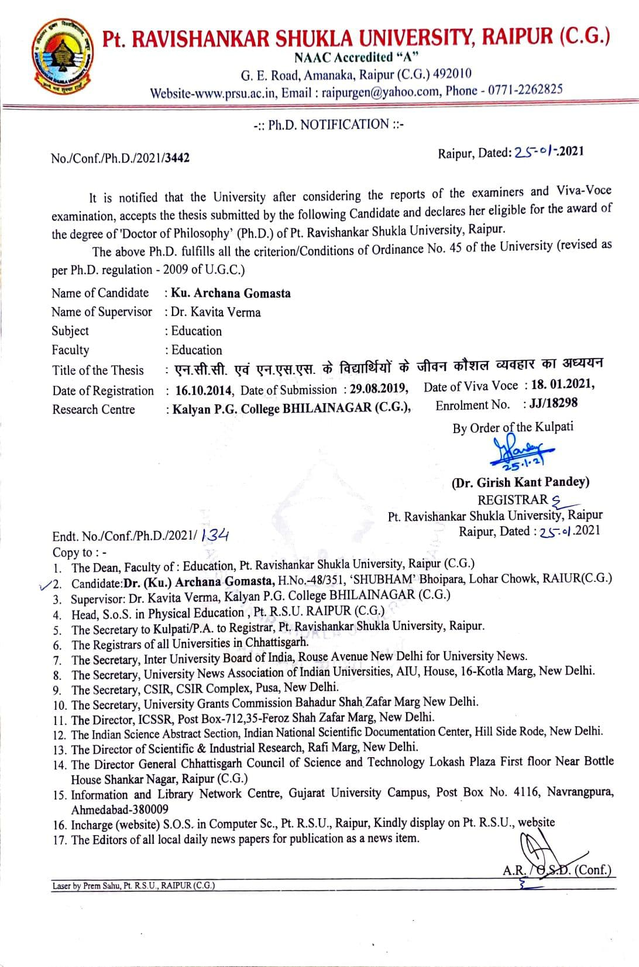
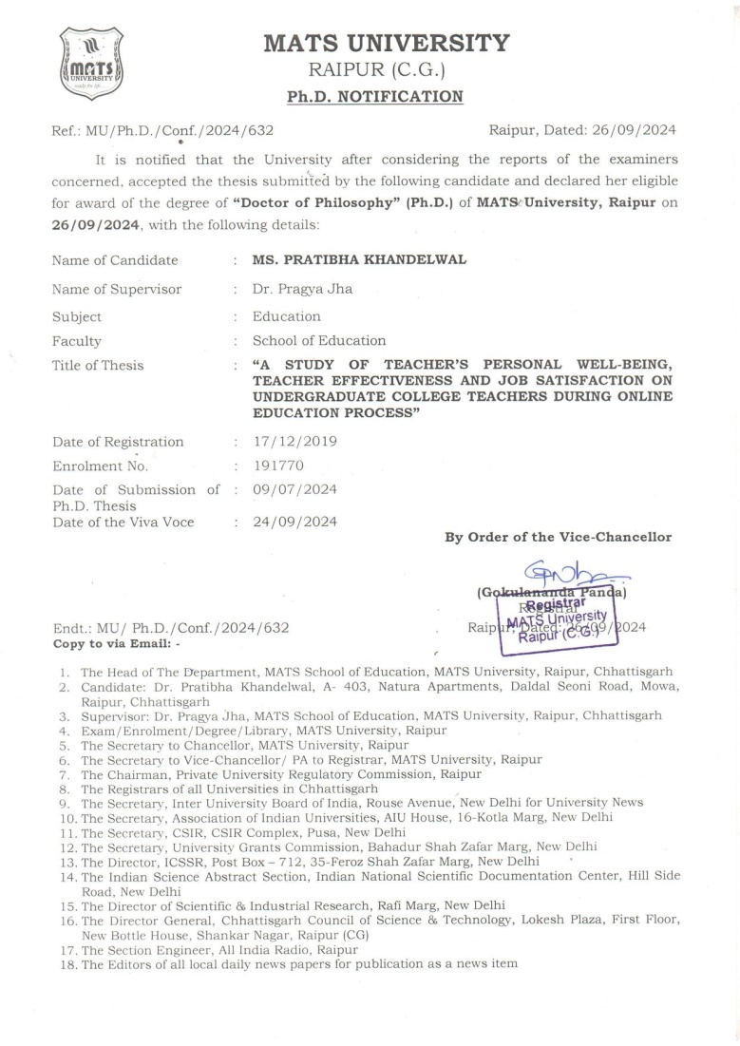
DEPARTMENTAL ACHIEVEMENT
Dr. Archana Gomasta 2)Dr. Pratibha khandelwal
Ph.D. in Education Ph.D. in Education

Slide 33
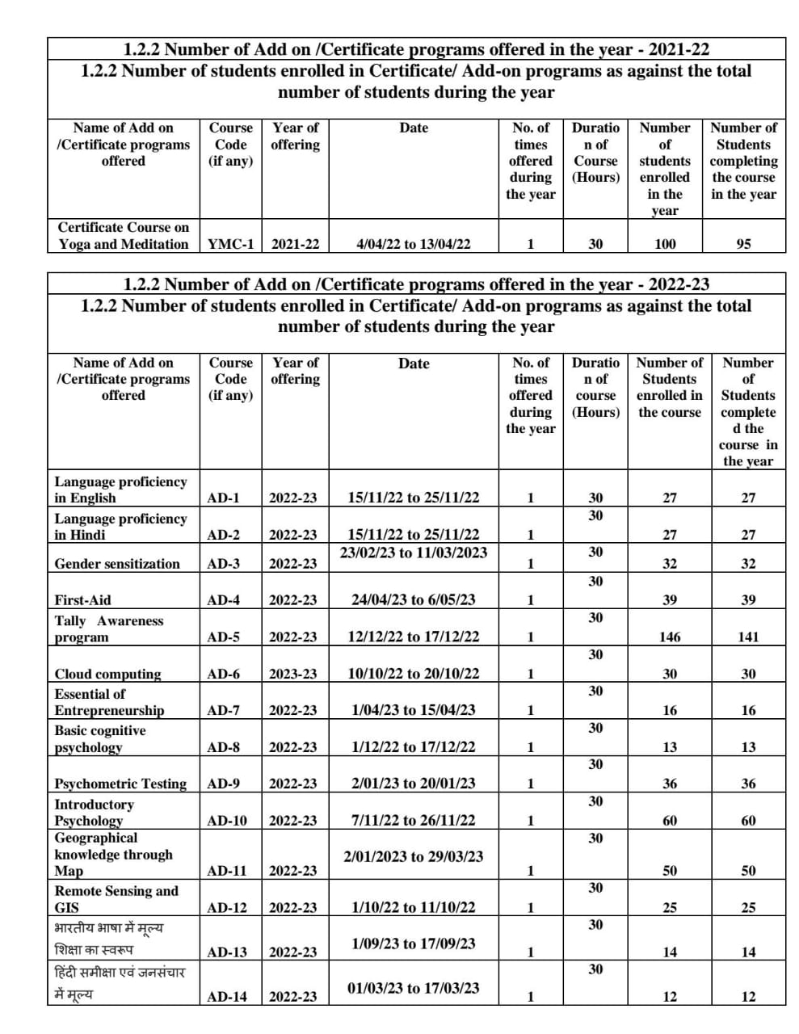
YEAR WISE ADD-ON-COURSE LIST 2021-2022,2022-2023

Slide 34
NUMBER OF ADD-ON COURSE DURING THE YEAR :-2023-24
Add-On-Course/Certificate Programs offered during the year
Number of Students enrolled in Certificate/Add-on-Programs as against th total number of students during the Year
S.No. | Name of Add on / Certificate Programs Offerd | Course Code(if any) | Year of Offering | No. of Times During the Year | Duration of Course | Number of Students enrolled in the | Number of Students completing the
1 | Language Proficiency in English | AD-11 | 2023-24 | 1 | 30 Hours | 34 | 34
2 | Language Proficiency in Hindi | AD-12 | 2023-24 | 1 | 30 Hours | 40 | 40
3 | N- x- dh yksd laLd`fr& xksnuk | AD-14 | 2023-24 | 1 | 30 Hours | 49 | 41
4 | Yoga & Meditation | AD-15 | 2023-24 | 1 | 30 Hours | 107 | 90

Slide 35
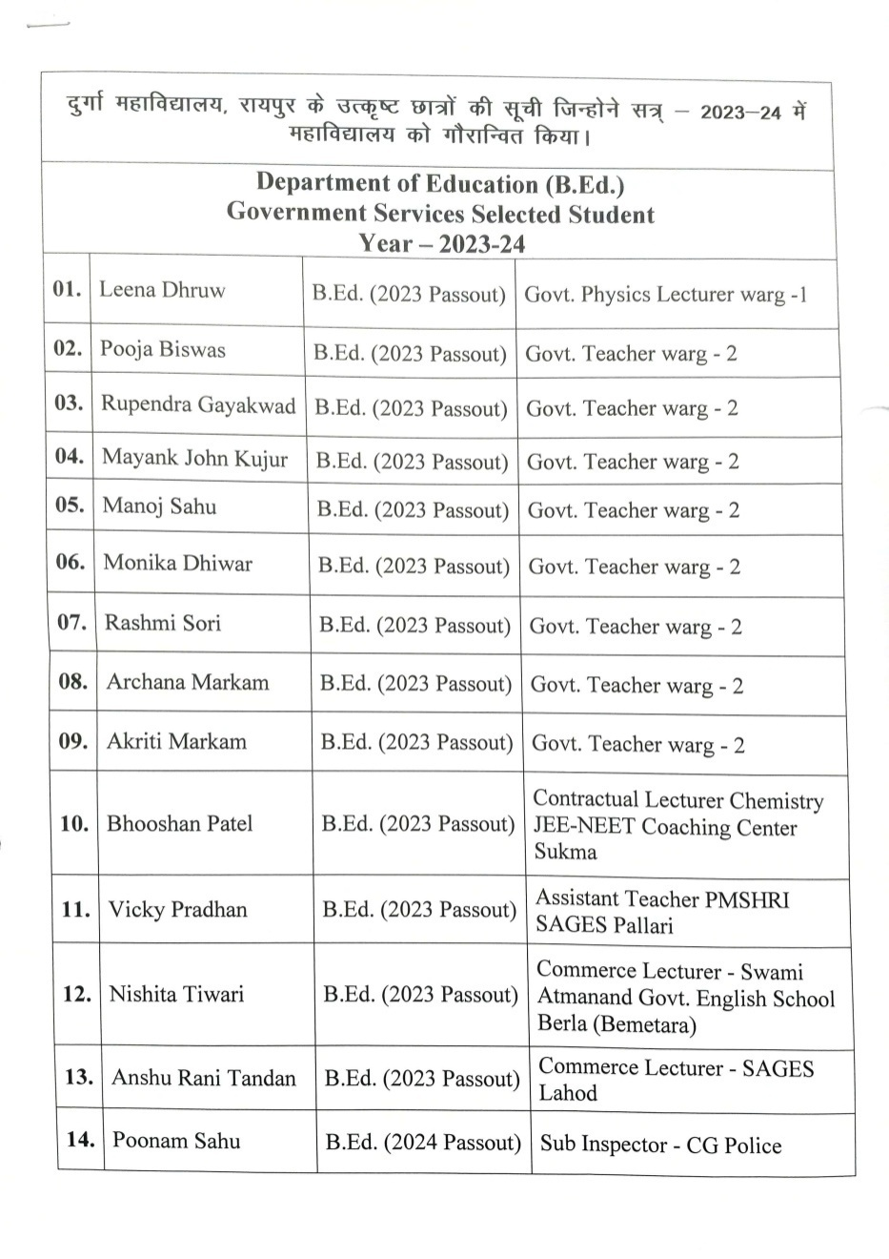
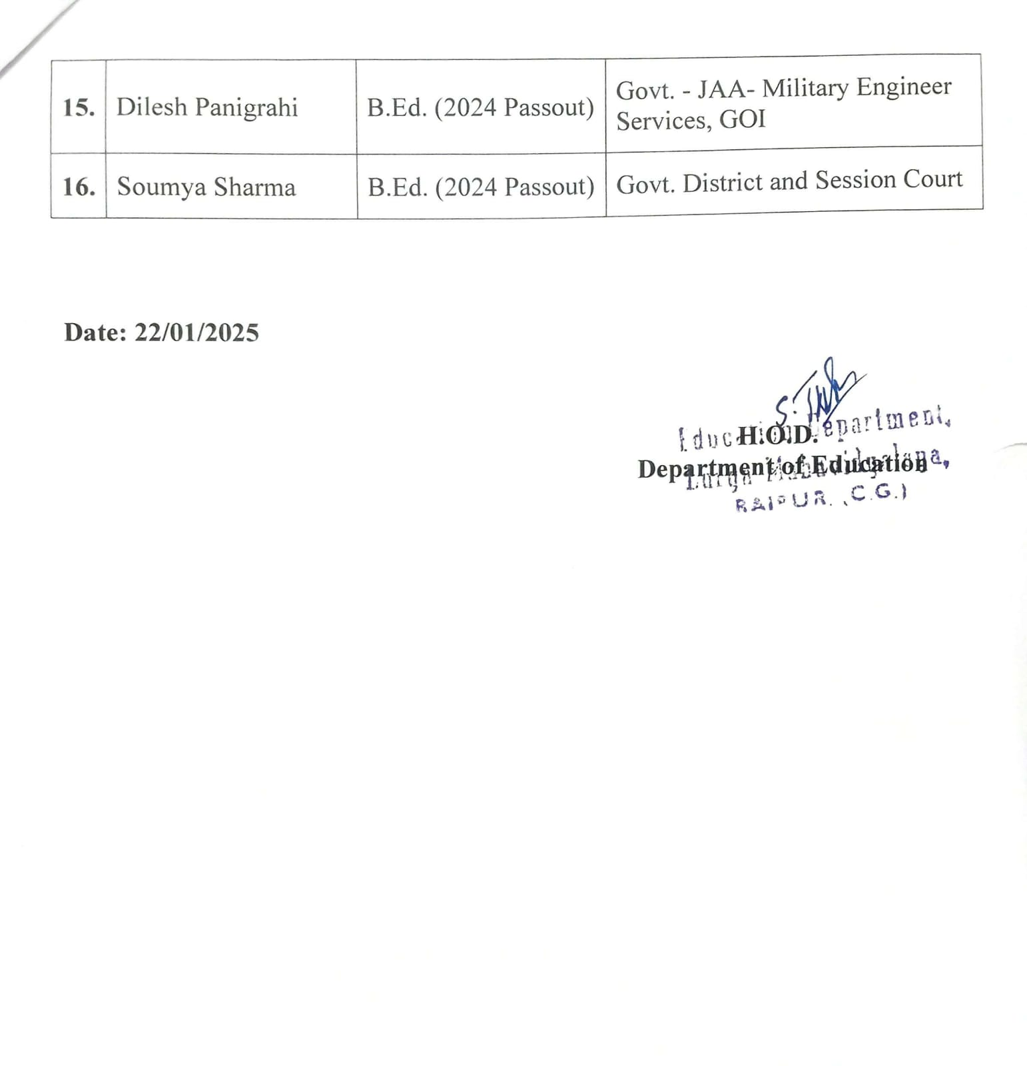
ALUMNI SUCCESS STORIES

Slide 36
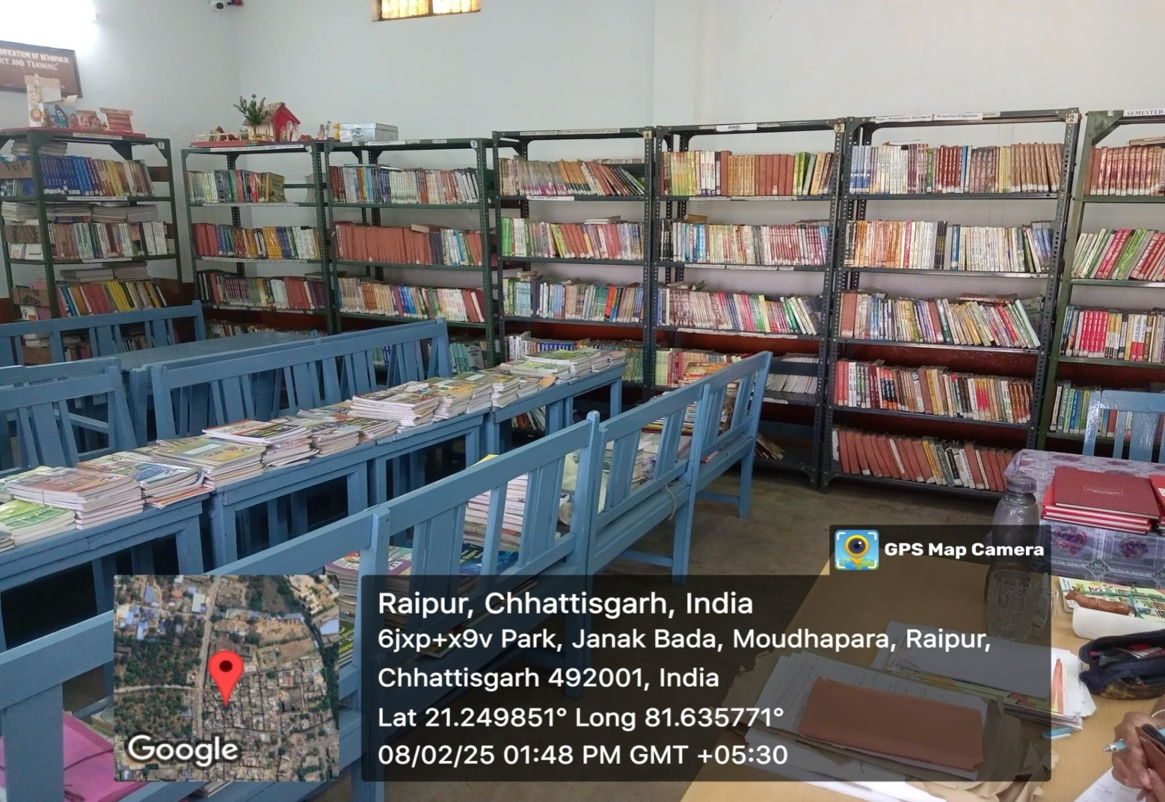
AMENITIES AND RESOURCES
Library :- Total Number of Books 3479

Slide 37
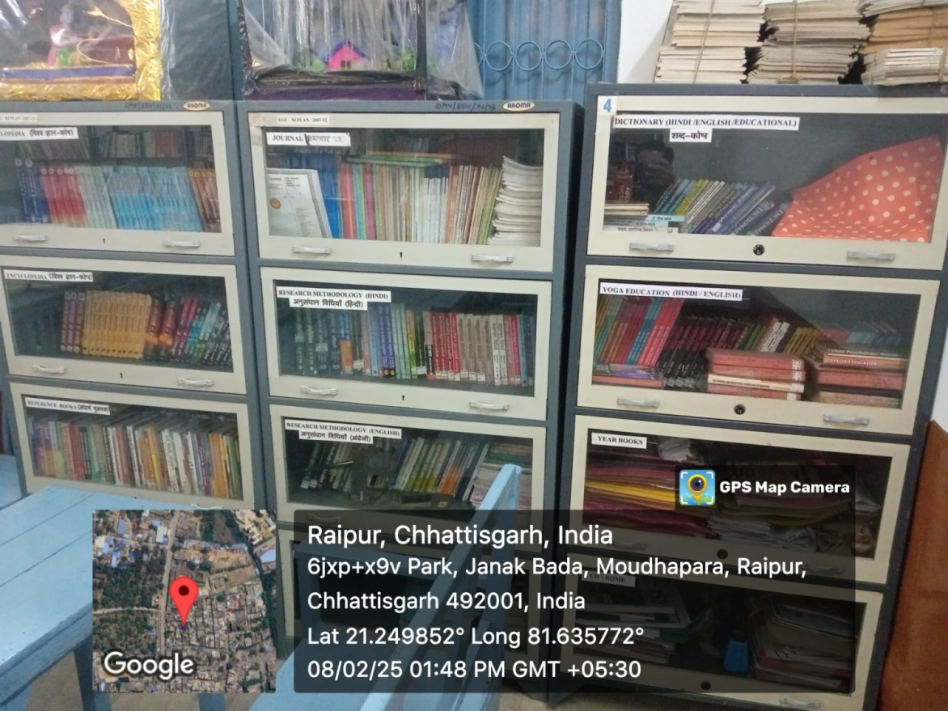
Book Bank
Donated By Pass out Students

Slide 38
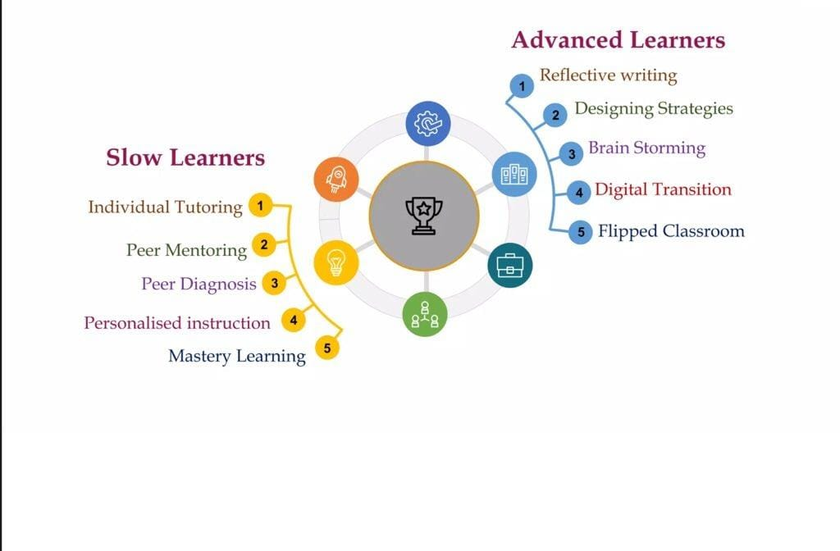
SPECIAL PROVISIONS

Slide 39
DEPARTMENTAL ACTIVITIES
Festival Celebration
Social Awareness Programme
Special Children School Visit
Children's day Celebration
Yoga and Sports Week.
Cultural activity
Students Development Programs
Seminar and Workshop

Slide 40

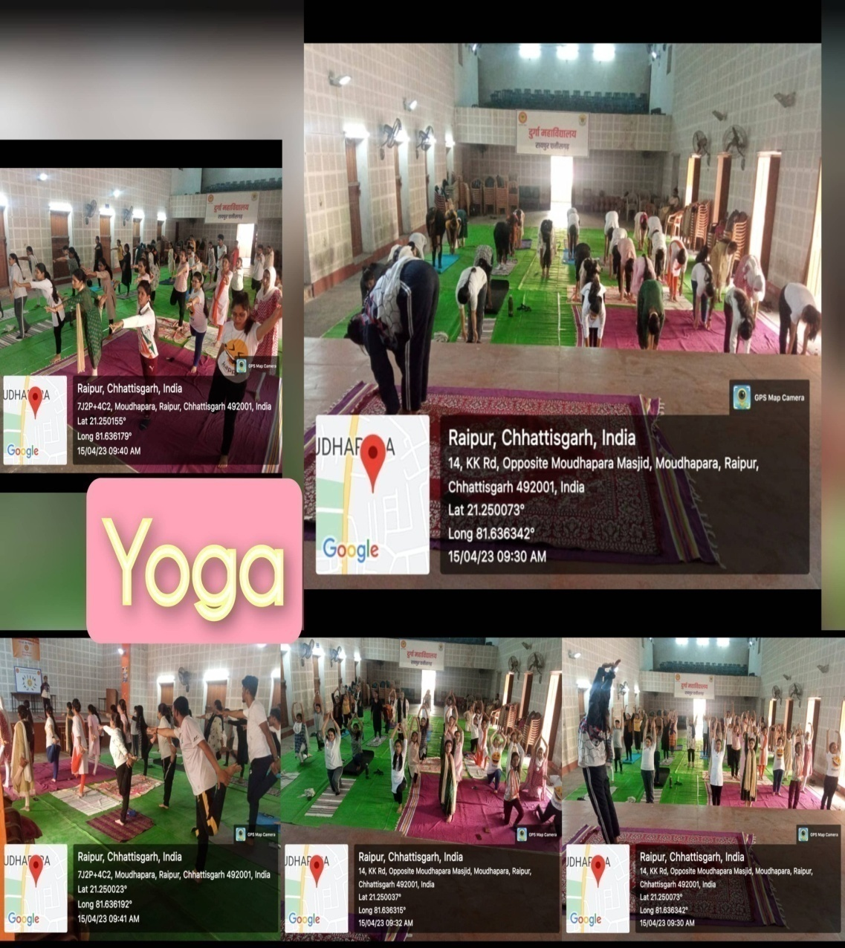

Slide 41


Slide 42
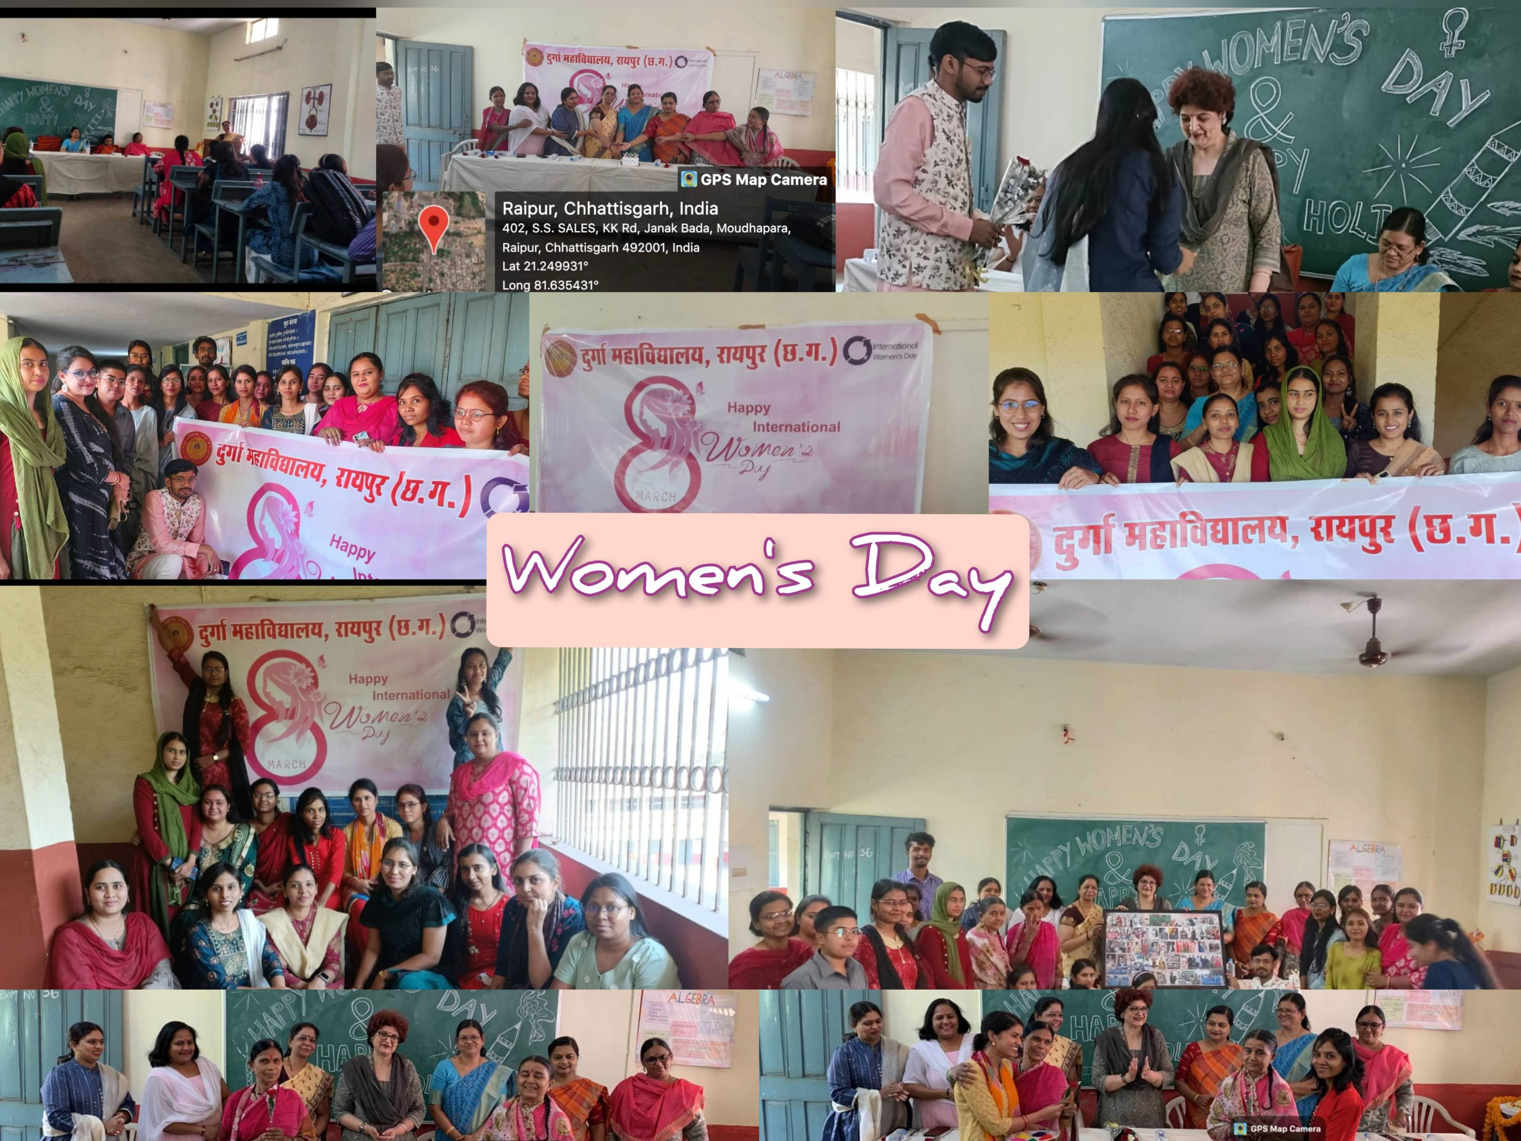

Slide 43
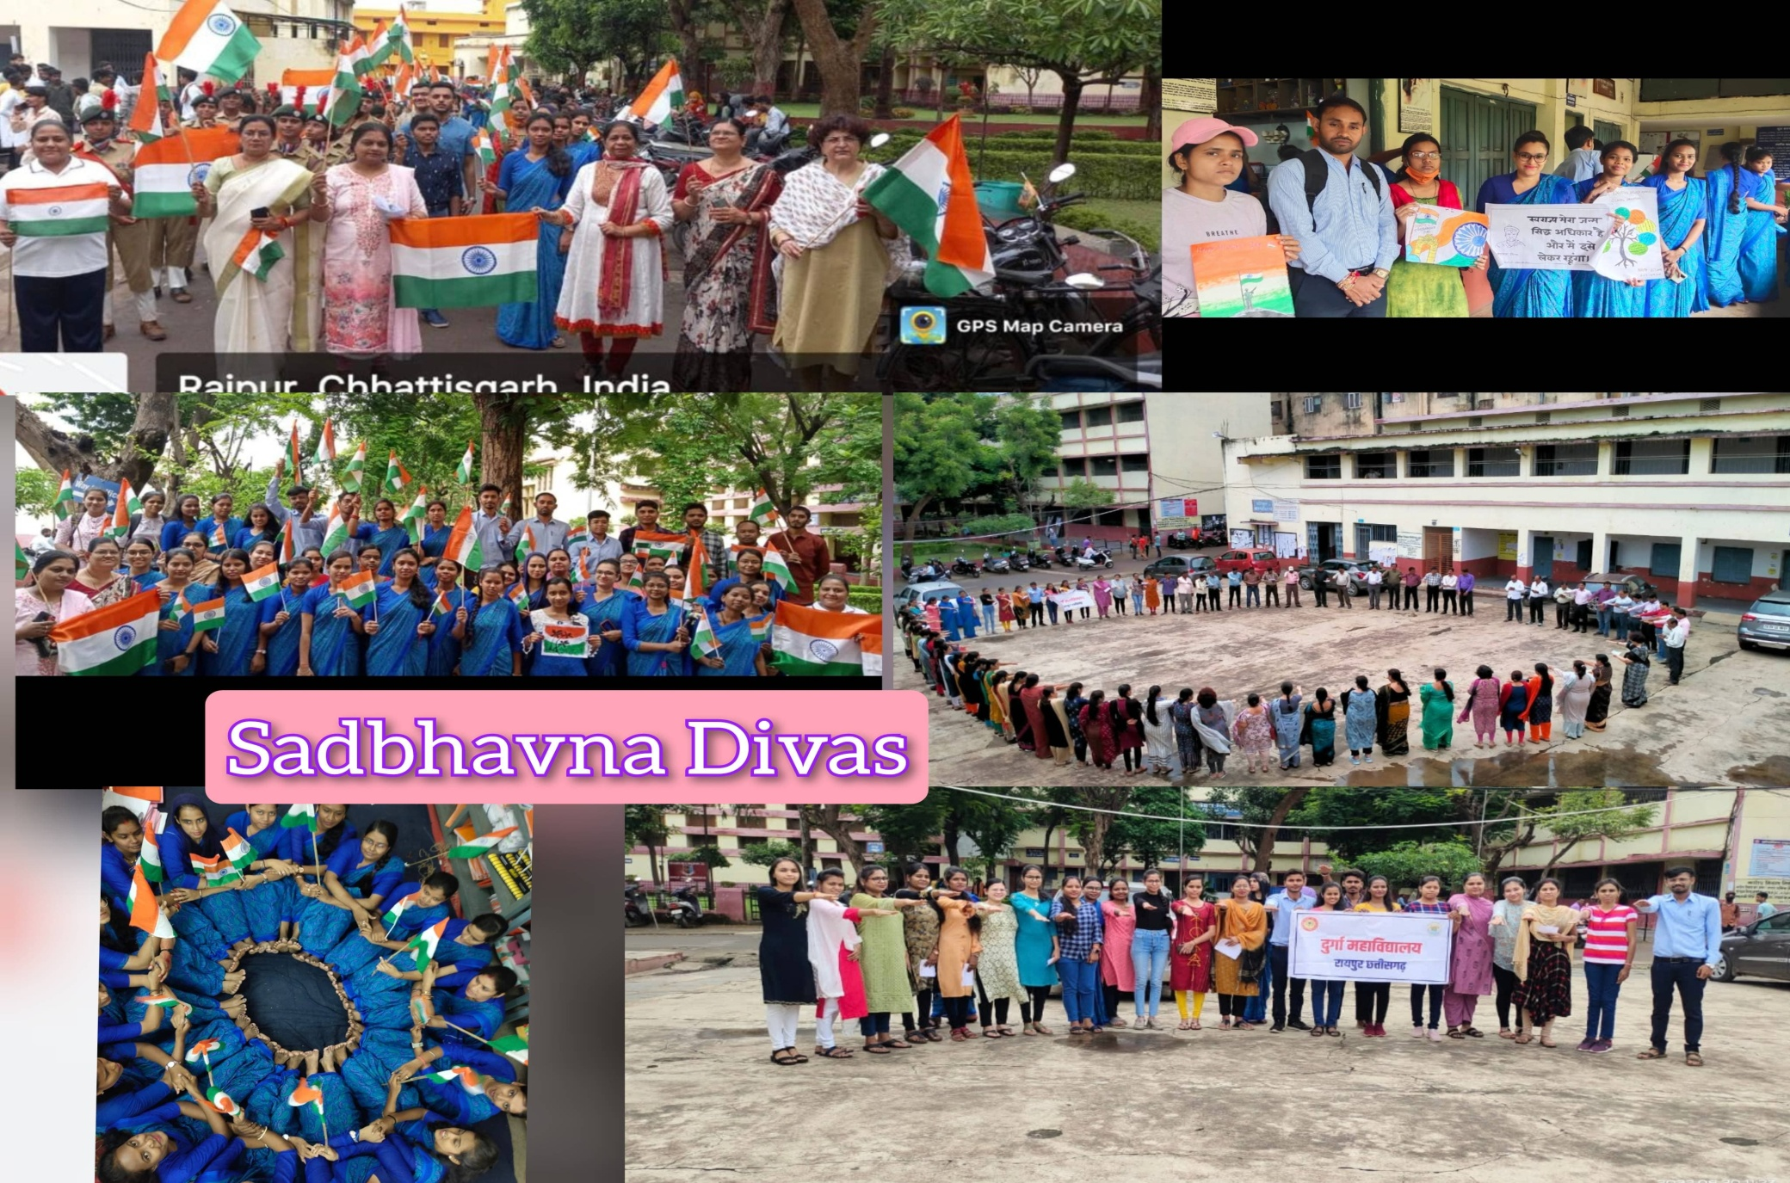

Slide 44
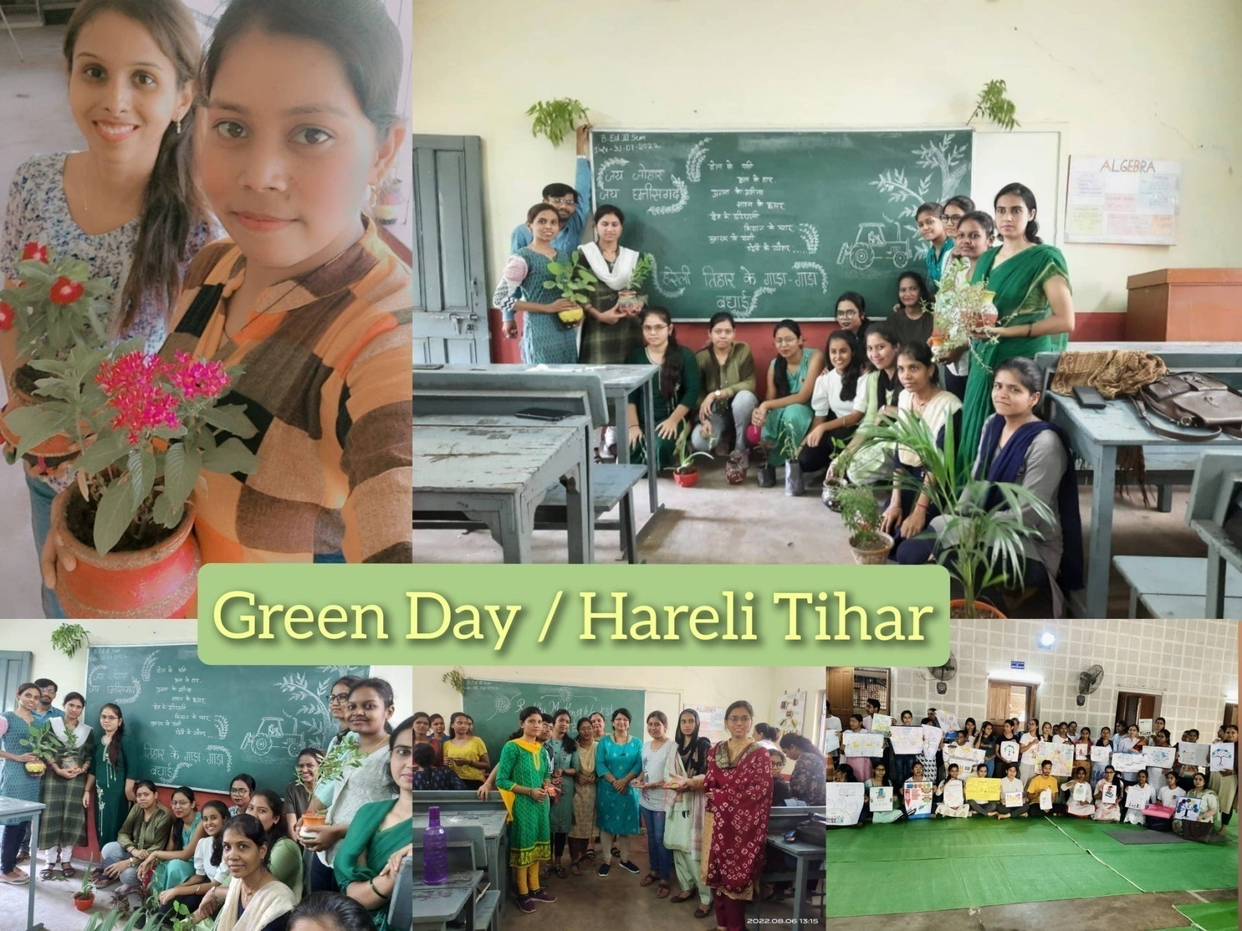

Slide 45
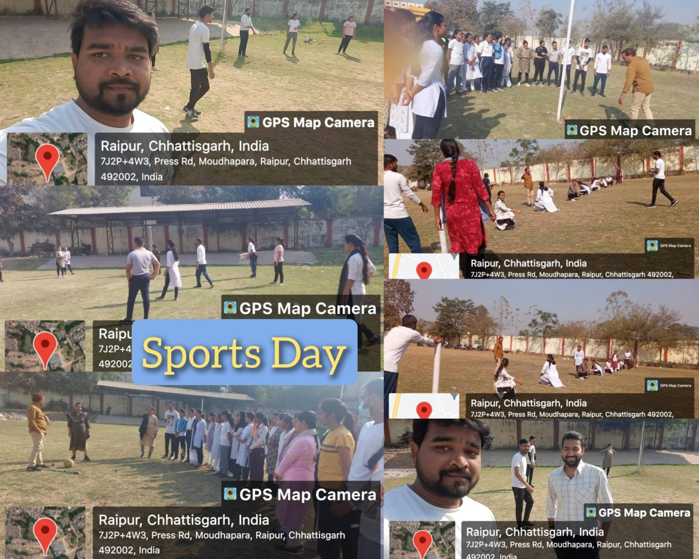

Slide 46
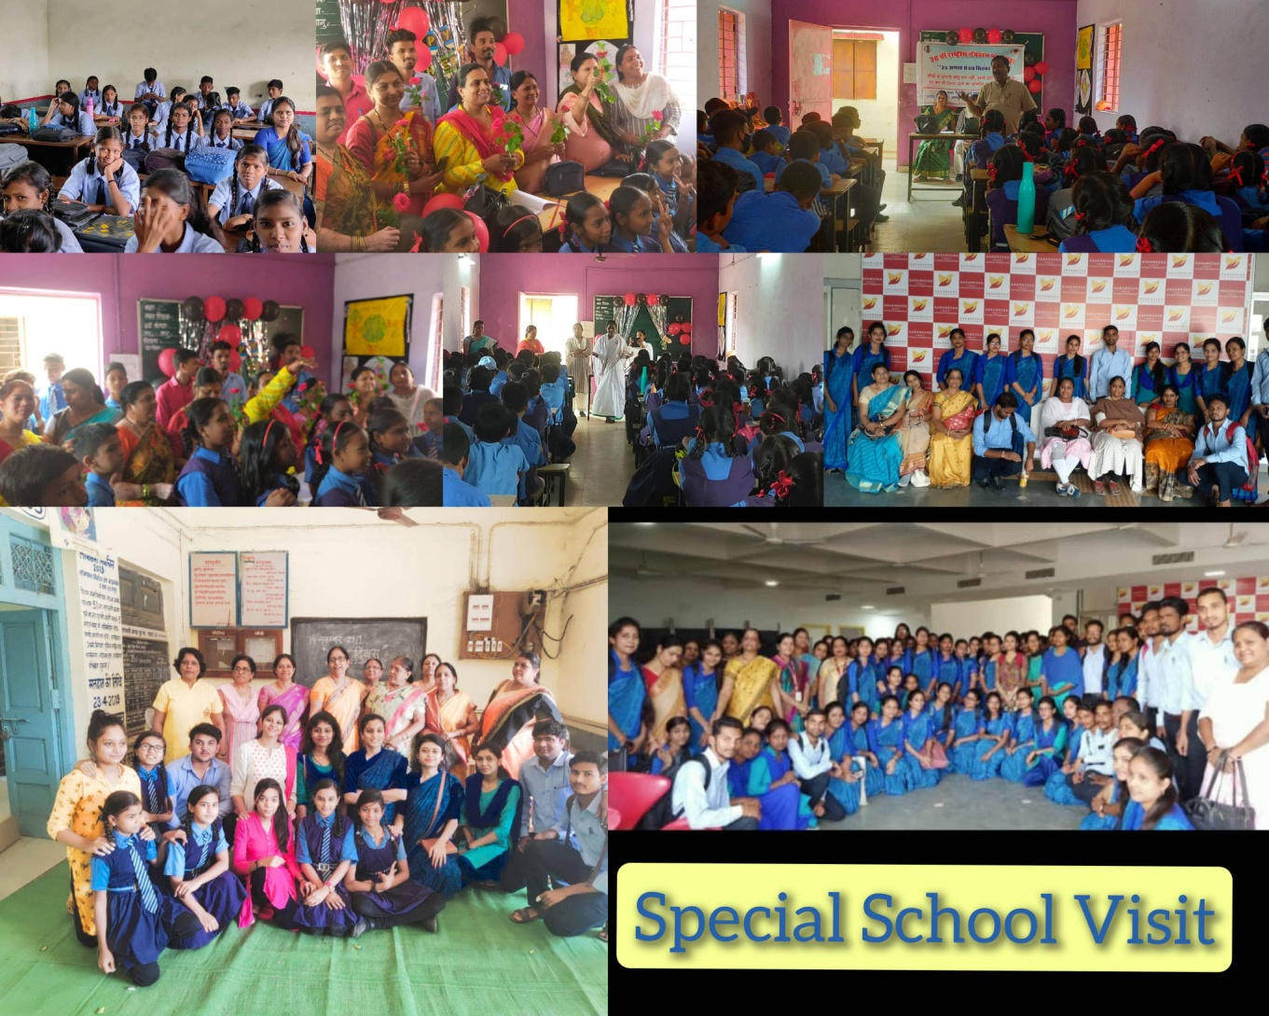

Slide 47
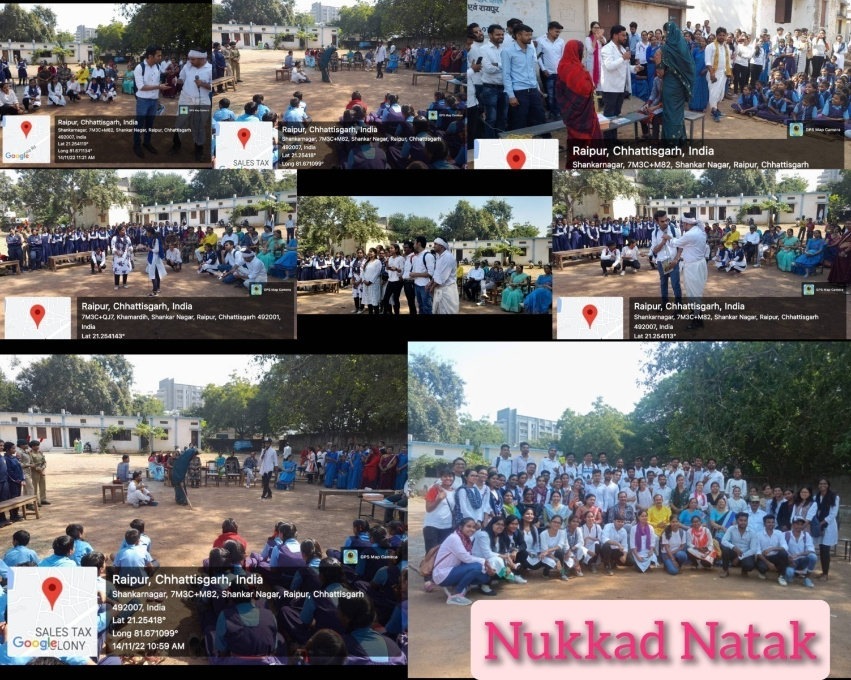

Slide 48
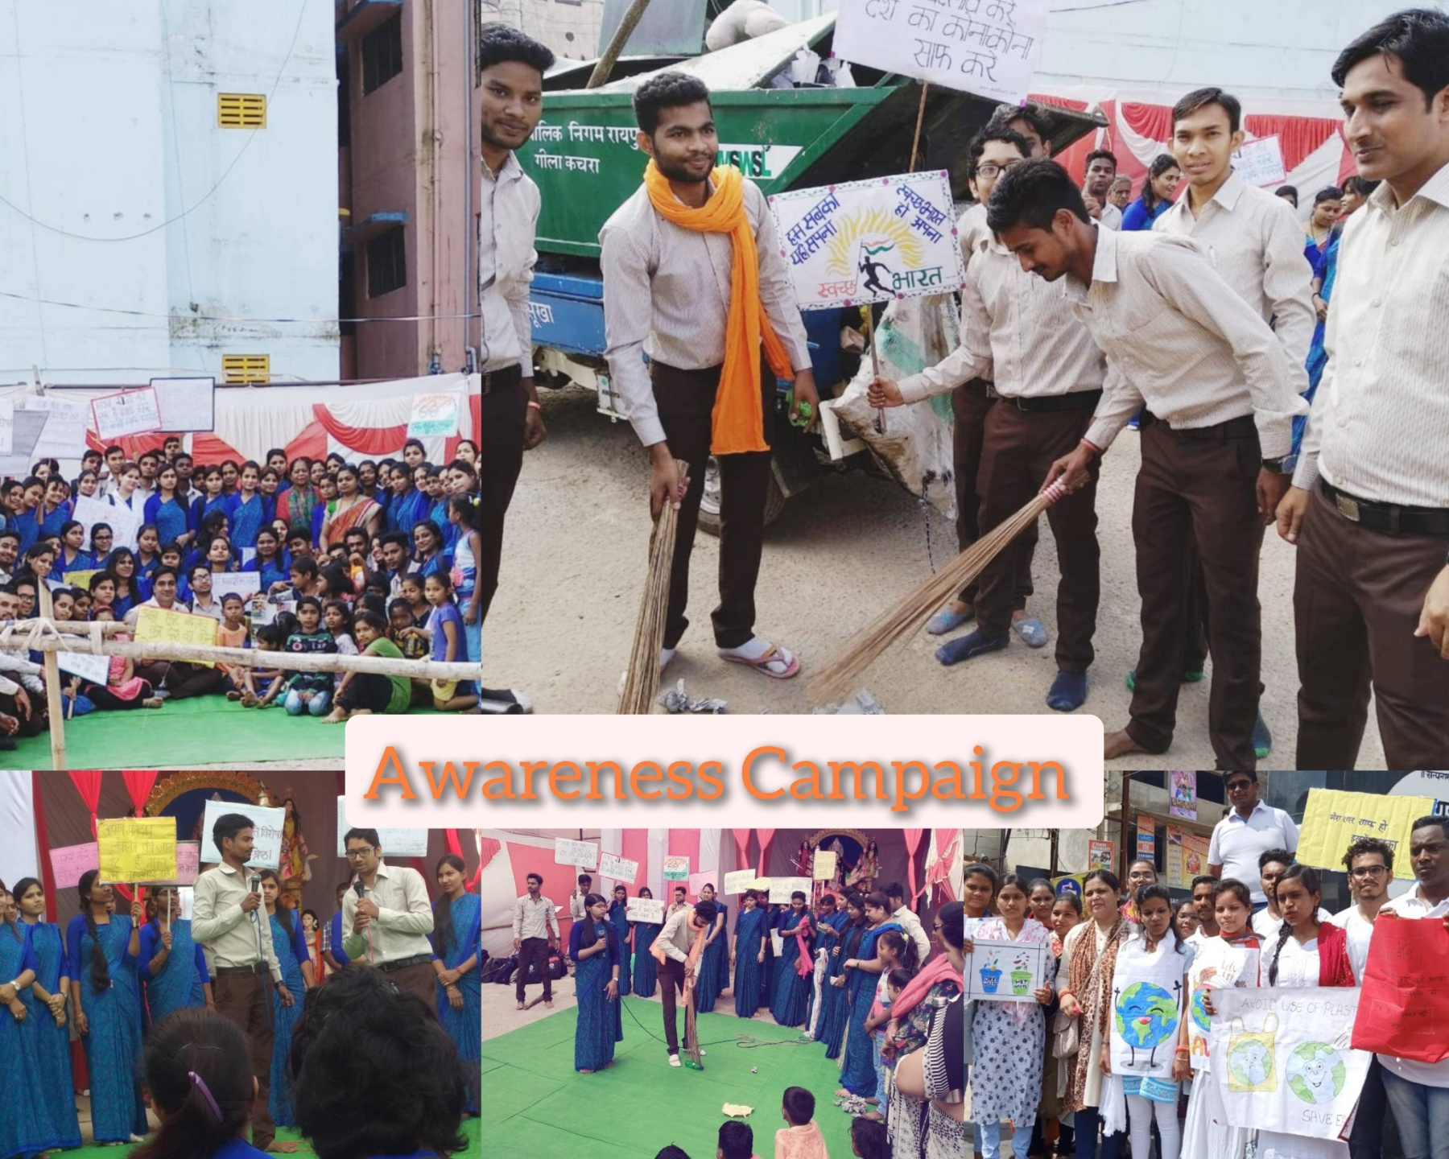

Slide 49
BEST PRACTICES
Add-on Course.
Skill Development.
Value add-on course.
Remedial classes.
Cottage Industry (Poultry, Nursery, MSME like Gadh Kalewa)

Slide 50
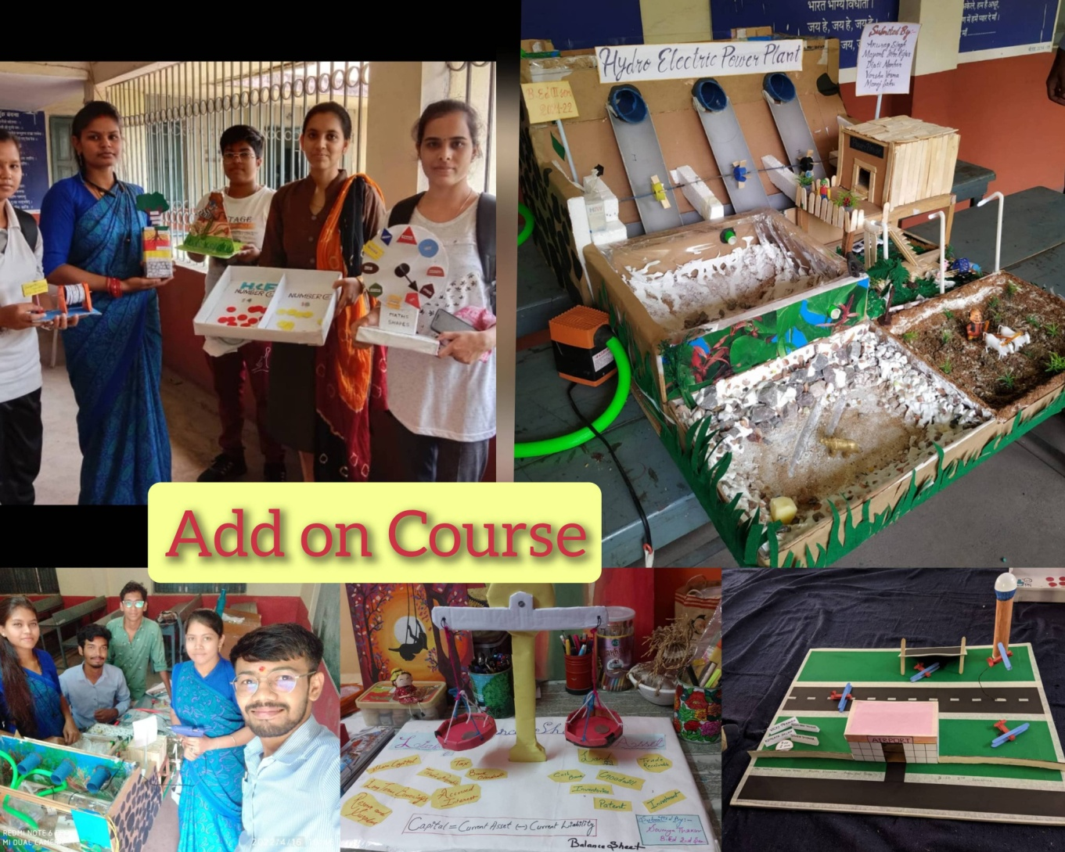
MODELS
Teaching Aid

Slide 51
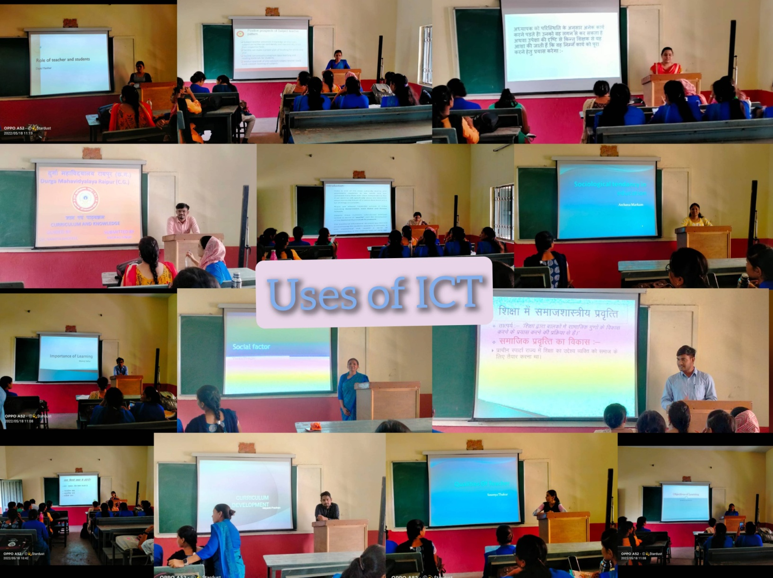

Slide 52
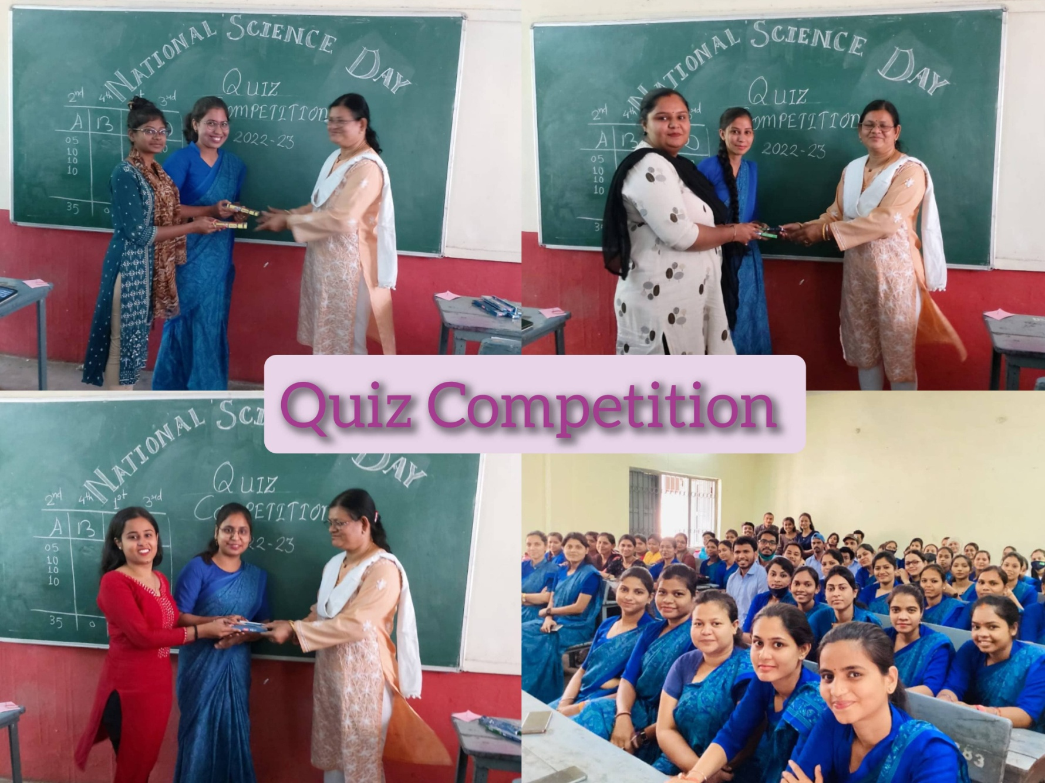

Slide 53
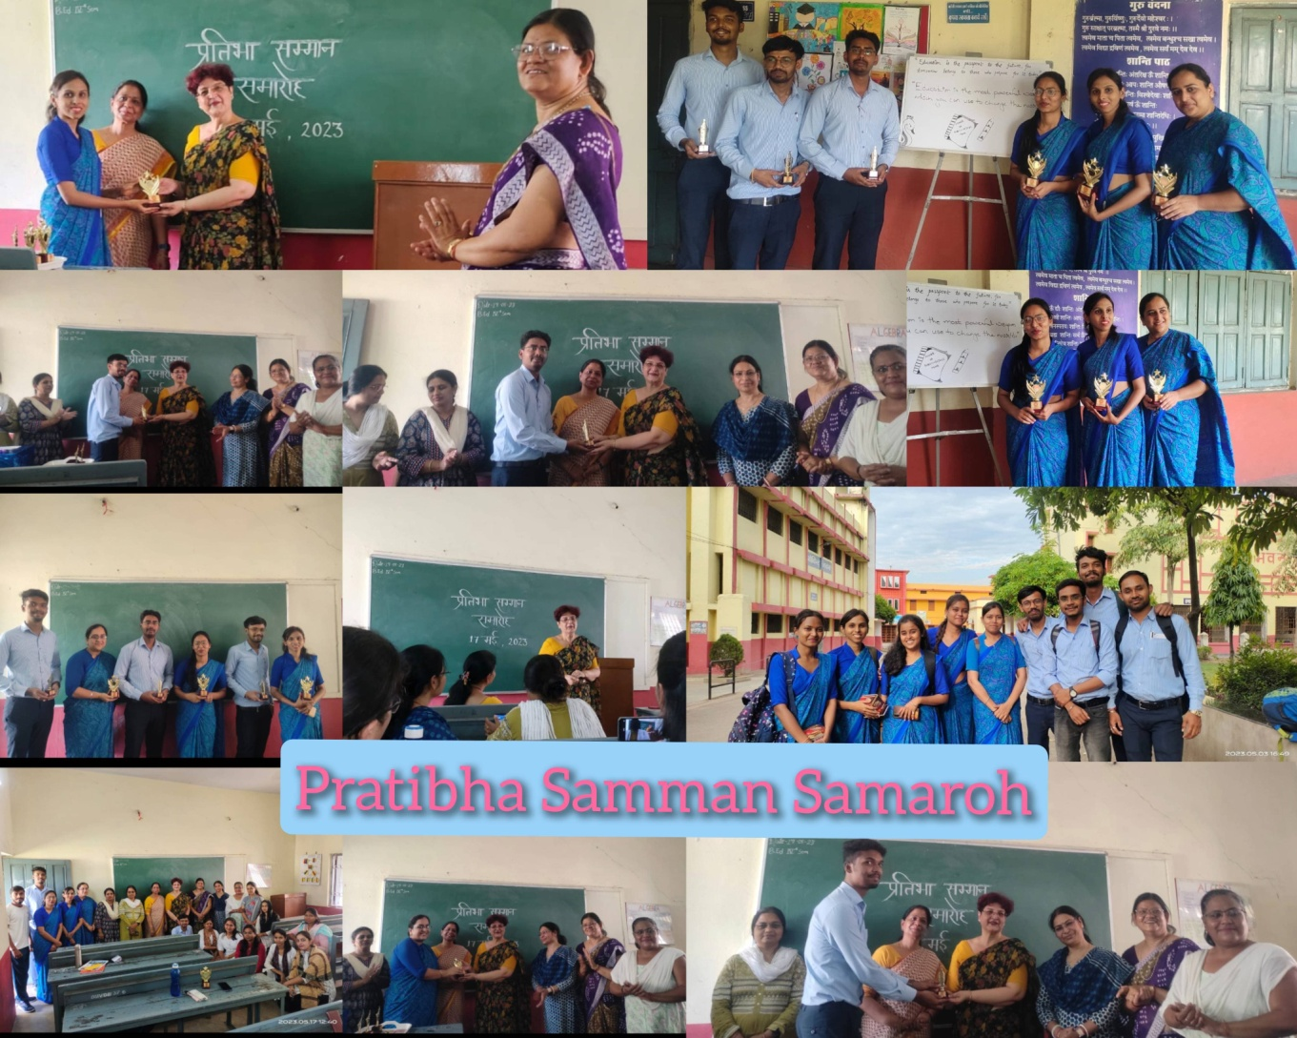

Slide 54


Slide 55
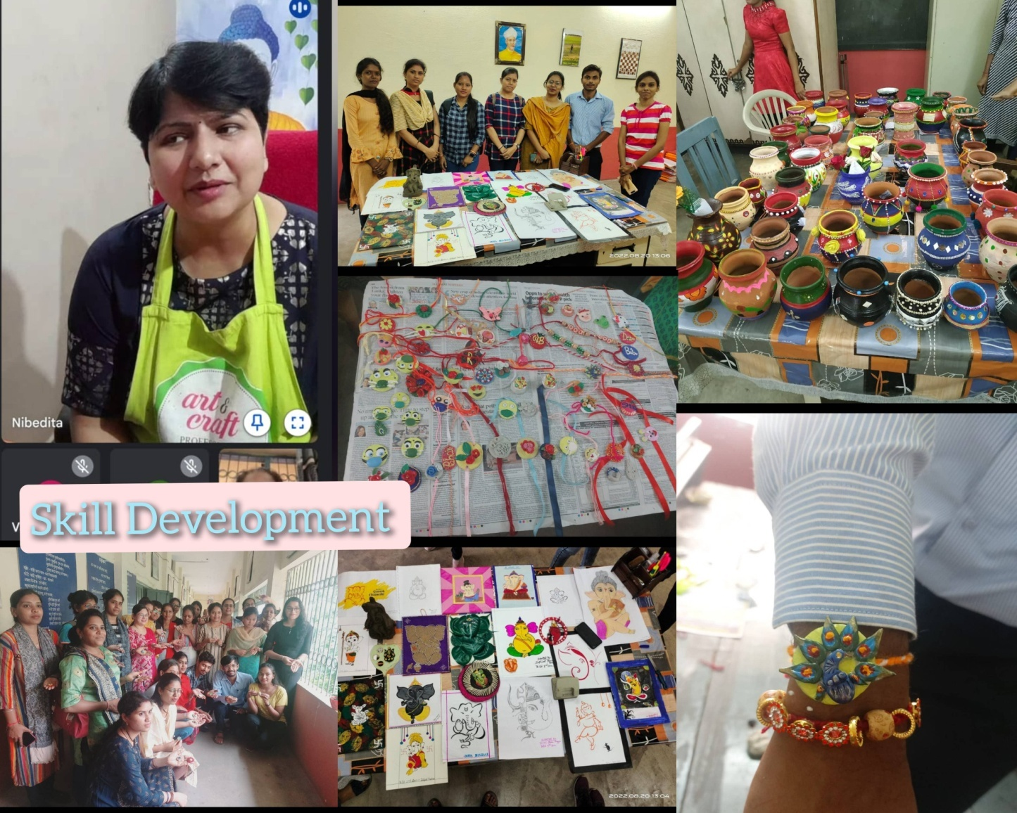

Slide 56



Slide 57

PARENTS MEETING & SEMINAR

Slide 58

FIELD VISITS

Slide 59


EXTRA CURRICULAR ACTIVITIES
Educational Tours

Slide 60




ADD-ON COURSE

Slide 61




COMMUNITY OUTREACH

Slide 62



TEACHER’S DAY CELEBRATION

Slide 63



WOMEN’S DAY CELEBRATION

Slide 64


GUEST SPEAKERS
AAKANKSHA SCHOOL – MS. SHEELA PILLE

Slide 65

Health Department
Awareness Program Tobacco Free Youth.

Slide 66


Slide 67



ADD-ON COURSE

Slide 68


SCHOOL INTERNSHIP,
SCHOOL OBSERVATION AND TEACHING

Slide 69





Slide 70




Slide 71
FORWARD LOOKING PLANS
To start following courses:
M.A. Education
D.Ed
M.Ed

Slide 72


