Slide 1
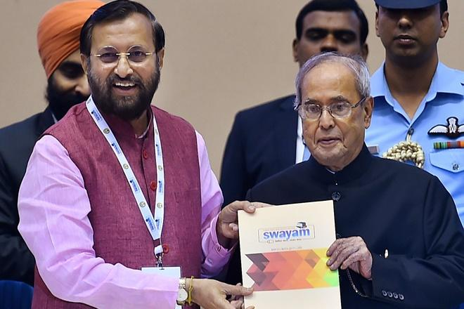
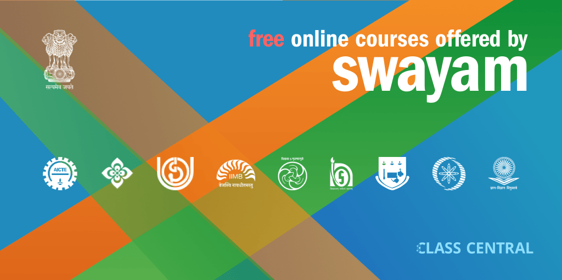
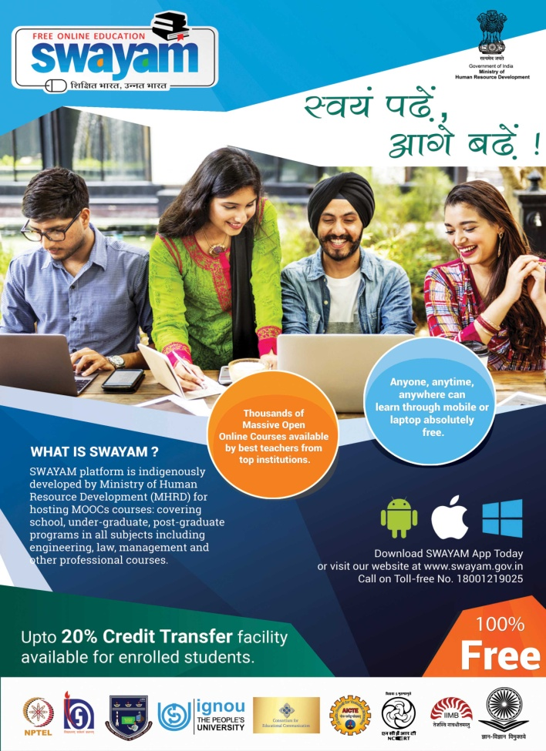


AN INTRODUCTION TO SWAYAM
&
MOOCs INITIATIVE
SANJIB PRAMANIK
Department of Geography
Durga College, Raipur (C.G.)

Slide 2
What is ‘SWAYAM’?
S
STUDY
W
WEBS OF
A
ACTIVE – LEARNING FOR
Y
A
M
YOUNG
ASPIRING
MINDS

Slide 3

IGNOU
IGNOU was founded to serve the Indian population by means of distance and open education, providing quality higher education opportunities to all segments of society from 1985. Presently it has 67 regional centres.

Slide 4
Three Verticals of SWAYAM
SWAYAM
Student
-Scheduled Courses
-Self Pace Courses
2. Teacher as Learner
(ARPIT Courses)
Teacher as Course Coordinator

Slide 5
NATIONAL COORDINATORS OF SWAYAM
(All India Council for Technical Education)
NITTTR
(National Institute of Technical Teachers Training and Research)
NPTEL
UGC
CEC
NCERT
NIOS
IGNOU
IIMB
AICTE
(National Programme on Technology Enhanced Learning)
(Consortium for Educational Communication)
(National Council of Educational Research and Training)
(National Institute of Open Schooling)
(Indira Gandhi National Open University)
(Indian Institute of Management, Bangalore)
(University Grants Commission)
for self-paced and international courses
for Engineering
for non technical post-graduation education
for under-graduate education
for school education
for school education
for out-of-school students
for management studies
for Teacher Training programme

Slide 6
SWAYAM 4 Quadrants Approach
Quadrant-I
E-Tutorial
Quadrant-II
E-Content
Quadrant-III
Assessment & Quiz
Quadrant-IV
Discussion Forum

Slide 7
What is offered in SWAYAM?
1. Courses that are taught in classrooms from 9th class till post-graduation.
2. Categories of courses include - Engineering, Science, Humanities, Management, Language, Mathematics, Arts and Recreation, Commerce, General, Library, Education.
3. At the end of each course, there will be an assessment of the student through proctored examination and the marks/grades secured in this exam could be transferred to the academic record of the students. UGC has already issued the UGC (Credit Framework for Online Learning Courses through SWAYAM) Regulation, 2016 advising the Universities to identify courses where credits can be transferred on to the academic record of the students for courses done on SWAYAM.

Slide 8
SWAYAM Registration – Eligibility
There is not any eligibility criterion specified for any learner under this portal.
As the main aim of this SWAYAM is to develop skill, knowledge, and education of every citizen of India there is no provision for eligibility criteria.
Any individual of any age, qualification, any caste/creed, any location can avail any course delivered through the SWAYAM portal.
However, in order to get certificate, learners have to check the eligibility requirement of the respective course in the portal.

Slide 9
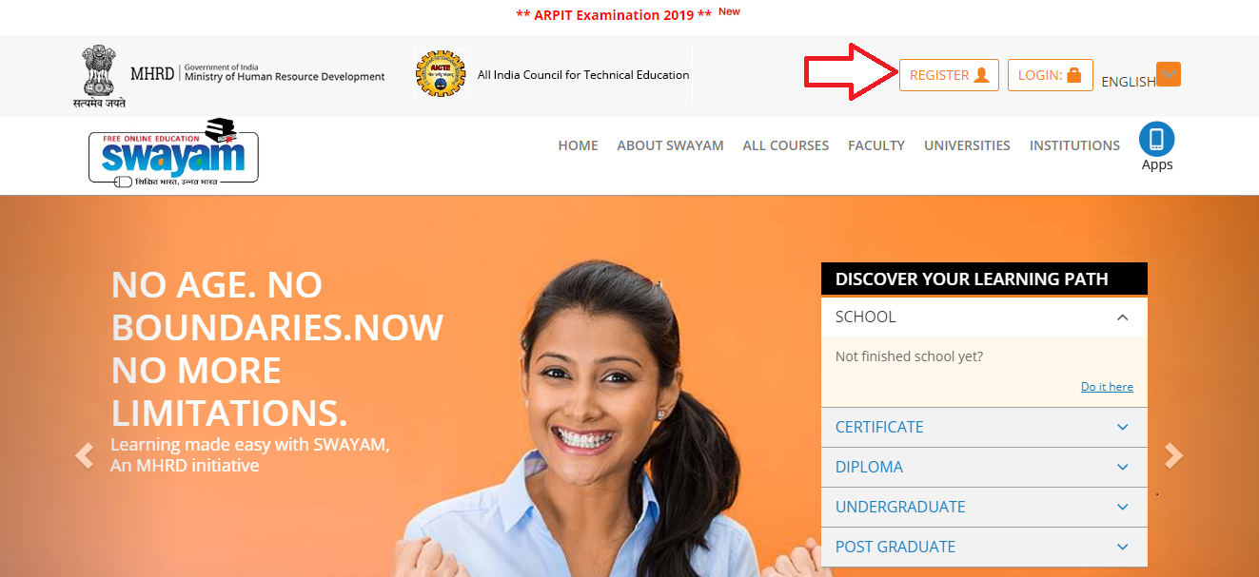
How to do SWAYAM Registration?
For becoming a SWAYAM learner, one has to register first. They can follow the given instructions-
Step-1
Visit SWAYAM portal i.e. www.swayam.gov.in
Step-2
They need to click “Register” button provided on the top of the homepage.

Slide 10
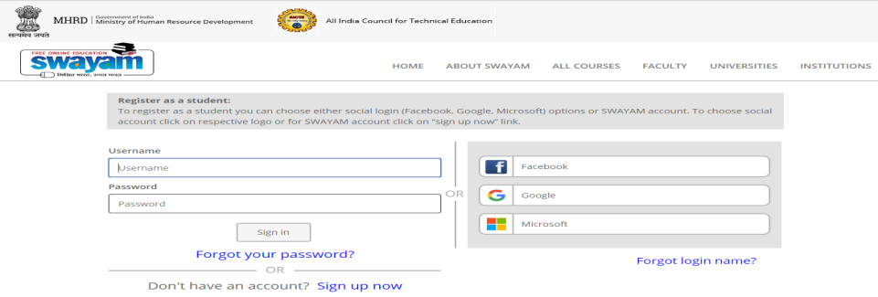
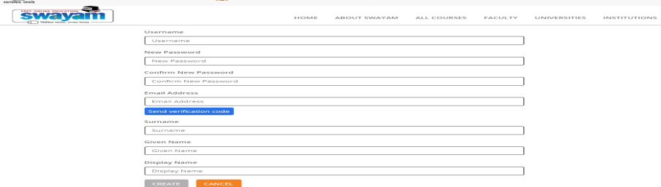
Step-3
Now learners have to login. They can login with their social media login (facebook, Google or Microsoft) of they can log in by clicking the “sign up now” option.
Step-4
On clicking the sign up now link, the given page will appear. Learners now have to provide all the details to create the account.

Slide 11
Step-5
A verification code will be send to the email ID and they have to click on “Create” button after the entering the names in the required fields.
Step-6
Learner’ account on SWAYAM will be created finally.

Slide 12
SWAYAM FEES
No fee is charged for any learner.
The courses provided under this portal are free of cost.
However, learners who want certification after the completion of the course are required to pay a specified amount of fee (which is usually low).
Such candidates must be registered with the portal.
Certificated will be allotted to only those candidates who are registered and have paid the course fee.

Slide 13
SWAYAM Test- Evaluation and certification
Once the registered candidates have completed the course, they have to appear in the examination.
Evaluation is the responsibility of the host Institute and Principal Invigilator (PI).
Evaluation is done on the basis of performance of the learners in the examinations, assignments, practical, and credit earned during the course.
After conduct of the examination and completion of the evaluation process, Grade/ Marks are awarded to the learners as per the evaluation scheme.
The final marks/grade are communicated to the learners/students within 4 weeks from the date of completion of the final examination.
After the process of evaluation process and declaration of result, certificates are issued to the successful learners.
Certificate is issued by the Principal Invigilator (PI) and is sent to the parent institute.

Slide 14
How to check the SWAYAM Test result?
The result is declared after the conduct of the examination. It is also made available on the SWAYAM portal.
Learners just have to visit the portal and have to click on the result link provided on the homepage.
Now they have to enter the “Participant ID” generated at the time of registration and have to click on “View Result”.
The scorecard will appear on the screen.
They can also download it.

Slide 15
Journey of the Platform…..
SWAYAM (MOOCs), e PGP
& SWAYAM PRABHA (DTH Channels)
Content delivery & MOOCs initiated
Guidelines developed
PIs identified
Project awarded
Content Creation in four quadrants
Born
(2011)
Bigger
2016-Mid
2017
Growth
2012
Stronger
2013-15

Slide 16



UGC (Credit Framework for Online Learning Courses through SWAYAM) Regulation, 2016
Learning
Courses
Issued on 19th July 2016
Notification
Online learning courses to be available on SWAYAM
SWAYAM to notify courses on June 1 & Nov 1, every year
Choice of Courses
Credit Transfer
Courses on SWAYAM permitted for credit transfer
Up to 20% courses in a Program can be on SWAYAM

Slide 17
What are MOOCs?
Massive Open Online Courses (MOOCs) are the online courses which are developed as per the specified teaching pedagogy i.e. four-quadrant approach and are made available on the SWAYAM platform.

Slide 18
MOOCs - A different educational space
Boundary less Institute / University
Massive- Large enrolment numbers
Open - No mandatory qualifications – Open to all
Online - Fully online
Course - Structured course content
is an online course aimed at unlimited participation and open access via the web.
The basic philosophy of MOOCs are 3A’s i.e., Anytime, Anyone, Anywhere.

Slide 19
e-Content vs MOOCs
E-Content
MOOCs
E-PG Pathshala provides e-content in four quadrants. It can be accessed as Open Educational Resource (OER) where no teacher support/hand-holding for students is available.
MOOCs has teacher-student groups where MOOC coordinator/teacher interacts with the learner. A learner can earn certificate/credit on successful completion of MOOCs course on SWAYAM.

Slide 20
ARPIT
The Ministry of Human Resource Development has officially launched online Annual Refresher Programme in Teaching (ARPIT) on 13th November, 2018, a major and unique initiative of online professional development of 15 lakhs higher education faculty using the MOOCs platform SWAYAM.
For implementing ARPIT, 75 discipline-specific National Resource Centres (NRCs) have been identified in the first phase.
UGC has notified equivalence of ARPIT as a refresher course for career advancement of faculty (DO Letter No. F.2-16/2002 (PS) pt. Fl.ll dated 3rd December, 2018).

Slide 21
Some Important Software & URL [Uniform Resource Locator (http.)] links for Development of e-content on MOOCs SWAYAM
Software
Screencastify Video recorder
For screen video recorder
prezi.com
powtoon.com
audacity.com
vsdc.com
ilovepdf.com
presentationtube.com
AZ Video recorder
Loom
for mobile user only
for attractive ppt creation
for making a video sound animation
for video recorder only
video editing software
for convert of pdf to differentformat
Screen capturing software
Video recorder with PPT

Slide 22
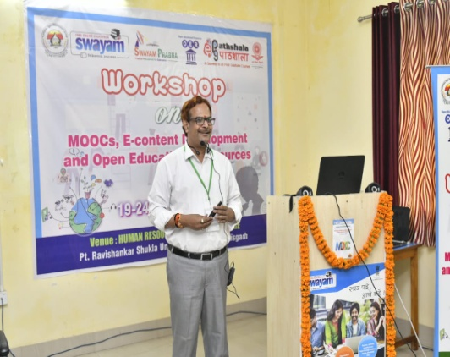
Contd......
URL [Uniform Resource Locator (http.)] links...
UGCmoocs.inflibnet.ac.in
For online courses in SWAYAM
Learnoer.col.org
For short online course for understanding of OER
www.mentimeter.com
moodle.org
moodle cloud.com
kahoot.it
kahoot.com
plickers.com
socrates.com
nroer.gov.in
14.139.60.151/lms/
For conduct an online quiz
For create to quiz
For doing online assignment
For doing online assignment
For e-content development in school education
E-learning portal of Prof. K. Srinivas
Create interactive presentation, workshops and meetings
For online assignment & discussion forum
For online assignment & discussion forum
Prof. K. Srinivas, Head ICT & PMU, NIEPA, New Delhi.

Slide 23
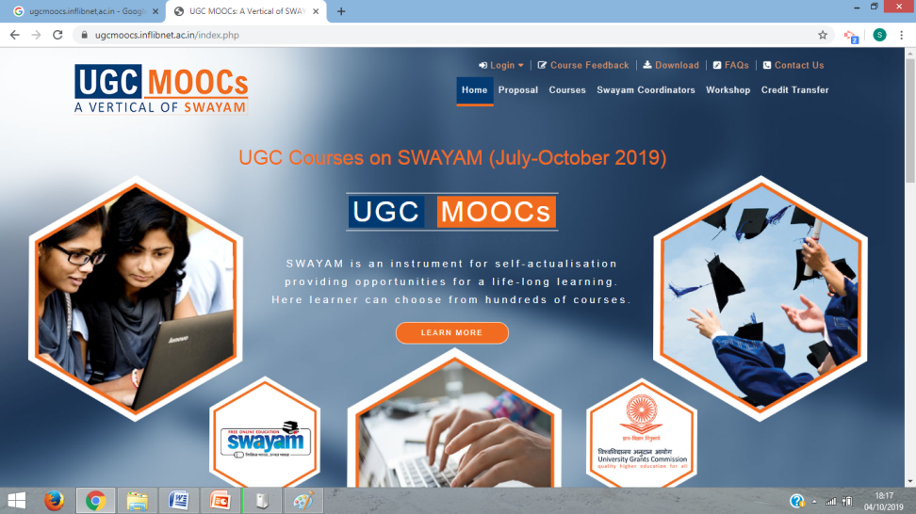
How to Apply the Online Courses in SWAYAM as a Course Coordinator?
For applying online course in SWAYAM go through the bellow mention URL link:
https://ugcmoocs.inflibnet.ac.in

Slide 24
Who can give the Proposal for Developing Non-Technology PG MOOCs for SWAYAM?
An academician/faculty having 5 years of PG Teaching Experiences in concerned field, can be the Course Coordinator.
The Faculty employed in University/College would be required to submit a consent letter of the host University/Institute to develop MOOCs Courses.
The Faculty employed in the institutions who are eligible to receive funding from UGC that i.e included under section 2 (f) and 12B of UGC Act 1956 and eligible to receive central assistance are eligible for applying of MOOCs.
As the courses, carry credits/ certification, they shall be cleared by the 'Host University/Institute', who are authorised to award degrees as per section 22 of the UGC Act, 1956 and also agree to conduct End Examination, assessment and grant credits/ certification.
One Course Coordinator can offer only one course at a time.

Slide 25
Development of 4 Weeks Online MOOCs Course by the Following
Five Steps......
Step-1
DESIGNING A FOUR WEEK’S COURSE
Tasks for Preparing Four [ 4 ] Weeks Online Course
1. | Design a Four Weeks ( 04) Online Course with Course Name , Course Team, Course Objectives ,Course Outcomes ,Assessments Discussion Forums and Any other information
2. | Prepare a Half a Page Right up [ Course outline ] with the above information
3. | Course Introductory Video Preparation | Prepare a PowerPoint Presentation [PPT ] with the following inputs Course Name Course Team Course Objectives Course Outcomes Assessments Discussion Forums Any other information Take Few CC Images from www.pixabay.com & www.flickr.com
4. | Prepare a “SCRIPT” for Recording the Course Intro Video & Week’s Module Intro Video
5. | Prepare 5 MCQ Questions [ Per Week ] ---- Knowledge, Application , Critical Thinking
6. | Prepare a Discussion Forum – 2 Questions [ Per Week ]

Slide 26
Step-2
DEVELOPING the COURSE CONTENTS
Tasks for Week – Wise Module Preparation
“Develop” the Course Contents
Tasks | Resource Details
1. | Searching CC Content - Youtube or Vimeo
2. | Week’s Introductory Video [Use : Presentation tube Software – Video Recording Software [OR] shooting a Video from a STUDIO}
3. | Preparing a suitable “SCRIPT” for Recording the Into Video
4. | Searching suitable “etext” from Creative Commons Licenses
5. | Use Suitable Videos from “ SWAYAMPRABAH” – 2 Nos.
6. | Use Suitable “eresources” from “ National Digital Library “ – 2 Nos.
7. | Use Suitable Creative Commons Licenses “ Images “ -- www.pixabay.com – 2 or more
8. | Use suitable Creative Commons Licenses “ Images “ -- www.Flickr.com – 2 or more
9. | To Create – Two or Three “ Screencasting” Tutorials for the Students
10. | Week’s EXIT Video [Use : Presentation tube Software – Video Recording Software [OR] shooting a Video from a STUDIO}

Slide 27
Step-3
DELIVERING A COURSE
“Delivering ” the Course Contents
Sl. No. | Tasks
1 | Upload “Course Introductory Video” and “Course overview /outline ”
2 | Understand the Three Enrolment Methods Guest Self Enrolment Manual Enrolment
3 | Understand how to Create a Single User ||||| Assign “Student Role” and
 | assign in a Course
4 | Understand how to Create and Upload “ Multiple Users”
5 | Upload “ News & Announcements ” in a Course
6 | Upload the Week’s Content
7 | Upload the “ Resources ” --- Vidoes & etext and Other Supplimentary
 | Material
8 | Upload Assessments - Multiple Choice Questions [ MCQ ]
9 | Upload Assessments - Online Assignments
10 | Upload the “ Discussion Forum” Activity
11 | Upload the “ Feedback” Activity
Step-4
TRANSACTING IN A COURSE
Step-5
MOTIVATING & ENGAGING OF THE LEARNER

Slide 28
Outcome of the Project
Addresses the problem of Access, Equity and Quality by addressing faculty shortage and lack of good quality faculty.
The project would help the students and teachers to update their knowledge and skills, especially for those located in rural/backward/remote areas.
The project would successfully bridge the digital divide and would help the nation move towards information-rich society.

Slide 29

Check the download link shared below and get SWAYAM app-
For Android Users- https://play.google.com/store/apps/details?id=in.gov.swayam.app
For IOS- https://itunes.apple.com/in/app/swayam-online-education/id1146833429?mt=8
For Microsoft- https://www.microsoft.com/en-in/p/swayam/9nblggh4xxml

