Slide 1

Durga Mahavidyalaya
Education Department
Welcome Everyone
Subject : Philosophical Perspective of Education
Topic : Basic Education of Mahatma Gandhi
Created By:
Kusum Rathore

Slide 2
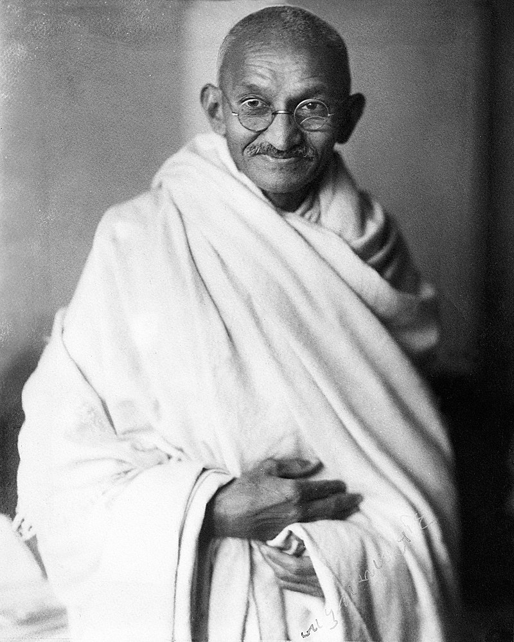
Introduction
Education is the process of acquisition of knowledge, skills, beliefs and moral habits.
Mahatma Gandhi proposed his scheme of Basic Education (Nai Talim) in a well formulated approach to education in 1937 in his news paper ‘Harijan’.
Gandhiji believed on action and hence his concepts of basic education can be classified as activity method or practical method.
Other names of Basic Education are:
  - Nai Talim
  - Wardha Scheme
  - Buniyadi Siksha
  - Craft Based Education

Slide 3
Principle of Basic Education
Free and compulsory education.
Mother tongue as medium of instruction.
Craft centred education.
Importance on moral education.
Emphasis on character building.
Development of self reliance.
Patriotism.

Slide 4
Curriculum of Basic Education
Basic Craft
Moral Education
Mother Tongue
Music and Drawing
Practical Mathematics
Social Studies
General Science

Slide 5
Teaching Method of Basic Education
Learning through Crafts.
Learning by self – experience.
Correlation method.
Mother tongue as medium of instruction.
Learning by doing.
Reading before writing.

Slide 6
Conclusion
Basic education is a valuable approach to education that has the potential to make a real difference in the lives of children.
It is an education that is based on the principles of self-reliance, character development, and vocational training.
It is a child-centered, activity-based approach to education that emphasizes the development of the whole child.
Basic education is a relevant and meaningful approach to education that can help children to become lifelong learners.

