Slide 1

Difference between combo box and list box in vb 6.0
Ravindra Singh
Asst.Prof.
Computer Department
Durga College
ComboBox
Combo boxes are so-named because they "combine" the features found in both text boxes and list boxes.
Combo boxes are also commonly referred to as "drop-down boxes" or "drop-down lists". There are three combo box styles:
0 – Drop Down Combo
1 – Simple Combo
2 – Drop Down List
At design-time, you set the style of the combo box with its Style property.

Slide 2
Of the three combo box styles, the one most similar to a ListBox is "2 - Drop-Down List". In fact, everything discussed in the last several pages regarding ListBoxes applies to drop-down style combo boxes EXCEPT the following:
· The combo box displays the selected item in the text box portion of the combo box.
The ListBox portion of the combo box remains hidden until the combo box receives focus and the user clicks the down arrow on the text box.
· You can change the width of a drop-down combo box, but not its height.
· Like a ListBox, and unlike the other combo box styles, the user can only select a value that is in the list – they cannot type in a new value. However, if the user does press a keyboard key, the closest item in the list alphabetically will be selected (i.e., if the user types the letter "B", and the word "Banana" is in the list, then "Banana" will be selected).
·

Slide 3
Multiple selections cannot be made. Only one item may be selected from the list.
· Unlike a ListBox, VB does not automatically pre-select the first value from a combo box. Therefore, the initial value of the ListIndex property is –1. If you do not pre-select a value in code (say in the Form_Load procedure), then be sure to check the ListIndex property for a value of –1 when you check to see which item the user selected.
The "0 – Drop Down Combo" style of combo box operates the same way as the Drop Down List, except that the user may type a new value in the text box portion of the combo box. Please note that if the user types a non-list value, this value is NOT automatically added to the list, and the value of ListIndex would be –1. You should check the Text property to access the user's selection or entry.
The "1 – Simple Combo" style of combo box operates in a manner similar to the Drop Down Combo in that the user can either select an item from the list or type a new entry. The difference is that the list does not drop down – like a ListBox, you determine the height of the list portion at design-time. This is the only combo-box style that allows you to adjust the height of the list portion.

Slide 4
ListBox
ListBox provide two property arrays into which you can place data: List and Item Data. Whenever you reference these properties of the List Box control, you must do so with an index reference, i.e.:
List1.List(X) or List1.ItemData(X)
The List array is a zero-based array of STRING items and is what the user sees in the ListBox. The ItemData array is an array of LONG INTEGER items in which you can OPTIONALLY place a numeric data item associated with the corresponding string item. If ItemData is used, each element is always associated with the corresponding element of the List array; it is not an independent array.
You cannot tell VB ahead of time how many items will be placed in the ListBox. The number of elements in the ListBox is maintained by VB via the ListCount property (a read-only property of ListBoxes), which is dependent on the use of the AddItem method to get items into the ListBox and the RemoveItem method to get items out of the ListBox.

Slide 5
Combo box has an arrow down button or dropped down while list box is you just select on the list.
combo box:
1. We can select ony one option from list.
2. We can add ,edit,select info. at run time.
3. We have only drop down facility.
4. We can't use checkbox within combobox.
5. Occupies less space but shows only one value for visibility

Slide 6
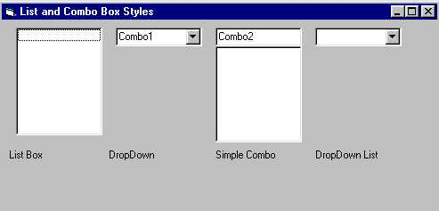
List box:
1. We can select multiple option from list.
2. We can't add,edit info. at run time.
3. We have both drop up & drop down facility.
4. We can use checkbox within listbox.
5. Occupies more space but shows more than one value.

