Slide 1
Diversity in indian society
Presented by – kusum Rathore

Slide 2
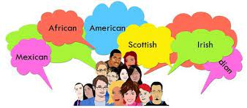
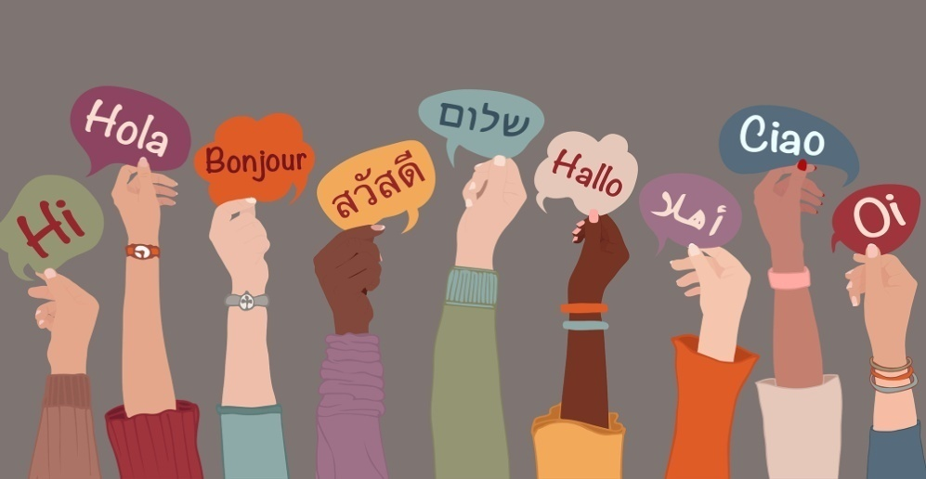
1 . Ethnicity - A term that refers to the social and cultural characteristics, backgrounds, or experiences shared by a group of people.These include language, religion, beliefs, values,etc.

Slide 3
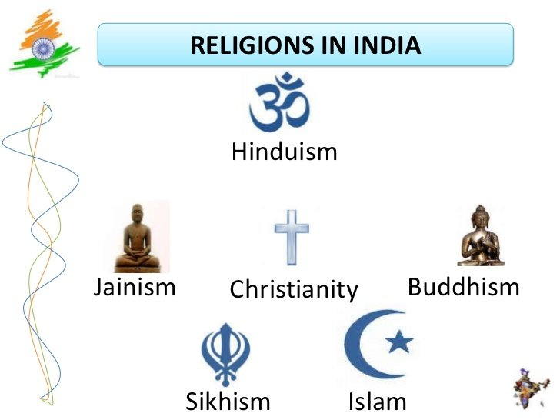
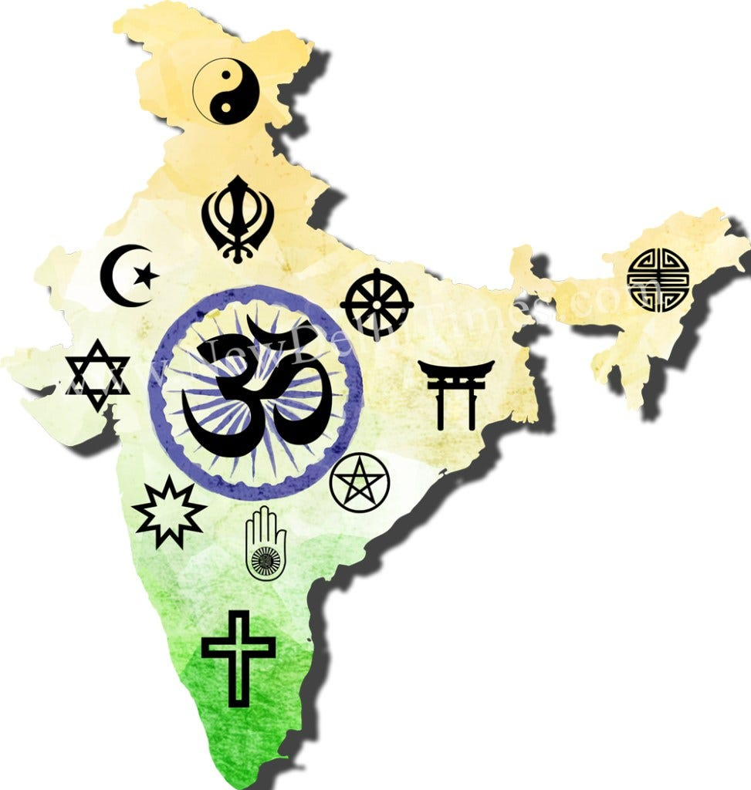
2 . Religious diversity - In terms of religious practice, Hinduism is the most popular in India, followed by Islam, Jainism, Buddhism, Sikhism and Christianity. Among 1,000 Indians, only 23 Christians, 19 Sikhs, 8 Buddhists, and 4 Jains were present in 2001.

Slide 4
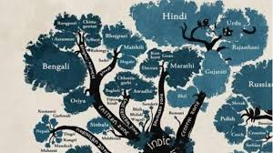
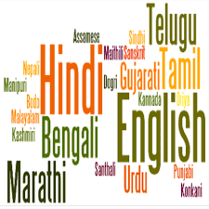
3 . Diversity of language - India is one of the most linguistically diverse countries in the world, with over 1,600 languages and dialects spoken by its citizens. Each language reflects the unique history, traditions and customs of the people who speak it, making India a melting pot of linguistic and cultural diversity.

Slide 5
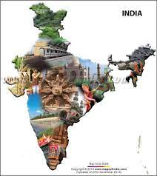
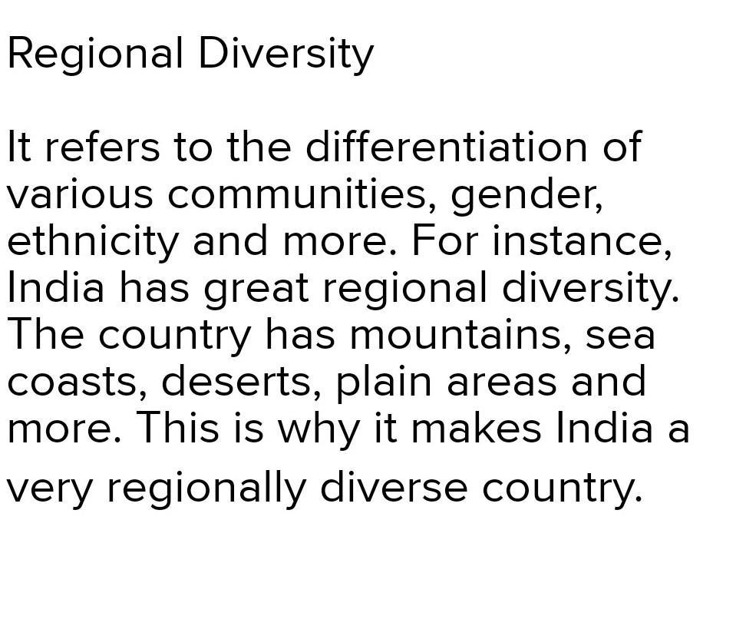
4 . Regional Diversity -

Slide 6
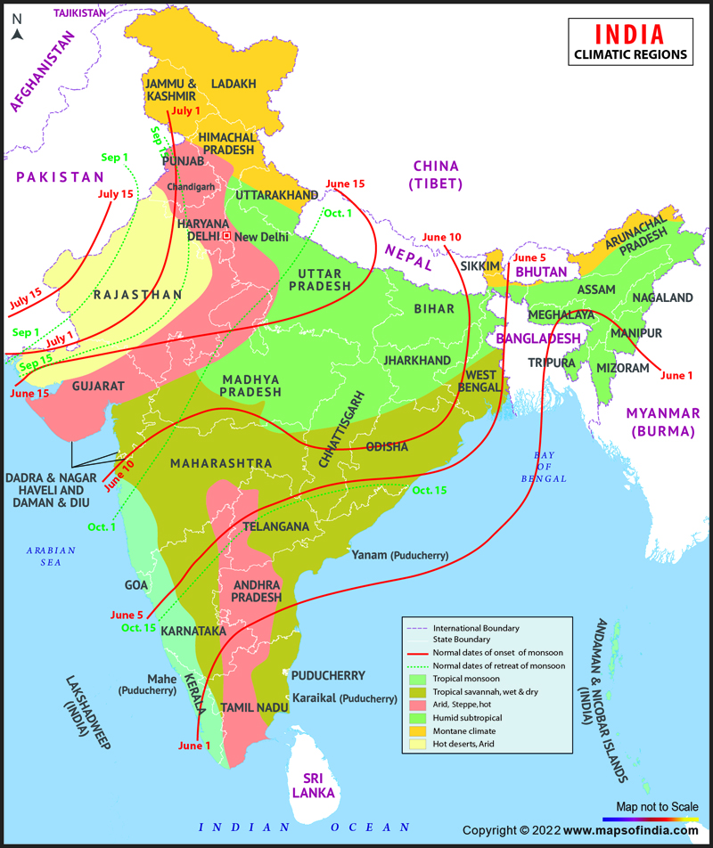
5.India experiences six major climatic types: Tropical Rainforest, Tropical Savanna, Tropical Monsoon, Semi-Arid, Arid, and Alpine. The country is home to diverse ecosystems, including rainforests, grasslands, deserts, and alpine meadows.

Slide 7
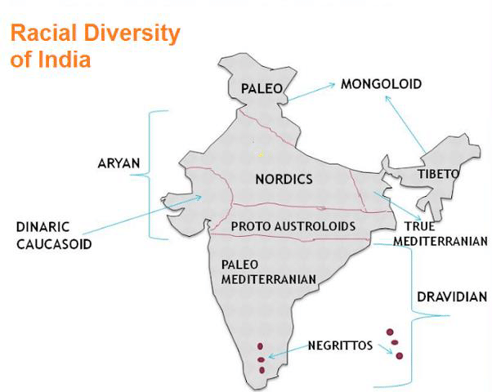
6. Racial Diversities - He identified three principal racial types in India i.e. The Dravidian, the Indo-Aryan and the Mongoloid.

Slide 8
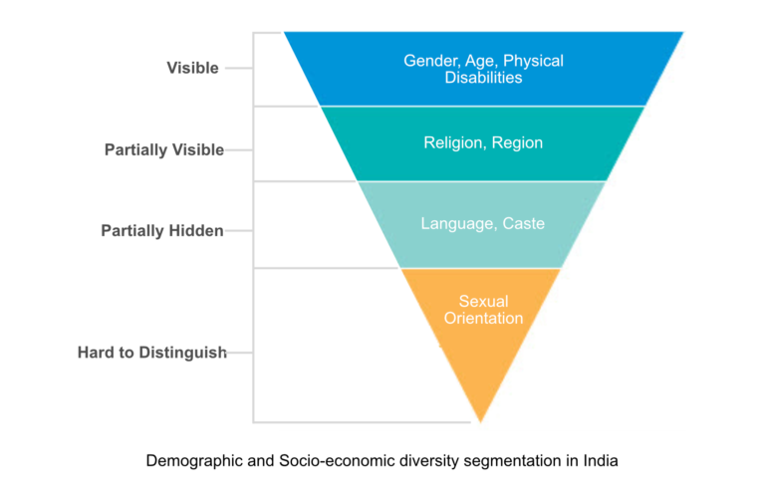
7. Demographic diversities About 80 per cent of the population is Hindu, with the rest following Islam, Christianity, Sikhism, Buddhism, Jainism, Zoroastrianism and other faiths. This has resulted in many distinct cultures and ethnicities, each with differing social traditions.

Slide 9
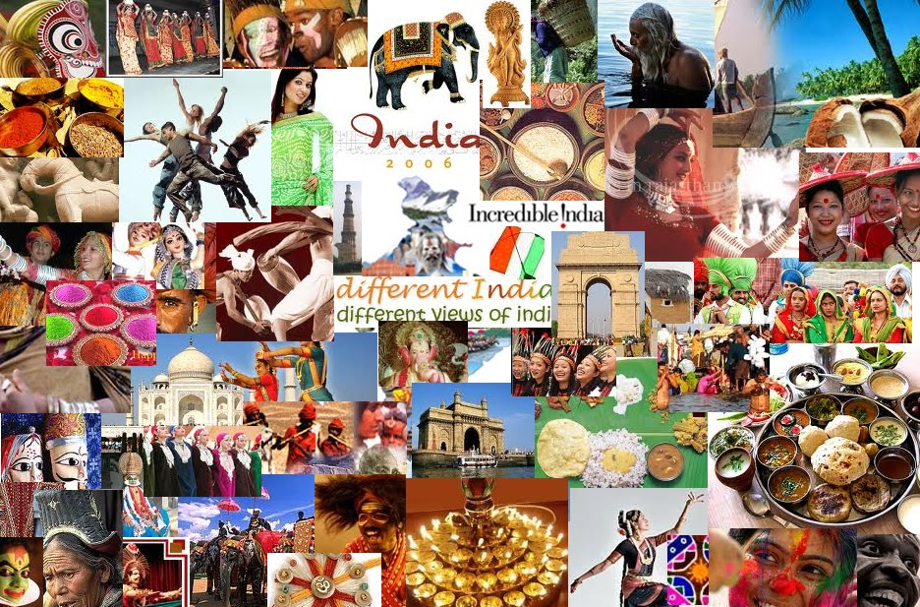
8 . Cultural diversities - Over the centuries, there has been a significant fusion of cultures between Buddhists, Hindus, Muslims, Jains, Sikhs and various tribal populations in India. India is the birthplace of Hinduism, Buddhism, Jainism, Sikhism, and other religions. They are collectively known as Indian religions.

Slide 10
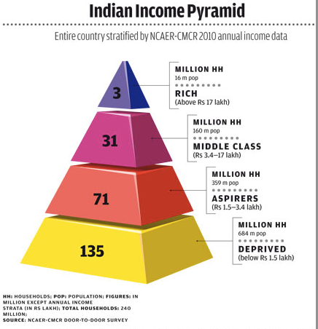
9 . Economic Diversities - India is a country with significant socio-economic diversity, with vast disparities in income, education, and access to basic amenities such as healthcare and sanitation.

Slide 11
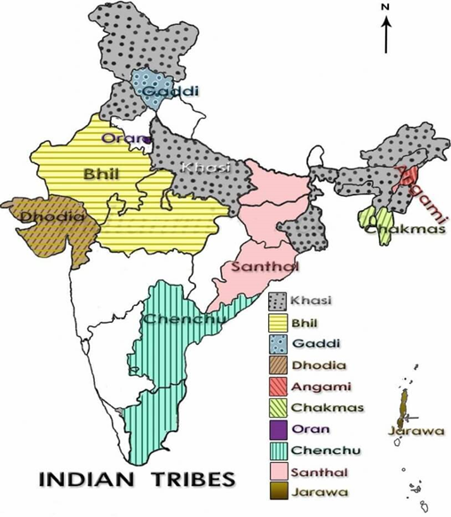
10 . Tribal Diversities - ribal communities in India are a diverse group, with significant differences in terms of language, culture, and traditions. They range from patriarchal to matriarchal, monogamous to polygamous, nature worshippers to polytheists, etc.

Slide 12
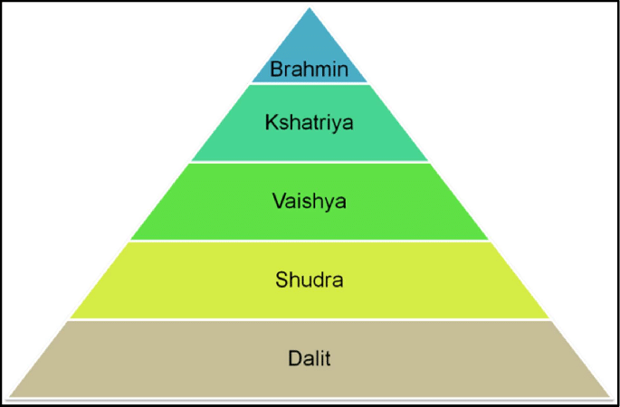
11 . Caste diversities - There are 3,000 castes and 25,000 sub-castes in India, each related to a specific occupation. Caste-based differences have also been practised in other regions and religions in the Indian subcontinent, like Nepalese Buddhism, Christianity, Islam, Judaism and Sikhism.

Slide 13


