Slide 1

DURGA MAHAVIDYALA,
MODHAPARA, RAIPUR, (C.G.)
2022-23
Paper-9 : Nai Talim: Skill Based Learning
Topic: Education in Non Violent School
Presented by –
Kusum Rathore

Slide 2
CONTENT
Introduction
Meaning of non violence
Definition of non-violence
Characteristics of non-violence
Types of violence in school
Causes of violence in school
Effect of violence in school
Education and non violence in school
Conclusion

Slide 3

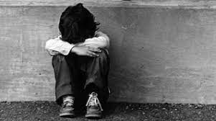
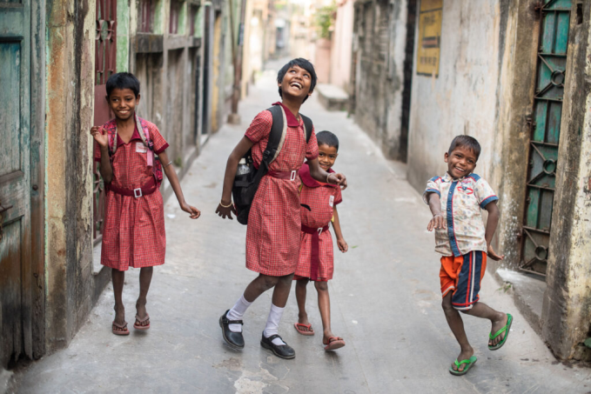
INTRODUCTION
Education is one the basic need to survive. It is essential in all terms of development i.e., physical, mental, social as well as social. In this process, there are many hurdles that we came across and one among them is violence.
Gandhiji said “ I do not consider non-violence to be a personal virtue only. It is also a social virtue that should be developed like other virtues…. It should be expanded to a greater national and international level.”

Slide 4
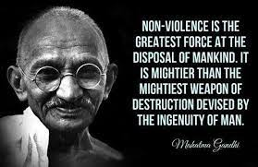

Meaning of non-violence
The term non violence is opposite of violence, which means not to harm the in any way through mind, words and deeds.
Non violence emphasizes on bringing values of humanity, love, truth, justice, equality, tolerance, harmony, humility, solidarity and self restraint.
Gandhiji used to reject the concrete form of non violence, he believed that killing someone is not only but the thought of it, is also violence. Violence is rashness, malice thought, false speech, and wish to harm someone.

Slide 5


Definition of non-violence
Mahatma Gandhiji – “Non-violence is the principle in which its opponents are won by love and not by hatred or conflict. Non-violence is the virtue of heroes and not of cowards.
Dr. Radhakrishnan – “Non-violence is the symbol of real power, not to hurt or harm in any way is non violence.”
Gautama Buddha – “One who does violence to living being, he is not Arya, one who has a sense of non-violence towards all living beings is called Arya.”

Slide 6
Characteristics of non-violence
Negative non-violence
Positive non-violence
Natural attribute
Non-violence is not cowardice
Non-violence is assumed in the negative sense in which there is no harm to anyone.
It means to have love, belonging and affection towards all being in the world
Gandhiji believes that human beings are non violent in nature and become violent due to circumstances
Gandhiji associates nonviolence not cowardice but fearlessness

Slide 7
Inclusion of love
Attainment of truth and god
Spiritual strength
Anger and hatred increase violence while love increases nonviolence.
‘Ahimsa Parma Dharma’ it means bon violence is a supreme virtue or religion.
Gandhiji said that there is a spiritual force in non violence which melts even those of hard hearts

Slide 8
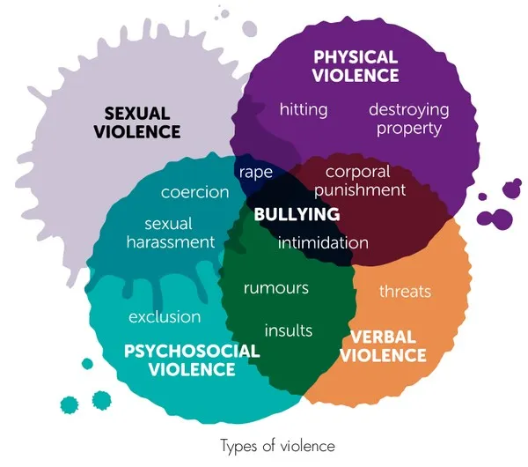
Types of violence in general

Slide 9
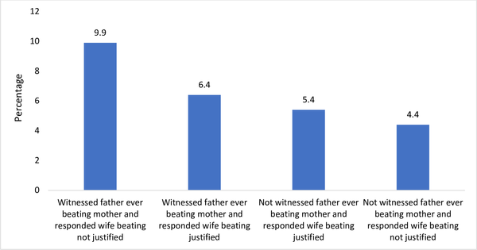
Effect of parents behavior on violence committed by students

Slide 10

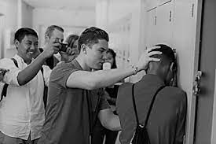
Types of violence committed in school
(2-types)
Violence committed by the teachers
Violence committed by students

Slide 11
Types of violence committed in school : (A) Violence committed by teachers
PHYSICAL VIOLENCE
EMOTIONAL VIOLENCE
ECONOMIC VIOLENCE
Beating children
Standing on knee
Tying
Sit-ups punishment
Sexual abuse
Class humiliation
Discrimination
Faull comments
Abusing
Suspension
Intentionally marks deduction
Impose excessive restriction
Punishment
Tuition and fees harassment
Goods demand
Money demands
Repeated fines

Slide 12


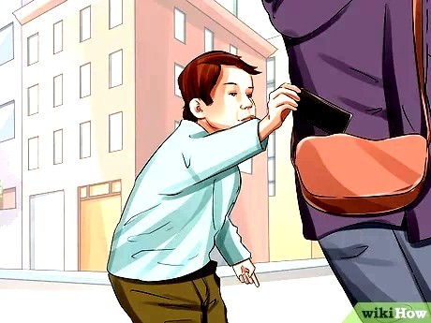
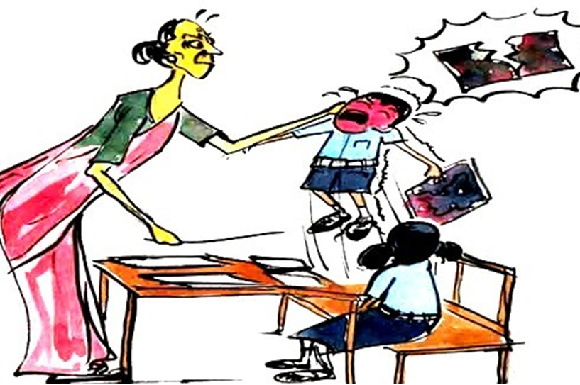
Some examples depicting violence committed by teachers

Slide 13
Types of violence committed in school : (B) Violence committed by students
Threatening classmates
Dirty quotes on walls
Sexually abusing
Damaging school properties
Stealing
Influencing intoxication among students

Slide 14
Causes of violence in school
Committed by teachers :
Due to improper mental health.
Extreme management pressure
Unqualified teachers
Lack of knowledge of child psychology.
Insufficient payment
Frustration
(B) Committed by students :
Due to inappropriate family background
Parents and teachers punishments
Discrimination by teachers
Over restriction
Lack of interest in studies.
Effects violent surroundings
Excessive compitition

Slide 15
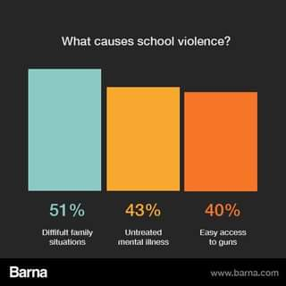
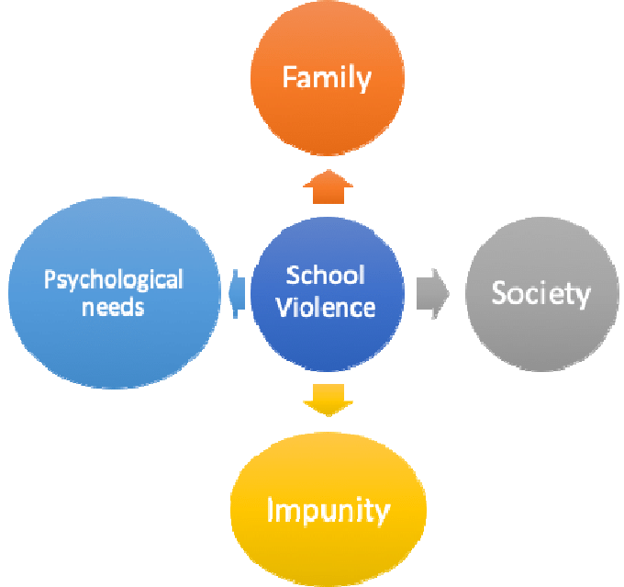
Some of the information and data about causes in school violence

Slide 16

Effects of violence in schools
Increase in drop outs
Adverse effects on students health.
Development of violence tendency.
Development of juvenile delinquent.
Obstruction in educational objectives
Obstruction in development of democracy
Consider violence the only option

Slide 17

Example of lack of knowledge about child psychology

Slide 18
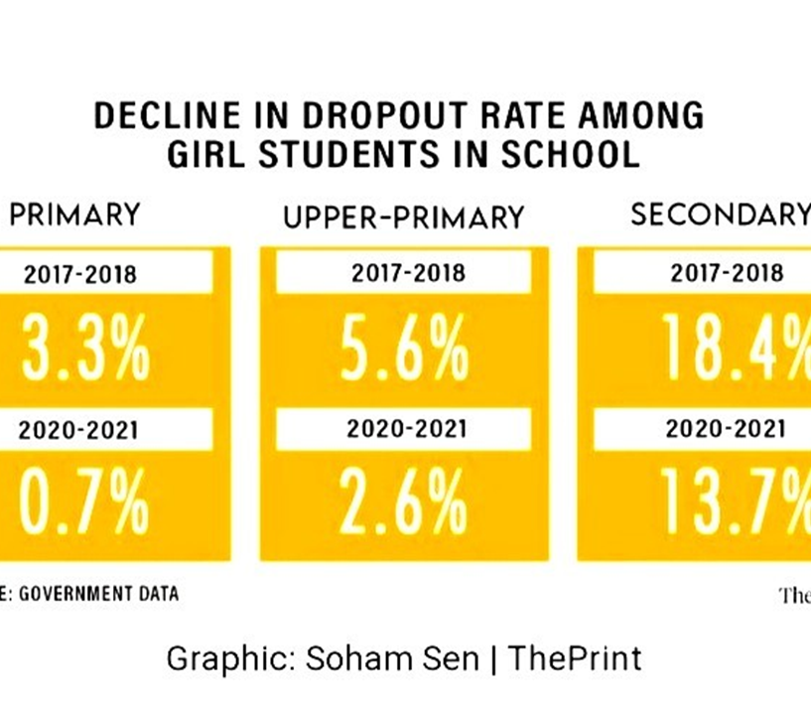

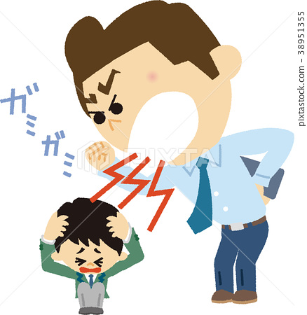
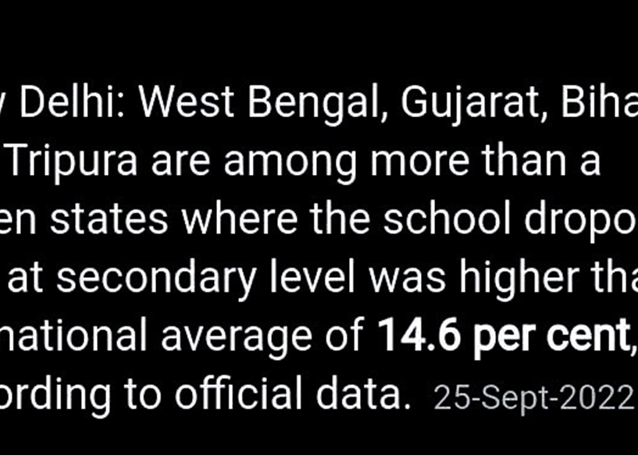
Some data related to effects of violence in school

Slide 19
Education and non violence in school
The form of education in a non-violent school/ classroom environment should be as follows:-
Use of child centered education
Importance to child psychology
Opposition of all type of punishment
Appointment of Deserving and Virtuous Teacher
Establishment of peace clubs
Screening of non-violent movies
Use of media
Organizing various festivals; co-curricular activities; workshops for teachers; and parents; and unity and integration camps.
Inclusion of non-violence in text books.
Use of counsellor

Slide 20
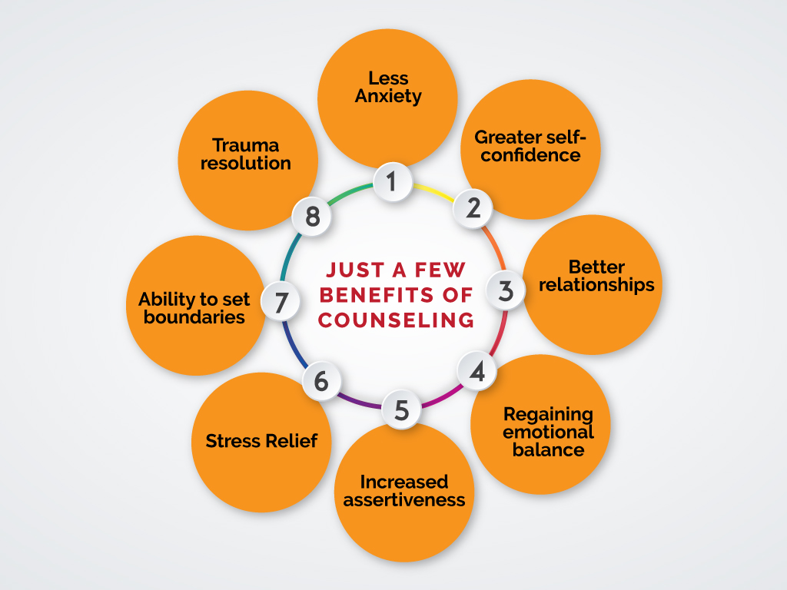
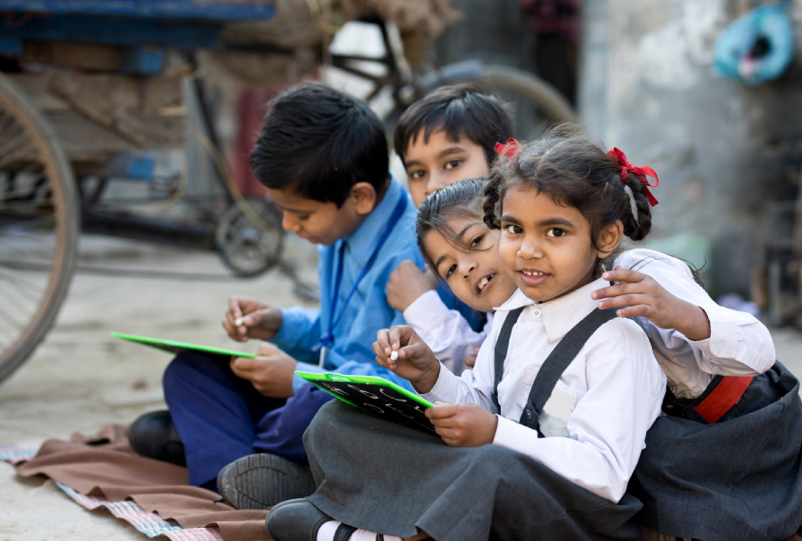
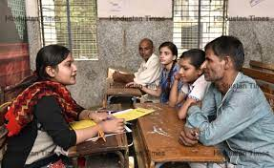
Some pictures related to education and non-violence

Slide 21
Thank you

