Slide 1
Name: Dr. Sanjib Pramanik
Name of the College: Durga College, Raipur (C.G.), India
Name of the Faculty: Arts
Designation: Assistant Professor, Department of Geography
Topic: FRIEDMAN’S STAGES OF GROWTH MODEL
(CORE-PERIPHERY MODEL)
Date: 12/07/2023

Slide 2

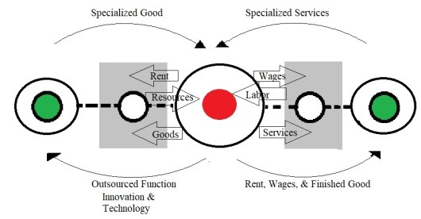
FRIEDMAN’S STAGES OF GROWTH MODEL
(CORE-PERIPHERY MODEL)
Dr. Sanjib Pramanik
Assistant Professor
Department of Geography
Durga College, Raipur

Slide 3
INTRODUCTION
The core-periphery model was developed in 1963 by John Friedmann and it identifies the spatical distances from the core.
John Friedman is one of the pioneering urban theorists of the late twentieth century.
He founded the Graduate School of Architecture and Planning at UCLA in the late 1960.
He is famous for his analysis of world city formation.

Slide 4
CORE-PERIPHERY MODEL
The core-periphery model of development, tries to represent the emergence of an urban system in four major stages which works equally with the development of transportation.
From an initial state of inequalities, disparities are reduced and a functionally integrated urban system emerges.
It helps explain why some inner city areas enjoy considerable prosperity, whilst others display all the signs of urban deprivation and poverty.
The core-periphery model works on many scales, from towns and cities, to a global scale.

Slide 5
John Friedman proposed that the world can be divided into four types of regions.
These are;
1.
2.
3.
Core regions
4.
Upward transition regions
Resource frontier regions
Downward transition regions

Slide 6
1. CORE REGIONS
Core regions refer to centres, which are usually metropolitan.
These centres typically have a high potential for innovation (improvement) and growth.
Example:
São Paulo in Brazil.

Slide 7
2. UPWARD TRANSITION REGION
Upward transition regions are areas of growth, which spread over small centers, rather than at the core.

Slide 8
3. RESOURCE FRONTIER REGION
This region refers to a newly colonized region at the periphery of a country, which is brought into production for the first time.

Slide 9
4. DOWNWARD TRANSITION REGION
These regions are on the periphery characterized by depleted resources, low agricultural productivity or by outdated industry.
A current Caribbean example of this is in Haiti.

Slide 10

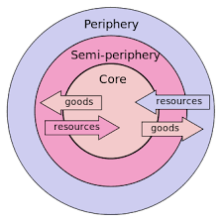
The Model Explained.............
Services, investment and jobs are concentrated in the core Central Business District (CBD).
Accessible inner city areas may benefit from a trickle down of wealth from the core.
For example, in some areas there may be a through-flow of office workers to the inner city seeking low-price lunchtime meals.
The core also provides work for inner city residents.

Slide 11
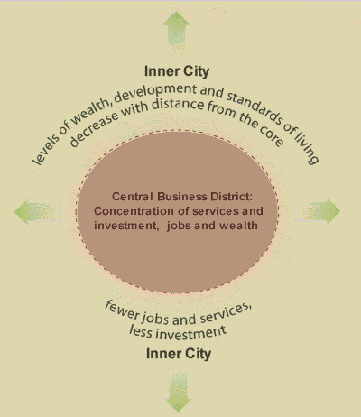
Core-Periphery Model
Spread
Effects

Slide 12
Less accessible inner city areas may experience a backwash effect, with the little investment that occurs in the inner city becoming concentrated close to the CBD, widening the poverty-wealth gap.
This is illustrated in the diagram below, a reversal of the core-periphery model.

Slide 13
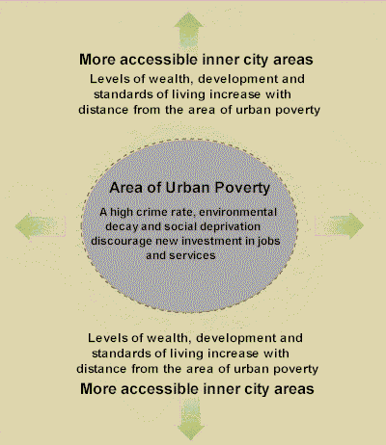
Core-Periphery Model
Reversal or
Backwash

Slide 14
STAGES OF DEVELOPMENT
According to John Friedman’s theory, there are four stages of development. These include;
Stage - 1
Stage - 2
Stage - 3
Industrial
Pre-industrial
Stage – 4
Transitional
Post-industrial

Slide 15
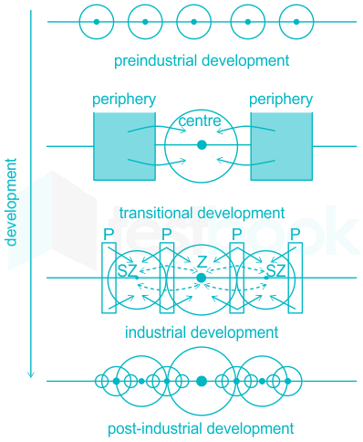

Slide 16
Stage: 1 (Pre-Industrial)
All the places are peripheral.
Place are isolated (Like these bullet points).
No interaction between places.

Slide 17
Stage: 2 (Transitional)
Development of a core.
Interaction between places.
Development of basic technology.

Slide 18
Stage: 3 (Industrial)
Growth centres (between the core and peripheral) develop.
Stable increase in economy.
More advanced technology.

Slide 19
Stage: 4 (Post-Industrial)
All places are self sufficient.
Major interactions.
Reduce inequality.

Slide 20
CONCLUSION
The model attempts to represent the emergence of an urban system in four major stages.
It helps explain why some inner city areas enjoy considerable prosperity, whilst others display signs of urban deprivation and poverty.

Slide 21

THANK YOU

