Slide 1
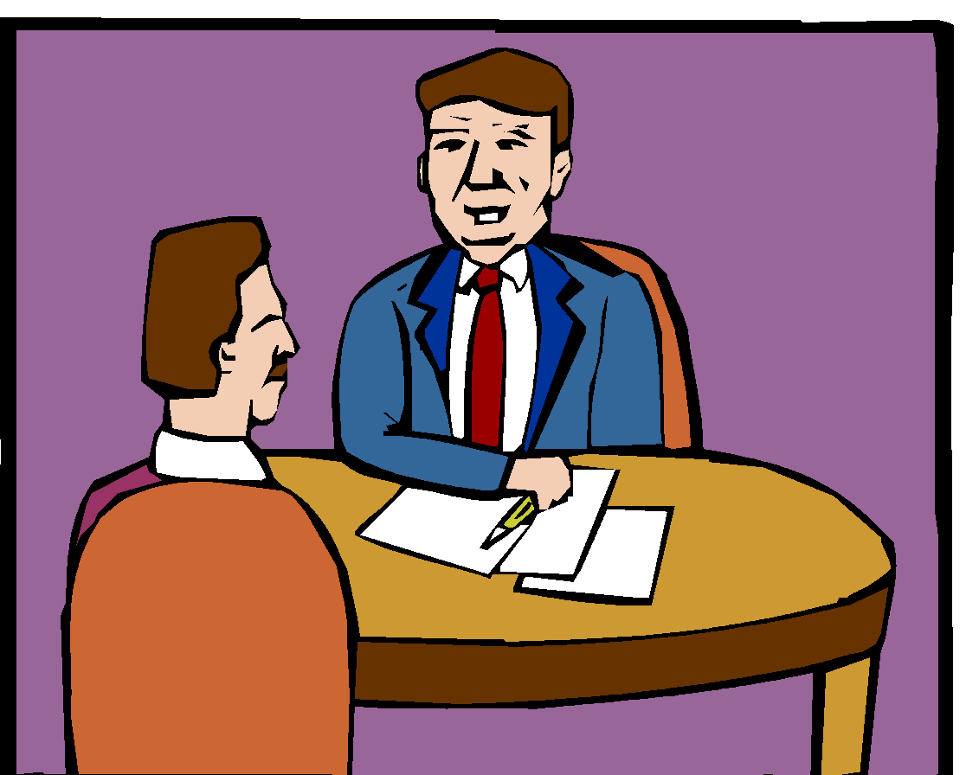
HOW TO PREPARE FOR AN INTERVIEW
Pratibha Khandelwal
Assistant Professor
Department of Education
Durga Mahavidyalaya

Slide 2
Main Topics
Meaning of Interview
Types of Interview
Phases of Interview
Types of questions asked
Do’s and Don’ts of Interview
Selection criteria of Interview

Slide 3

Meaning of Interview

Slide 4

Meaning of Interview
Word “Interview” means “view between”.
It is a conversation between minimum 2 persons with a purpose, of getting a view of each other.
Be always ready for the interview. Your next “boss” may be beside you at an unexpected time or place.

Slide 5


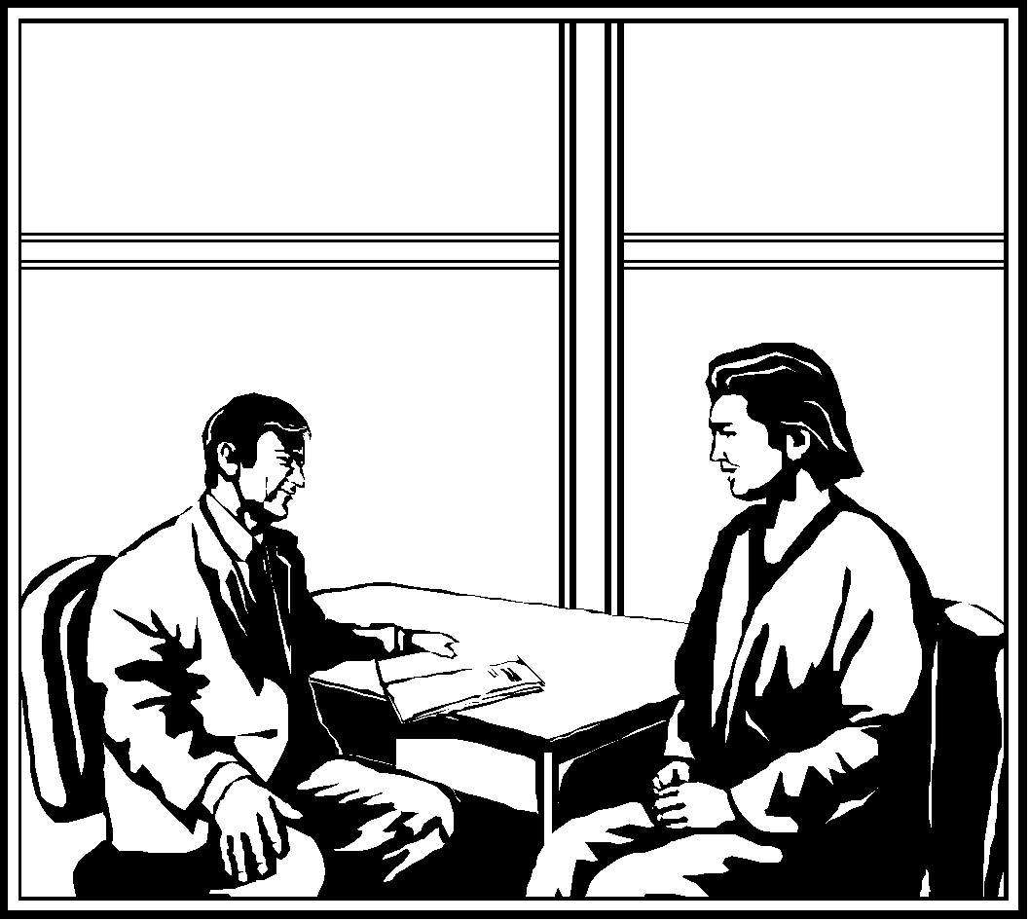
Types of Interview

Slide 6
Types of Interview(1)
On the basis of structure(number of persons involved)
  Face to face interview
  Group interview
  Panel interview
On the basis of purpose
  Selection interview
  Appraisal interview(performance)
  Promotional interview
  Exit interview
  Reprimand interview(anti disciplinary)
  Grievance interview

Slide 7
Types of Interview(2)
Other types of interview are
  Informal / formal
  Role play / reverse role play
  Telephonic / video / lunch or dinner interviews
  Stress / assessment instrumental / technical interviews
  Structural / unstructured interview
  Theoretical / behavioral interview
  Combination interview

Slide 8


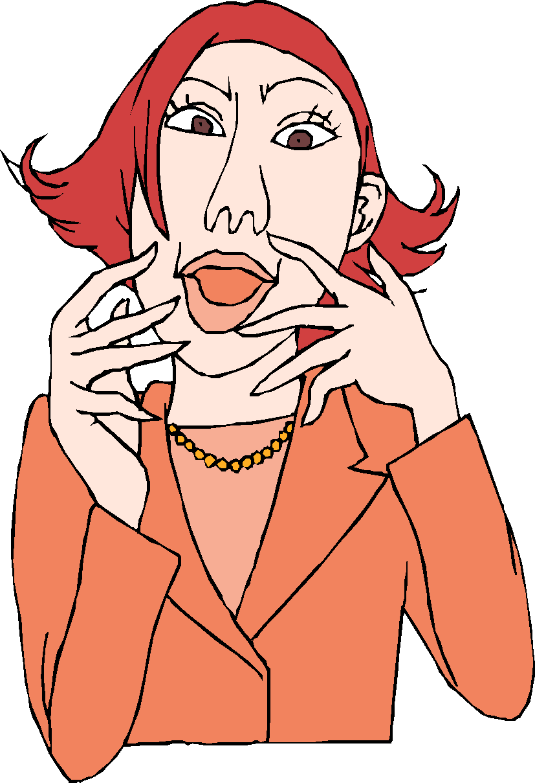
Phases of Interview

Slide 9
Phases of Interview
Before interview
  Research about organization(who, size, clients, growth, services…)
  Personal assessment(SWAN, skills, interest, experience…)
  Quiz yourself(probable questions, mock interviews…)
  Be through with your basics
  Physical preparation(appearance, resume…..)
During interview
  General tips(natural, on time, confident, dress well……)
  Verbal communication(clarity, concise, brevity….)
  Body language
  Effective closing
  Take notes & Negotiation
After interview
  Collects thoughts immediately
  Review notes
  Thanks and follow up
  References

Slide 10

Types of Questions asked

Slide 11
Type of questions asked
On personal details
On academic career
On curricular activities
On co-curricular activities
On general knowledge
On experience gained
Miscellaneous topics
Hypothetical questions
Probing questions
Open ended questions
Close ended questions
Loaded questions
Leading questions
Reflective questions

Slide 12


Do’s and Don’ts of an Interview

Slide 13
Do’s of Interview
Be punctual and come prepared
Bring extra copies of resume, photos and other documents
Be natural and cheerful
Be honest, sincere, ethical and gracious
Show interest
Be always open and positive minded
Do stress your achievements
Be confident, energetic, calm and poised
Keep effective body language
Wear conventional, sober and dignified dress
Speak clearly, simply, fluently and briefly

Slide 14
Don’ts of Interview
Don’t act too smart and don’t be too talkative
Don’t lie and make excuses
Don’t say negative about others
Avoid controversial topics
Don’t discuss personal issues
Don’t inquire salary & don’t exaggerate present salary
Don’t fake or overwhelm
Don’t speak against your last company or boss
Don’t chew or talk on cell phone

Slide 15

Selection Criteria in Interview

Slide 16
Selection Criteria of Interview
Intelligence
Appearance and poise
Confidence
Communication skills
Interviewing skills
Interest
Leadership potential
Knowledge
Interpersonal relations
This emotional experience regardless of outcome is only a speed bump in your career process.

Slide 17
Questions asked in examination
What preparation you will make before appearing for a job interview?
What traits does an employer look for ,in a candidate while making interviewing him?
Writ short notes on “Interview”.
How should a candidate conduct himself during selection interviews?
What is an interview and how should a candidate prepare for the interviews?
Discuss the factors because of which a qualified candidate may not be selected for an interview.

