Slide 1
Listening Skill
Pratibha Khandelwal
Assistant Professor
Education Department
Durga Mahavidyalaya

Slide 2

What is Listening?
Achieving ability to comprehend material delivered at relatively fast speed; comprehending spoken material in standard Indian English, British and American English. Intelligent listening in situations. Advantages of listening. Hearing and listening. Essentials of good listening. Use of modern communication devices. Telephonic conversation.

Slide 3

Main topics
Meaning and components of listening.
Difference between hearing and listening.
Significance of good (attentive) listening.
Types of listening
Barriers to listening
Essentials of good listening
Techniques to improve listening

Slide 4

Facts about listening
Listening: Learned first, Used most (45%), Taught least.
Speaking: Learned second, Used next most (30%), Taught next least.
Reading: Learned third, Used next least (16%), Taught next most
Writing: Learned fourth, Used Least (9%), Taught most.

Slide 5
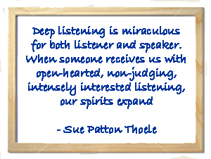
Meaning and components

Slide 6
Meaning and components
Listening is a process of receiving, interpreting and responding to the messages received from the sender.
Listening is composed of 6 distinct components
    Hearing
    Attending(identification, focusing)
    Interpretation (decoding)
    Evaluation (deciding value)
    Remembering (sending it to STM or LTM)
    Responding

Slide 7
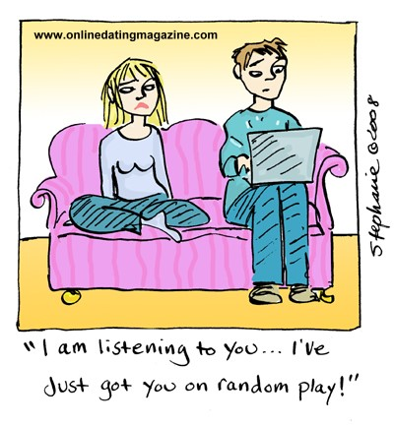
Difference between hearing and listening.

Slide 8
Difference between hearing and listening.
Hearing
Listening
It is with senses & brain.
It is automatic.
It is not systematic.
It is not purposeful.
It is a one way process.
It is physiological.
It is a simple process.
Person is passive.
It is with mind.
It is voluntary.
It is systematic.
It is purposeful.
It is interactive.
It is psychological.
It is a complex process.
Listener is active.

Slide 9
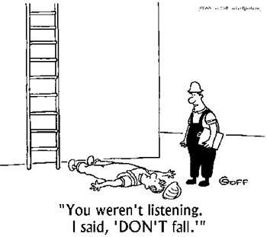
Significance of good listening

Slide 10
Significance of good (attentive) listening
When a person listens to a spoken message by using his concentration power, experience, guesswork, prediction ability, logical sense etc. it is called intelligent listening.
A good listener learns more than indifferent listener.
An attentive listener stimulates better speaking by the speaker.
A good listener can restructure vague speaking into clearer meaning.
A good listener learns to detect assumptions, prejudices and attitudes.
A good listener can understand and evaluate inferences and reasoning.
A good listener can distinguish facts from opinion.

Slide 11
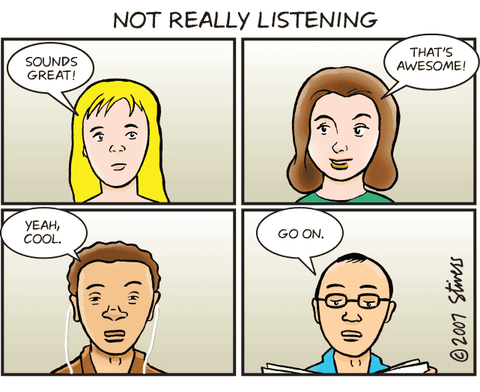
Types of listening

Slide 12
Types of listening
Non listening (content is not needed)
Pseudo listening
Active or focused listening(from hearing to respond)
Passive listening(responding is absent)
Emphatic listening
Selective listening
Bottom line listening
Evaluative listening
Offensive listening
Defensive listening
Attentive listening

Slide 13
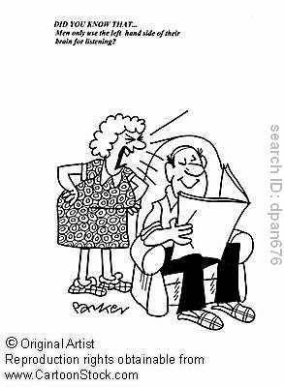
Barriers to listening

Slide 14
Barriers to listening(1)
Physical barriers
  Noise
  Physical discomfort
  Distance between speaker and listener
  Physical distraction
Psychological barriers
  Ego, anxiety, fear, stress, worry…
  Lack of attention
  Poor motivation
  Negative attitude
  Bias and prejudices
  Closed mindedness

Slide 15
Barriers to listening(2)
Linguistic barriers
  Improper delivery
  Improper message decoding
  Ambiguous language
  Jargon
Cultural barriers
  Cultural differences
  Different values
  Different norms
Other barriers
  Difficult topic
  Time period and
  Difference in status

Slide 16
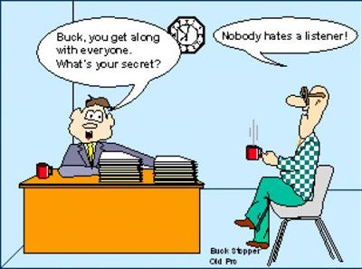
Essentials of good listening

Slide 17
Essentials of good listening
Be alert while listening.
Exercise your mind(we listen faster than we speak so fill the gap in understanding).
Resist distraction.
Find areas of interest.
Judge content, not delivery.
Hold your fire.
Be a flexible listener.
Listen with open mind.
Listen between lines(to tone , voice, stress...).
Listen for ideas and not facts.

Slide 18

Techniques to improve listening

Slide 19
Techniques to improve listening
Have desire to listen.(prepare physically, mentally....)
Pay attention and be alert.
Make no assumptions.
Remove distractions.
Be empathetic and patient.
Monitor non-verbal.
Take notes.
Ask questions.
Delay evaluation and premature conclusion.
Try and understand speaker’s perspective.
Keep body language effective.

Slide 20
Questions asked in examination
What are the different techniques to improve listening ability. Differentiate between hearing and listening?
Describe the essentials of good listening.
What are the techniques to improve listening ability? Discuss.
“Listening is a conscious activity the demands a lot more than just physical hearing.” Discuss.
Write a short note on the importance of listening. Differentiate between listening and hearing.
“How to become a better listener”. Explain.

