Slide 1
MANAGEMENT OF PSYCHOPATHOLOGY
Dr. Shankuntala Dulhani
Assistant Professor
Department Of Psychology
Durga Mahavidyalaya Raipur

Slide 2
b.A. Part 1 unit -5
Topic – MANAGEMENT OF PSYCHOPATHOLOGY

Slide 3
WHAT IS PSYCHOPATHOLOGY ?
“It is the term used to refer either the study of mental illness or the study of manifestation of the behaviors and experiences which may indicate to mental illness or Psychological Impairment.”

Slide 4
PSYCHOANALYTIC THERAPY :-
“ Psychoanalytic Therapy is a type of treatment based upon theories of ‘SIGMUND FREUD’ who is considered the Father of Psychology and also the founder of Psychoanalysis. “

Slide 5
STEPS OF PSYCHOANALYTIC THERAPY

Slide 6
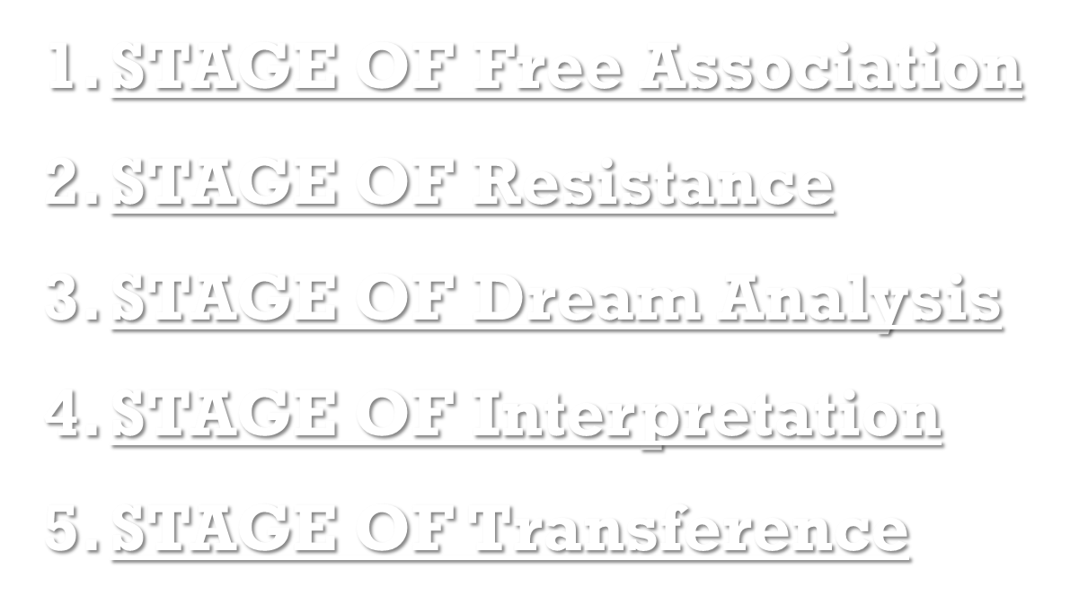


Slide 7
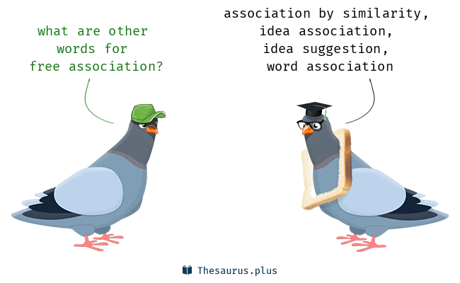
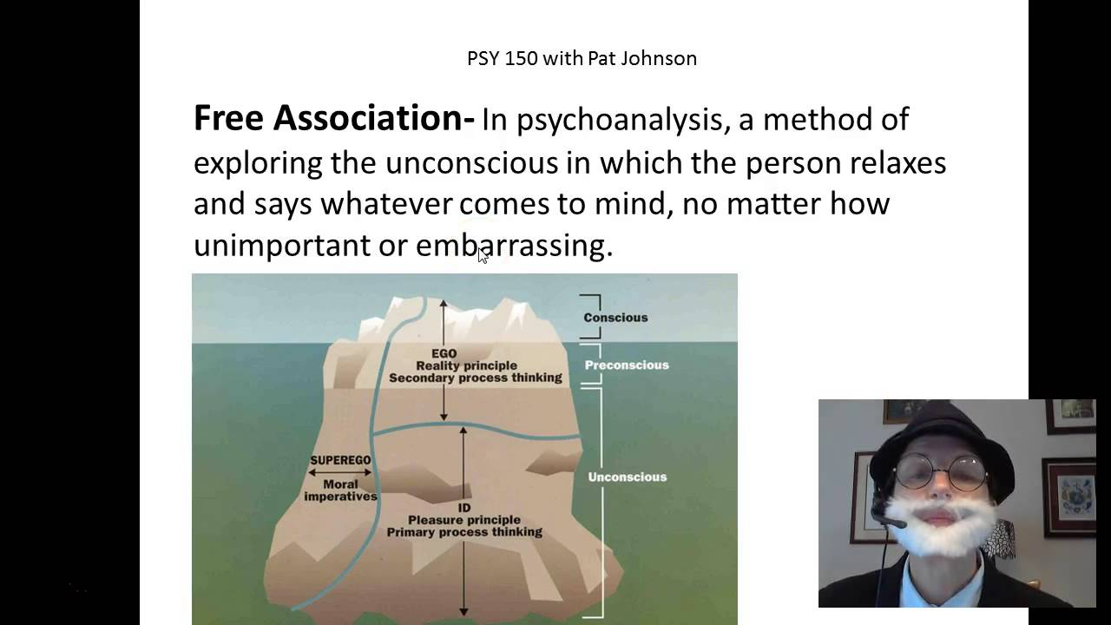
Stage of free association :-

Slide 8
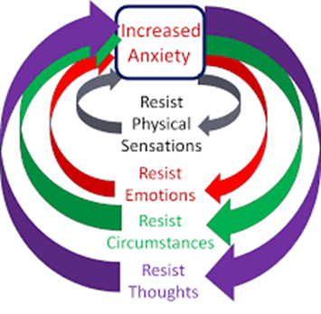
Stage of resistance :-
This stage identifies the clients restriction or refusal and reluctance to bring surface of awareness. Resistance of any kind coming from free association gets into the way of this progress .This the therapist helps the client.

Slide 9
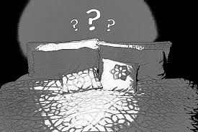

Stage of dream analysis:-
It is the investigation of repressed feelings that can be expressed in our dreams . Psychoanalytic theory believes repressed feelings often manifested themselves in their dreams. It happens because defenses are lowered when we sleep .
Dream analysis help uncover this unconsciousness.

Slide 10
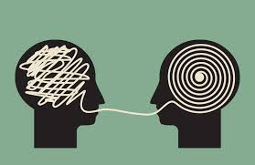
Stage of interpretation :-
A technique where therapist use to explain or point out or even teach the meaning of the gathered unconscious material . Interpretation is the main line of communication for the clients to understand their unconscious and help their ego assimilate the material to help them further progress to uncover unconscious material .

Slide 11
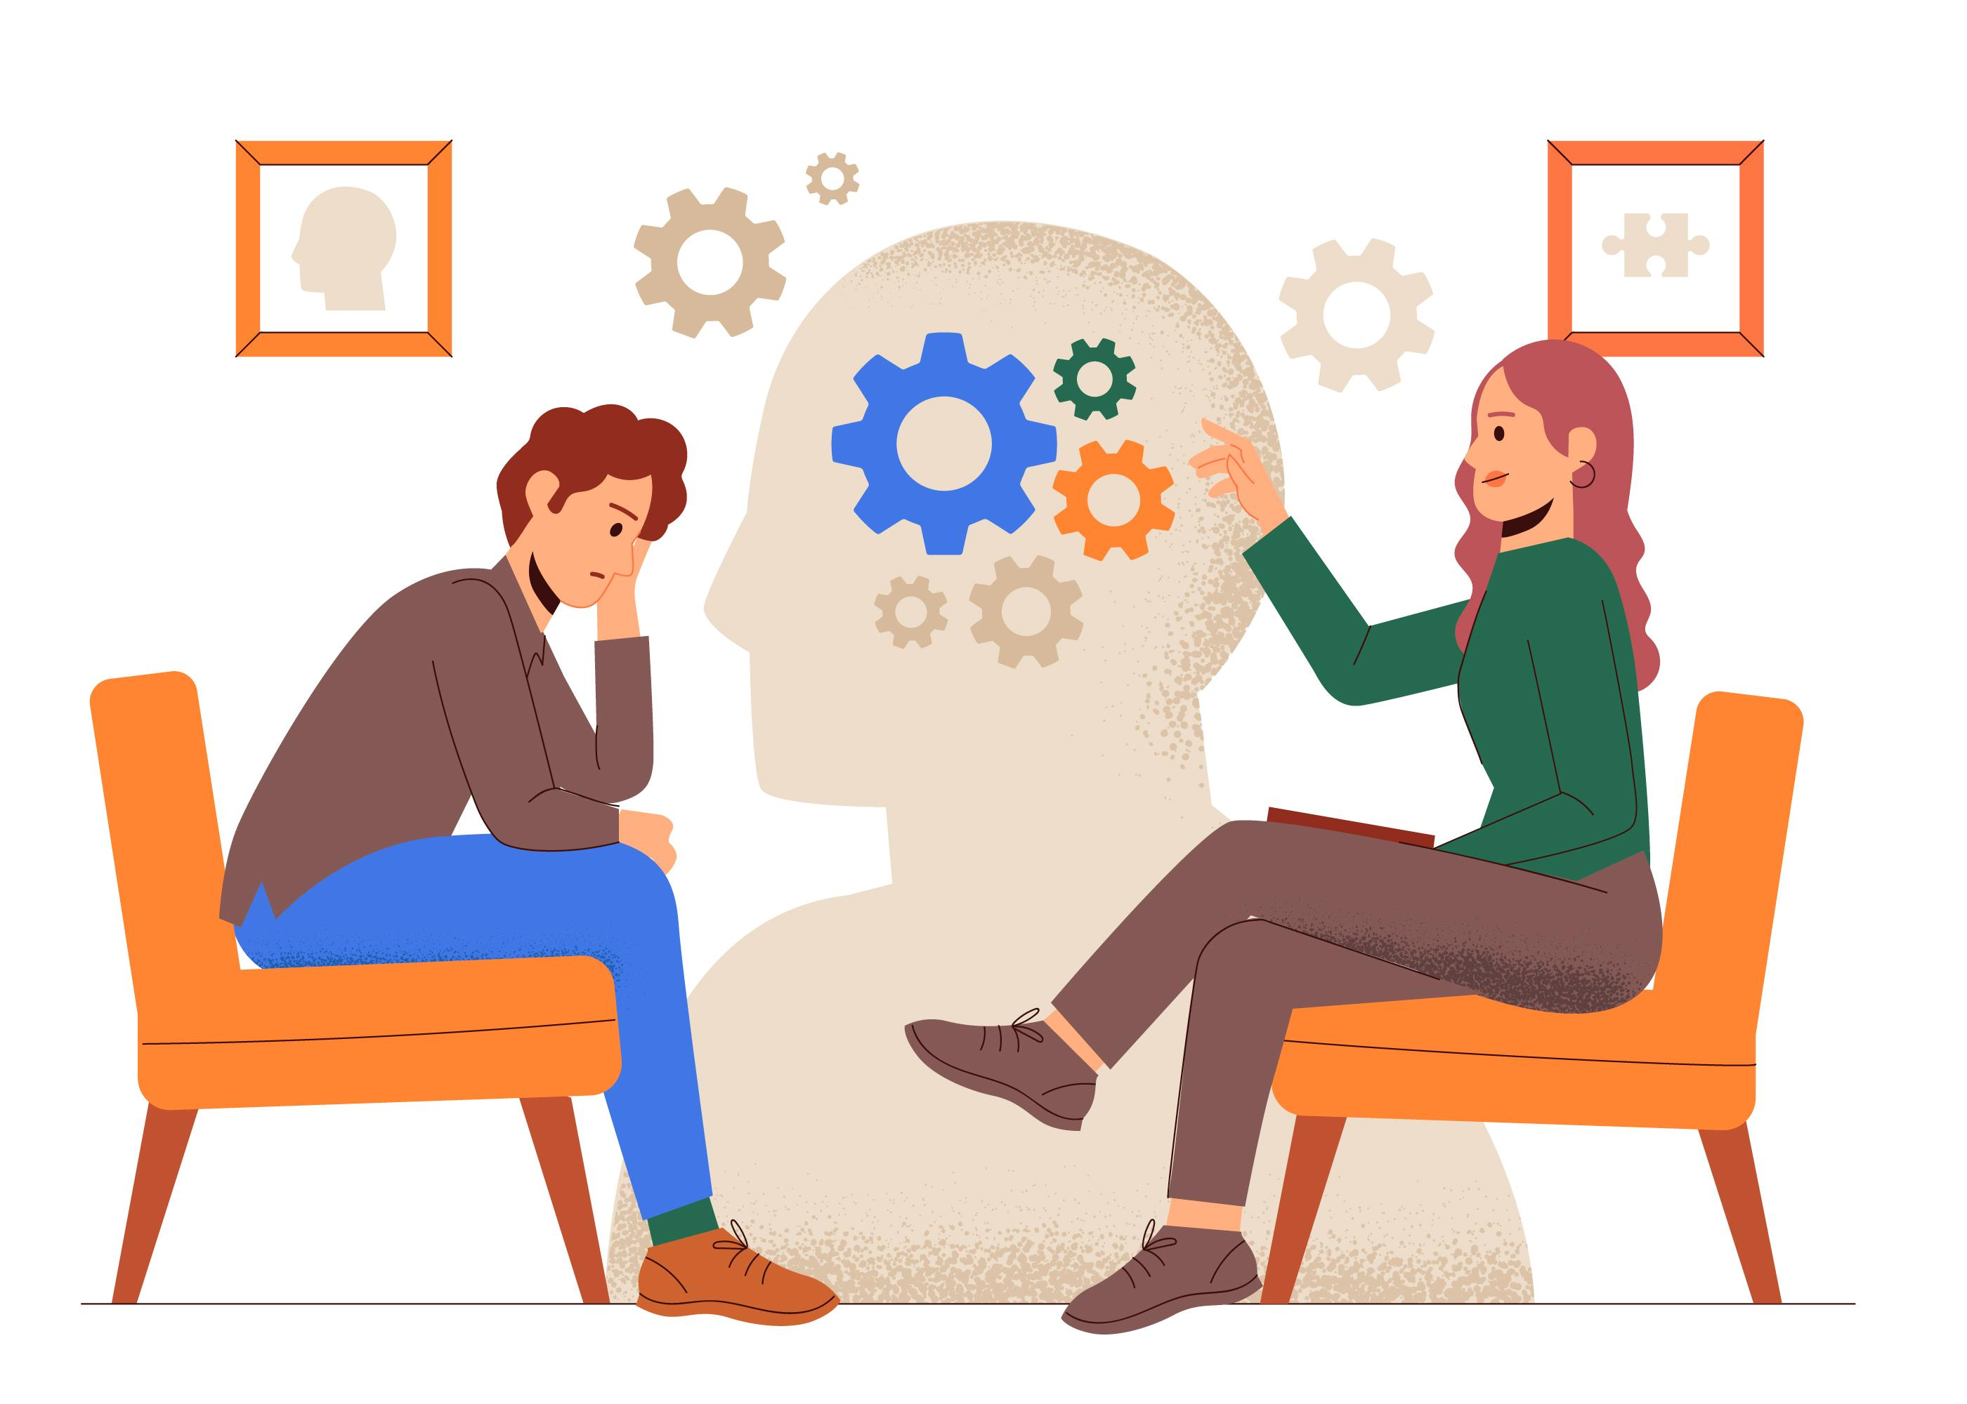
Stage of transference
It is important that the therapist analyze and properly interpret the transference relationship they hold which ultimately holds the crucial solutions for the clients to understand.

Slide 12

Stress management

Slide 13
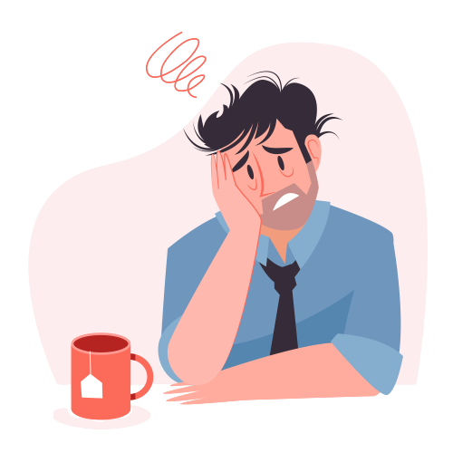
About stress :-
Stress can have a big impact on your body , in ways felt only by you, and in ways the world can see .There are many ways to reduce and control stress using wide range of techniques and psychotherapies to control a person’s level of stress which is known to be Management Of Stress.

Slide 14

CAUSES OF STRESS :-
Job Insecurity
Workplace culture
Divorce / Breakups
Financial Problems
High Performance Demand
Serious Illness
Family/Personal problems
Pressure from society and Peers
Death Of loved Ones

Slide 15

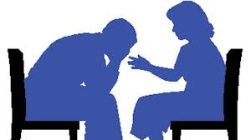


STRESS REDUCTION METHODS -
Body Relaxation Exercises
Breathing technique
Physical exercise (Yoga , workout)
Meditation
Counseling (Talk therapy, life coaching)

Slide 16

Etc [electroconvulsive therapy] shock therapy

Slide 17
MORE ABOUT SHOCK THERAPY:-
Shock therapy is the most powerful treatments . It is effective in more than 80% of the patients with serious depression . It is a treatment of chronic mental health conditions by Electroconvulsive Therapy [ETC]. Or by inducing electric shock. It was 1st induced by a pair of Italian Psychiatrist in 1938. This treatment involves the induction of electrical stimulation .

Slide 18
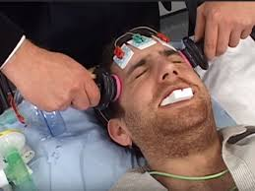
BENEFITS V/S RISK OF SHOCK THERAPY:-
BENEFITS:-
Treats severe Depression
Treats severe Mania
Treats Agitation and aggression
Treats schizophrenia
Treats dissociative disorders
RISKS :-
Cause confusion in patients
Memory Loss
Physical Side Effects
Medical complications

Slide 19

Group psychotherapy
It is a form of psychotherapy in which one or more therapists treat a small group of clients together in a group. The team can legitimately refer to any kind of psychotherapy when delivered in a group format , including cognitive behavioral therapy or interpersonal therapy but it is usually applied to psychodynamic group.

Slide 20
Benefits of group psychotherapy:-
Groups provide support to deal with mental illness or addiction etc.
Groups provide a sounding board ,people listen to your problems and deal with it .
Can create an essence of belongingness .
There is less judgement in group therapy session .
Group therapy promotes social skills .
It costs less than individual counselling.

Slide 21
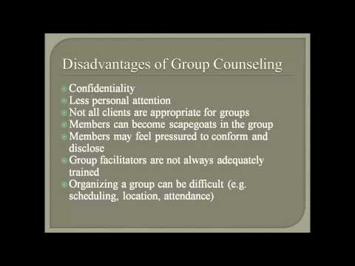
Disadvantages of group therapy:-

Slide 22
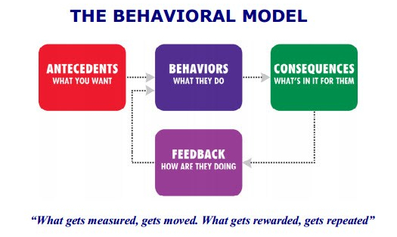
Behavior therapy:-
When behavior of an unknown person becomes disordered ,The abnormal behavior is treated by this theory. Behavioral therapy seeks to identify and help to change potentially self-destructive or unhealthy behavior . It functions on the idea that all the behaviors are learnt and that unhealthy behaviors can be changed. This therapy can benefit people in a wide range of disorders.

Slide 23
Techniques 0f behavior therapy
TECHNIQUES
Systematic Desensitization
Aversion Therapy
Implosive Therapy and flood
Assertive Therapy
Modeling
Bio –Feedback Method

Slide 24
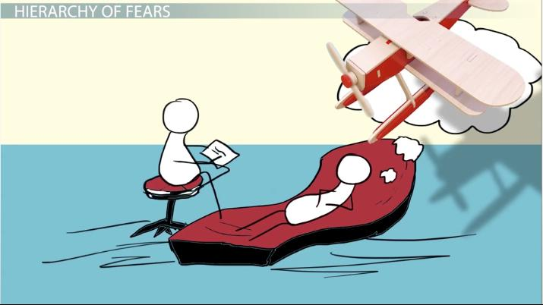
Systematic desensitization :-
It was given by Walt and Salter .
The person is first relaxed and made comfortable with the situation and are asked to imagine those situations which produces anxiety in them .
Steps are as follows:-
1.Training in relaxation .
2. Construction of hierarchy of anxieties .
3. Procedure.

Slide 25

aversion therapy
This therapy is used on alcoholics/smokers.
Interest in something which is not good is removed from the patient by this therapy.

Slide 26
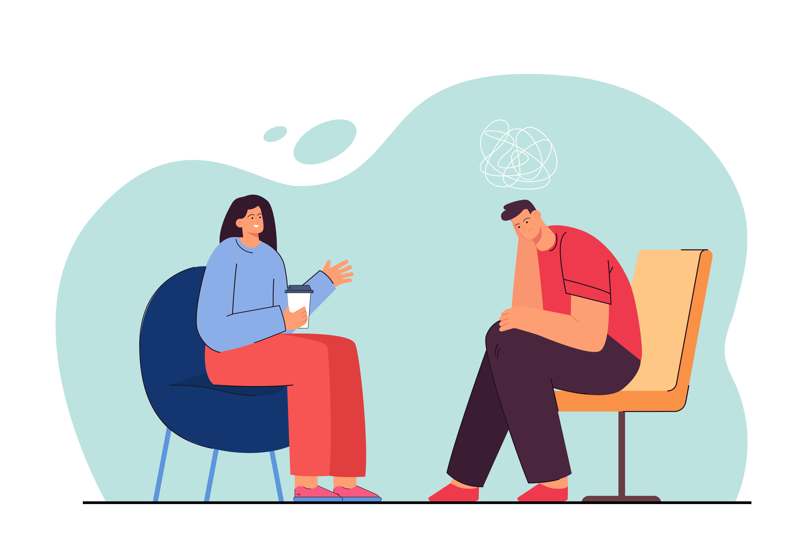
assertiveness therapy
Mostly found in introverts.
These patients can’t speak their own thoughts.
It is very suppressed.
Through this therapy patients are taught to overcome their problem.

Slide 27
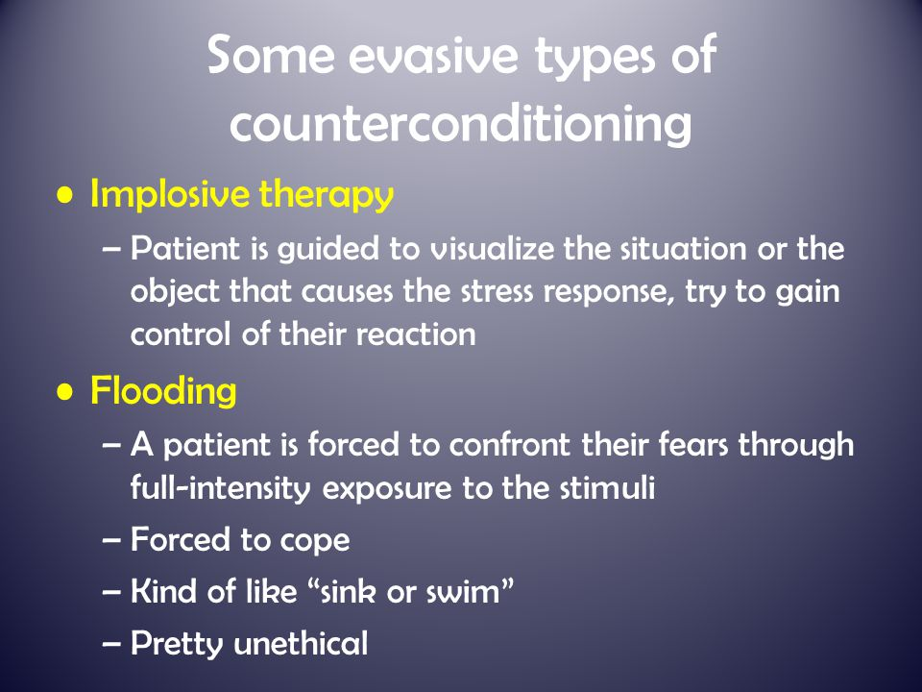
Implosive and flooding therapy :-
Implosive – Patients are made to imagine about any situation which he/she fears of .
Flooding – Patients are taken to actual places /situations which the patient fears of.

Slide 28
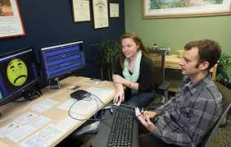
Bio – feedback method :-
In the above given method an electronic machine is used in the treatment.
It is used on Psychophysiological patients. It is a mind and body technique that involves using visual or auditory feedback to gain control over involuntary bodily functions .Simply it a technique involving the monitoring of persons physiological state and feeding information about it back to that person .

Slide 29
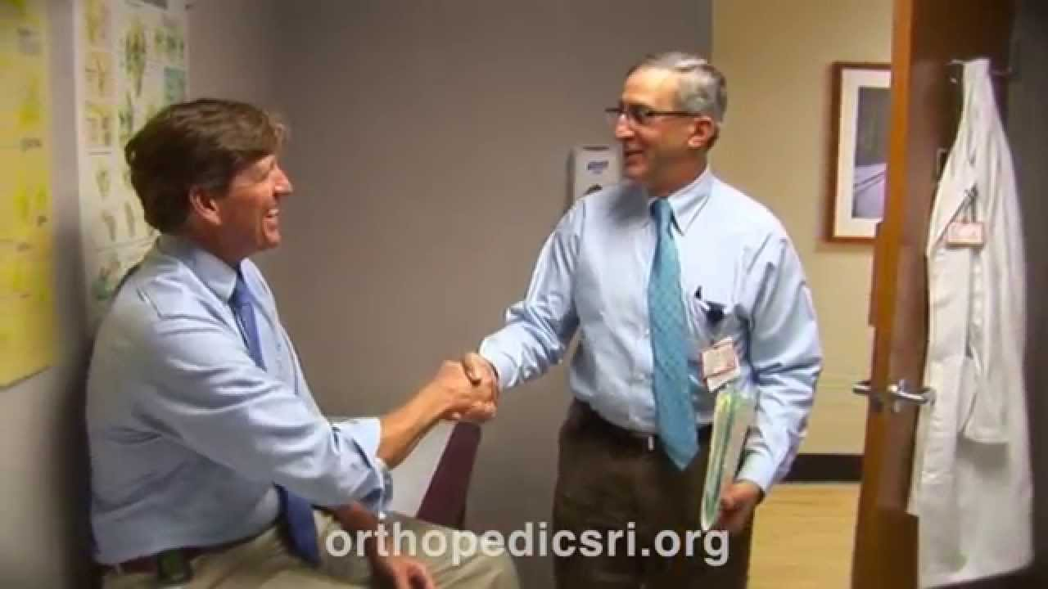
Modeling:-
In this method a model or ideal of someone is presented to the patient . It is method used in the cognitive behavioral technique of psychotherapy whereby the client learns by imitation alone , without any specific verbal direction.
Sometimes even doctor becomes a model to the patient.

Slide 30
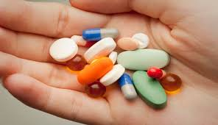
The drug therapy
Drug Therapy, or Psychopharmacotherapy, aims to treat psychological disorders with medications. Drug therapy is usually combined with other kinds of psychotherapy. The main categories of drugs used to treat psychological disorders are antianxiety drugs, antidepressants, and antipsychotics.

Slide 31
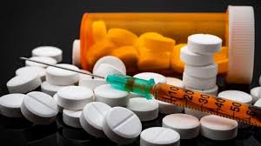
There are 4 types of drugs:-
DRUGS FOR TREATMENT OF ANXIETY DISORDERS –
Valium
Ativan
Serax
FOR TREATMENT OF SCHIZOPHERENIA –
Mellaril
Thorazine
Serentil
DRUGS FOR TREATMENT OF MOOD DISORDERS-
Nardil
Parnete
Marplan
DRUGS FOR TREATMENT OF ATTENTION DEFICIENT/ HYPER ACTIVE DISORDER (ADHD)
Occurs in small children .
Mostly in the elder child.
Drugs not given often.
Treated with counselling also.

Slide 32
THANK
YOU!

