Slide 1

Presentation Skills
Pratibha Khandelwal
Assistant Professor
Department of Education
Durga Mahavidyalaya, Raipur

Slide 2
Main topics
Meaning of presentation
Elements of presentation
Planning a presentation
Designing a presentation
Practicing before presentation
Arrangements before presentation
Making presentation
Features of good presentation
Effective body language
Audio-visual communication

Slide 3

MEANING OF PRESENTATION
Presentation means speaking on a topic before a selected audience on some formal occasion.
Presentation is a formal talk addressed to selected audience and ‘presents’ ideas or information in clear structured way. It is any audio or visual way of communication with an aim to deliver a message to the audience.

Slide 4

ELEMENTS OF PRESENTATION
Presenter
Audience
Content to achieve purpose

Slide 5

PLANNING A PRESENTATION
Making presentation is an art and requires planning. M.M. Monipally (2001) has explained presentation planning in terms of 5 ws.
Why ( to inform, educate, empathize, influence, convince)
Who(age, sex, education level, status etc)
Where (size of hall, number of audience, arrangements)
When(time and duration of presentation)
What (content of presentation)

Slide 6
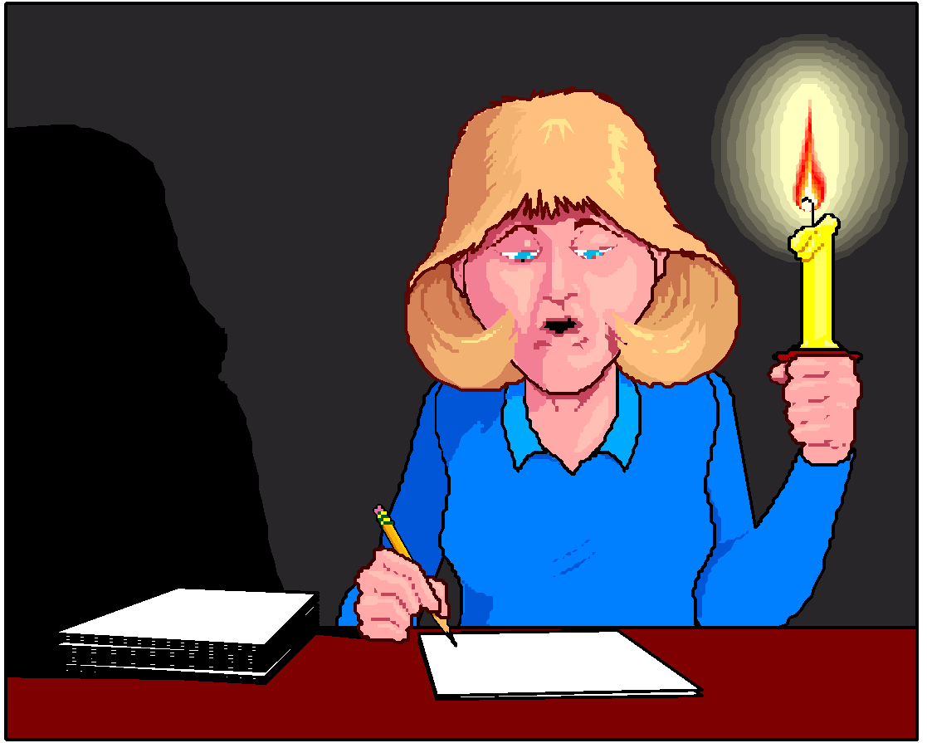
DESIGNING A PRESENTATION
It is the most tedious task and the ideas and points to be conveyed needs to be given a proper format, so as to make acceptable and comprehensible to the audience. A presentation should be structured as
Introduction
Main body
Conclusion
Question-answer session

Slide 7

INTRODUCTION
An effective introduction is must to arouse interest and curiosity in audience. It also helps the presenter to capture attention and develop rapport with audience.
Presenter can relate an incident, tell a story, quote an imminent person, ask question, give statistics and use other tactics to introduce a topic.

Slide 8

MAIN BODY
Main body of presentation consists of key ideas, facts, figures and supporting materials. Presenter should select and arrange the materials in right sequence depending upon the objective of presentation and type of audience.
One should always try and proceed from easy to difficult, acceptable to unacceptable and main to sub points.

Slide 9

CONCLUSION
It is the last chance to sell the idea and leaves the final impression. So, it must be well planned and well delivered. It should generate the last thought in the minds of the listeners regarding the issues taken up in the speech and it should also make clear to audience as to what they should do next.
Presenter can summarize main points or make a promise. One can also end with question and answer session.

Slide 10
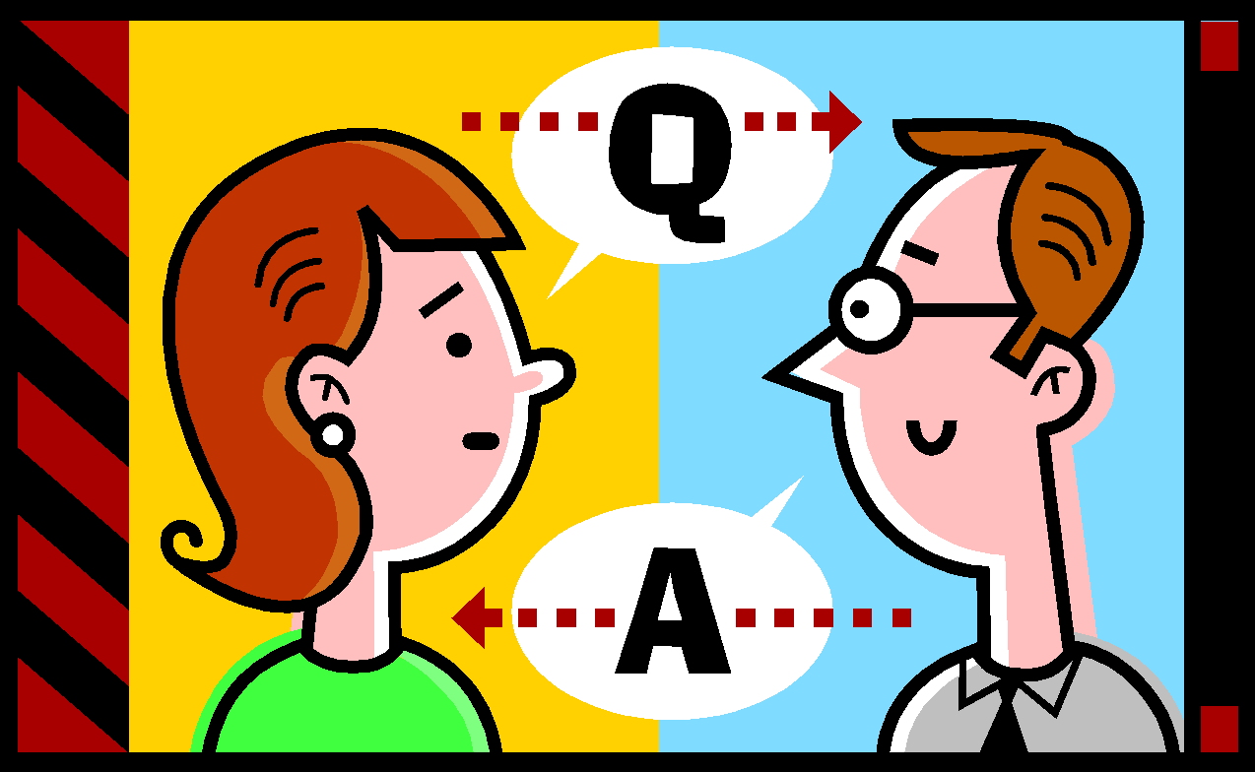
QUESTION AND ANSWER SESSION
Encourage the participants to ask questions.
Listen to questions carefully and answer them.
Tactfully edit the repeated questions.
If you don’t know the answer don’t misguide.

Slide 11

PRACTICING BEFORE PRESENTATION
Some possible practice techniques are :
Avoid reading or memorizing
Rehearse out loud and on your feet
Memorize your introduction, conclusion and main transitions.
Concentrate on your introduction
Practice with your visuals
Simulate the situation
Improve your delivery
Time yourself

Slide 12

ARRANGEMENTS BEFORE PRESENTATION
    Check the room arrangements
    Check the lighting and ventilation
    Check your visual aids
    Test all the equipments
    Test the readability of your slides
    Set up your notes and other things
    Arrange the space and objects around you (height and distance)
    Get comfortable with place & audience
    Relax physically and mentally

Slide 13

MAKING PRESENTAION
Make effective use of body language.
Use positive words and connect to the audience.
Speak with required loudness, pitch, pace….
Speak with correct pronunciation and expression.
Speak to motivational listeners.
Concentrate on here and now.
Forget how you look and sound.
Forget your own mistakes and stumbles.
Use audio-visual aids.

Slide 14

FEATURES OF GOOD PRESENTATION
Preparation and mastery
Suitable language
Right content
An effective opening and closing
Logical arrangement of main points
Brevity and precision
Lively delivery with humour
Audience participation
Using audio-visual aids
Appropriate seating arrangements
Effective use of body language

Slide 15



EFFECTIVE BODY LANGUAGE
Body language is a form of non-verbal communication that supplements verbal communication. Some elements of body language are
Posture
Hand and arm gestures
Body movements
Eye contact
Facial expression
Pauses

Slide 16
Audio-visual communication(1)
We remember through the senses
20% of what we hear = Audio sense
30% of what we see = Visual sense
50% of what we hear and see = Audio-Visual sense
80% of what we say = Work sense
90% of what we say and do = Multisensory task
In audio-visual communication one tries and facilitates both audio and visual sense while presenting an idea, so as to make presentation interesting, attractive, vivid stimulating and effective.

Slide 17

Audio-visual communication(2)
Types of audio-visual aids
  Audio aids (radio, CDs, tape recorders….)
  Visual aids (pictures, charts, maps, models , OHP……)
  Audio-visual aids(computers, LCD, television……)
Importance of audio-visual aids
  Helps to catch and hold attention.
  Increases retention of the audience.
  Facilitates understanding.
  Provides reinforcement.
  Helps in developing perception of audience.
  Saves time and energy.
  Makes presentation interesting, vivid and effective.

Slide 18
Audio-visual communication(3)
Techniques to make audio-visual communication effective are
  Materials should be easy to understand.
  Materials should be interesting.
  Materials should arouse imagination of the audience.
  Materials should be well synchronized.
  Language of the audio material should be flawless.
  The status and cultural background of the audience should be taken care while choosing the aids.
  Audio visual aids are not the substitutes but supplement.

Slide 19
Audio-visual communication(3)
Techniques to make audio-visual communication effective are
  Choose suitable place and time for display.
  When not in use, keep the equipments switched off.
  Use economical aids.
  Aids should be adopted to the intellectual maturity of the audience.
  In visual aids color chosen should be good and clear.
  Use aids only if required don’t forcefully fit them
  Audio visual aids are not the substitutes but supplement.

Slide 20
Questions asked in examination
What all factors should be kept in mind to make the presentation effective?
What role does body language play in making an oral presentation effective?
What are the different factors one has to be sensitive to, for effective presentation?
Write short notes on audio-visual aids and body language?
Describe the principles of oral presentation. What factors would you bear in mind while going for an oral presentation before a large group?
What do you understand by audio-visual communication?
What are the skills a person should possess for effective presentation?
Importance of audio-visual aids in presentation, give some examples?

