Slide 1
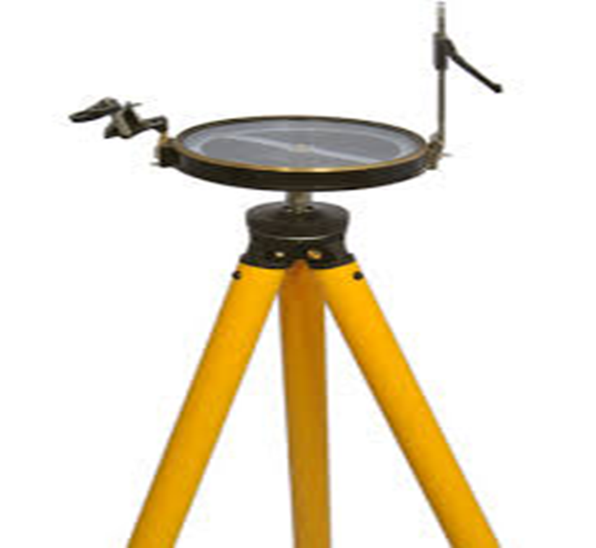
₍PART - 2₎
Name : Dr .Purnima Shukla
Name of the College: Durga College, Raipur (C.G.), India
Name of the Faculty: Arts
Designation : H.O.D. , Department of Geography
Topic : SURVEYING ₍PRISMATIC COMPASS₎
Date : 12/07/2023

Slide 2
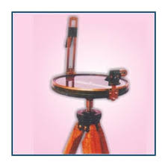
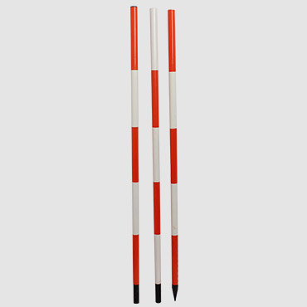
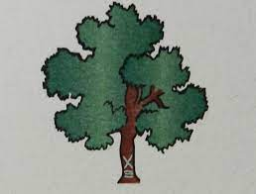
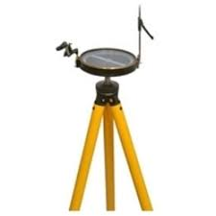
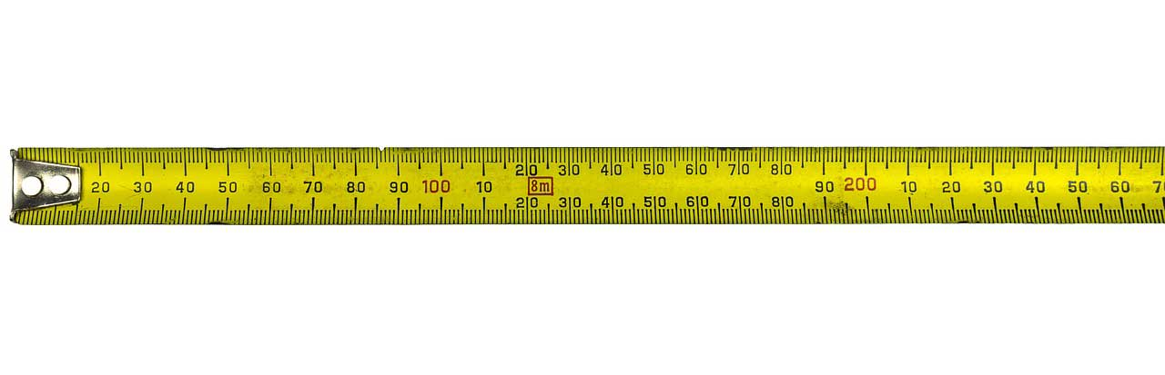
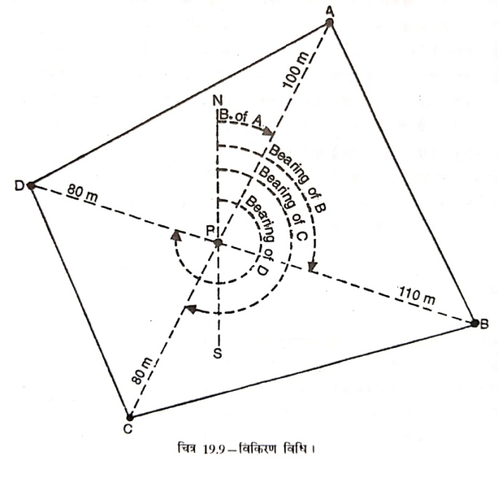

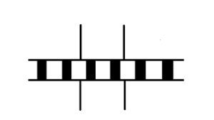
Methods of Prismatic Compass Survey Like Plane table survey, following methods are used for conducting the prismatic compass survey:
Radiation Method
2. Intersection Method
3. Traverse (Open and Closed) Method
4. Resection Method
PS
a
b
Radiation or Radial Line Method
e
d
c
A

Slide 3
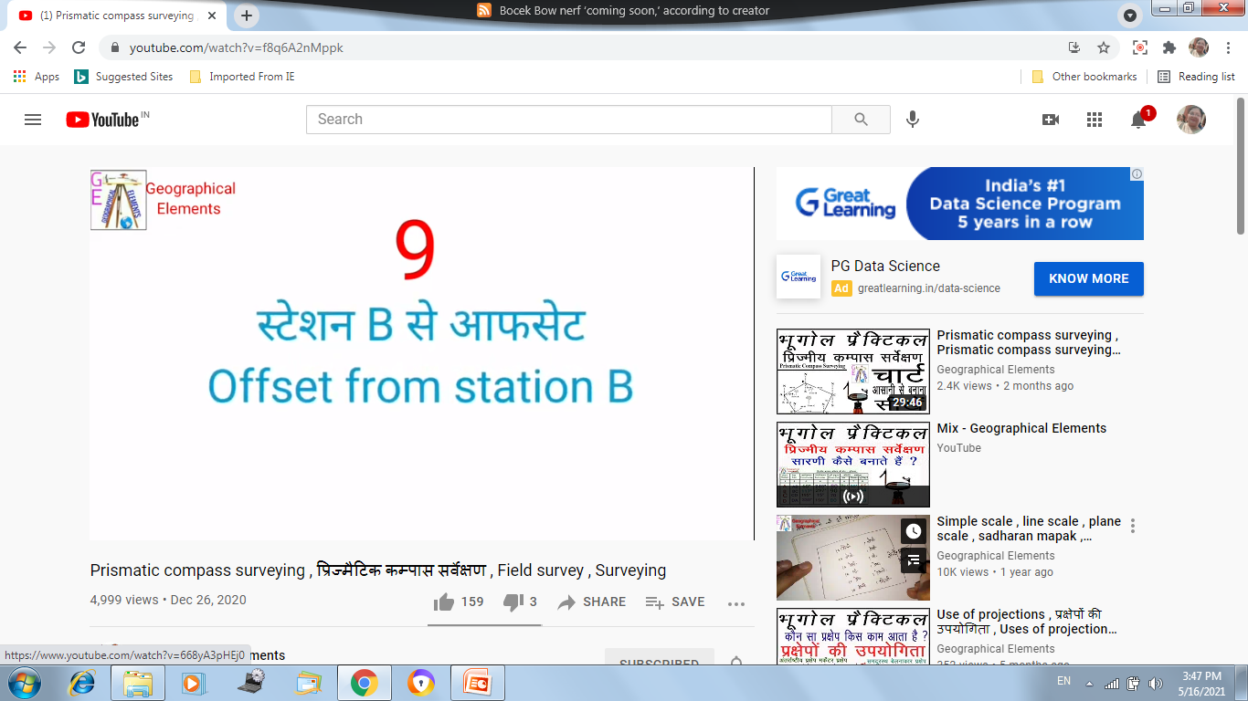
Station | Distacen | Forword Bearing | Back Bearing | Offset
 |  |  |  |  | Bearing
 |  |  |  | Name | Forword | Back
AB | 10 | 70° | 250° | TREE | 60° | 240°
BC | 15 | 110° | 290° | WALL | 70° | 250°
Intersection Method
A
B

Slide 4
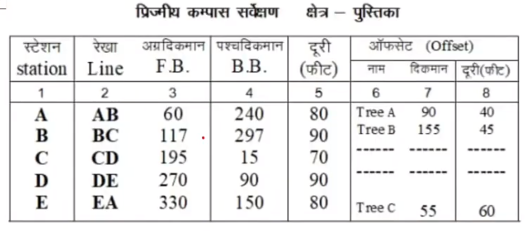
PS

Slide 5
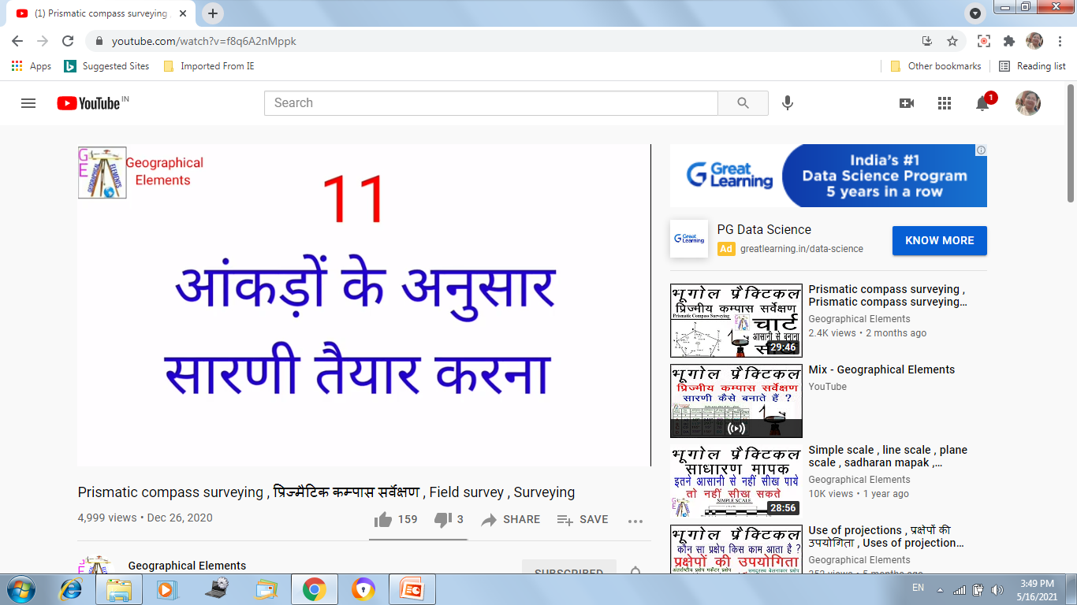
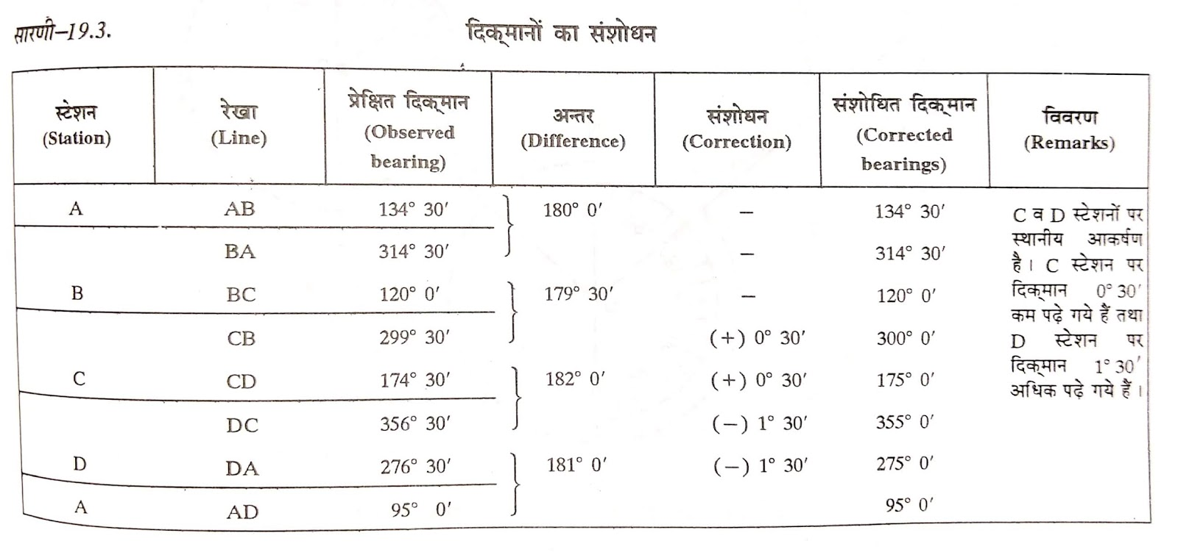
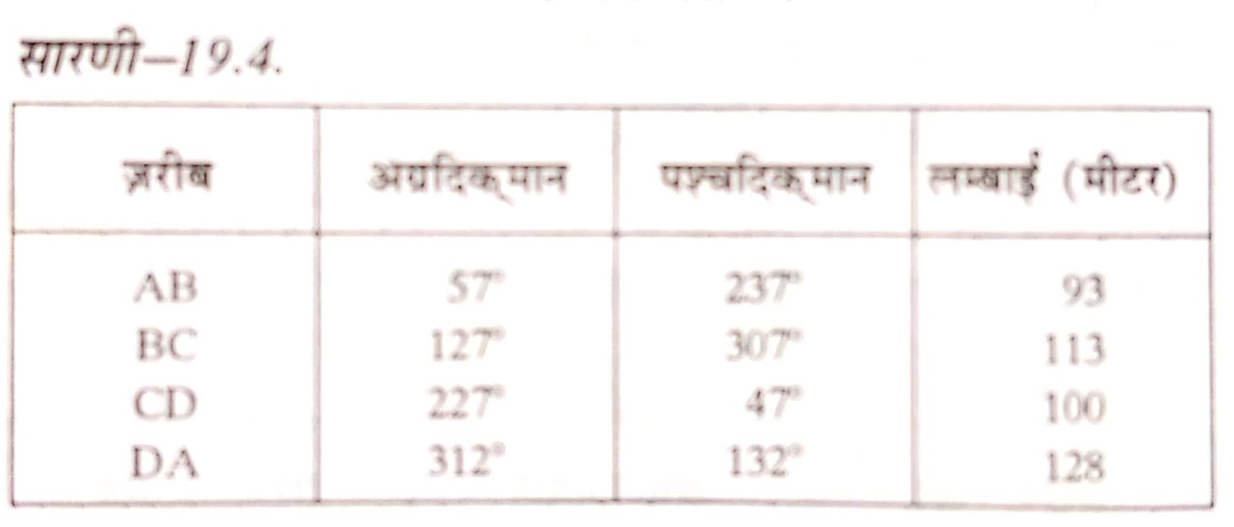

Slide 6
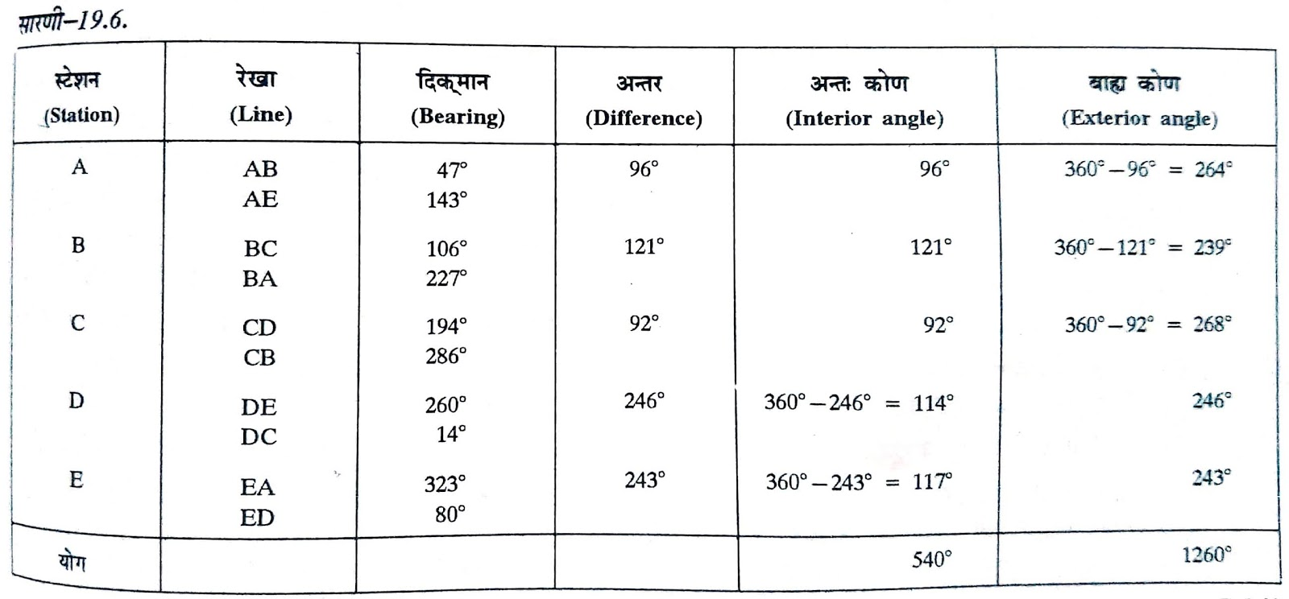
PS

Slide 7
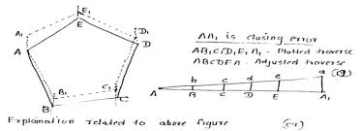
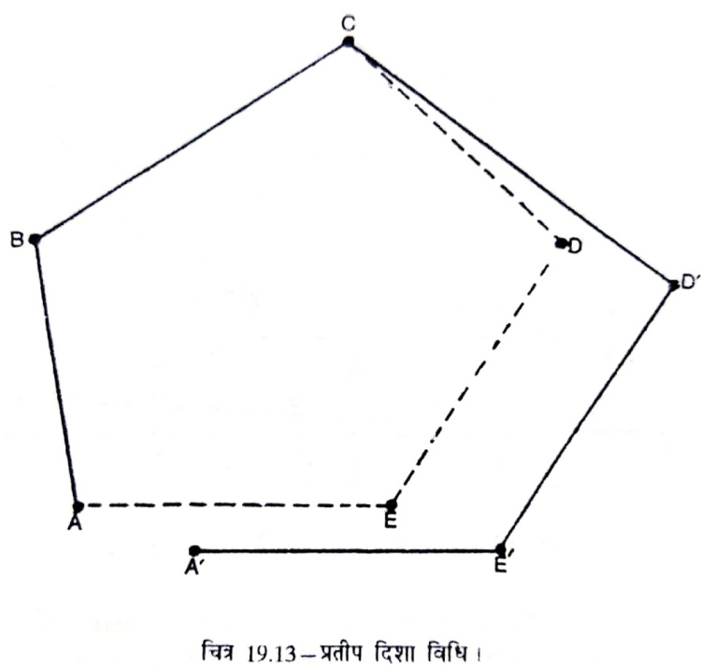
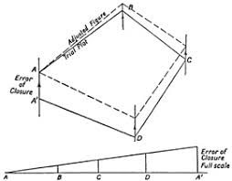
PS

Slide 8
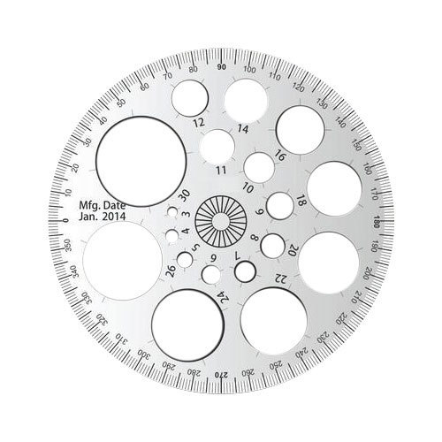
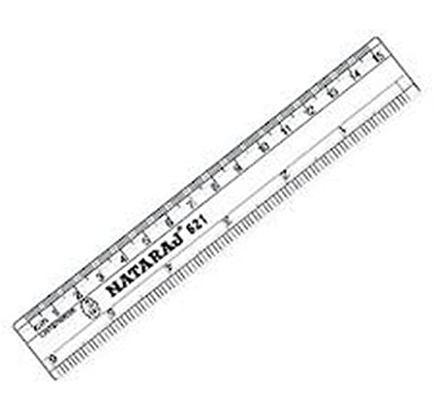
PS
.

Slide 9

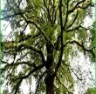
Methods of Prismatic Compass Survey
PS
Radiation Method
.
.
.
A
INDEX
TREE
WALL
TREE
POLE
.
.
1;200

Slide 10
Methods of Prismatic Compass Survey
PS
Intersection Method
.
.

Slide 11
Methods of Prismatic Compass Survey
PS
Traverse (Open ) Method
B
A
C

Slide 12
Methods of Prismatic Compass Survey
PS
Traverse (Closed) Method
Traverse Adjustment - Bowditch method
N
B
C
A
A’
D
E
1:500
M5 5M
A
B
C
D
E
A’

Slide 13
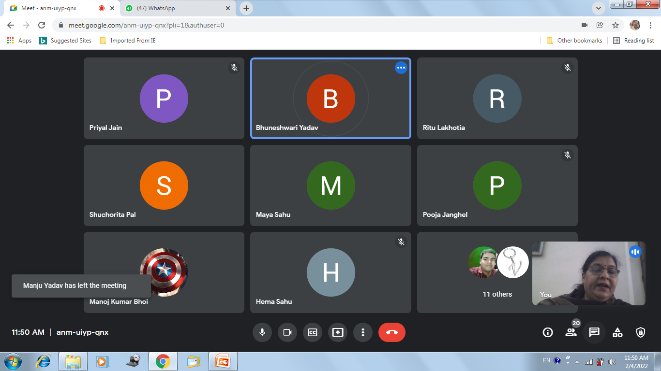


Slide 14
