Slide 1

SOCIAL PSYCHOLOGY
Science of human interactions and social environment.
Dr. Shankuntala Dulhani
Assistant Professor
Department Of Psychology
Durga Mahavidyalaya Raipur

Slide 2
INTRODUCTION TO
SOCIAL PSYCHOLOGY
B.A. Part 2
Paper 1 – Unit 1

Slide 3
INTRODUCTION TO
SOCIAL PSYCHOLOGY
Social psychology is the scientific study of how people's thoughts, feelings, and behaviors are influenced by the actual, imagined, or implied presence of others.
It focuses on understanding how people interact with one another, how they form attitudes and beliefs, how they make decisions, and how they behave in groups.
In essence, social psychology seeks to understand the complex interplay between individual and social factors that influence human behavior and social interactions.

Slide 4

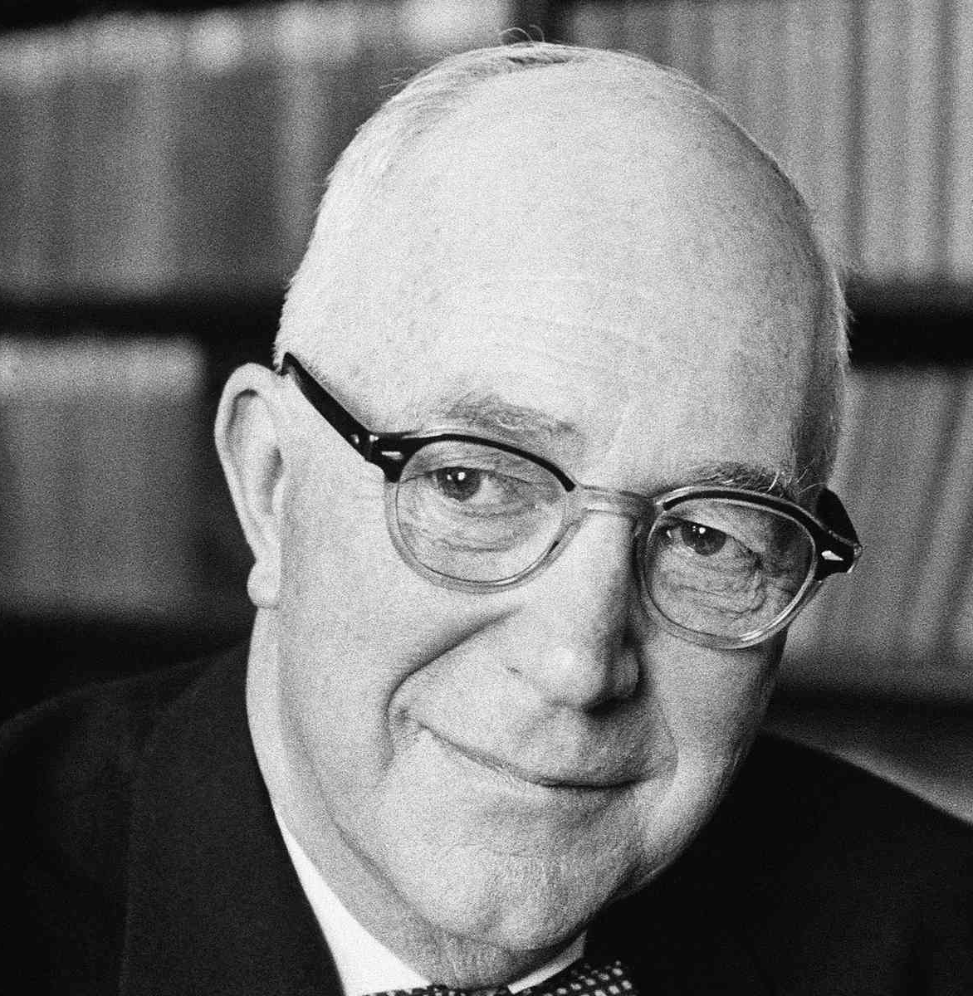
DEFINITIONS
"Social psychology is the scientific study of how people think about, influence, and relate to one another.“
- Elliot Aronson
"Social psychology is the scientific study of the ways in
which people's thoughts, feelings, and behaviors are influenced
by the real or imagined presence of other people.“
- Gordon Allport

Slide 5



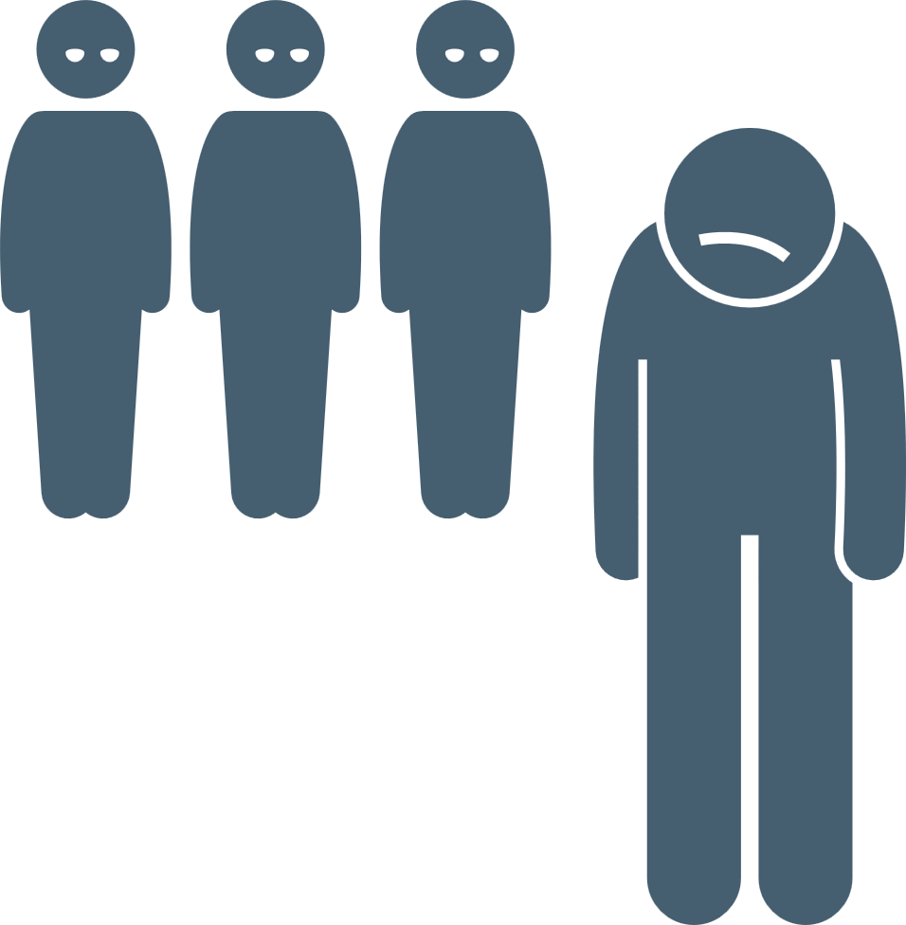

AREAS OF STUDY WITHIN
SOCIAL PSYCHOLOGY
SOCIAL PERCEPTION
ATTITUDE
SOCIAL INFLUENCE
PREJUDICE AND DISCRIMINATION
INTERPERSONAL RELATIONSHIPS
AGGRESSION

Slide 6
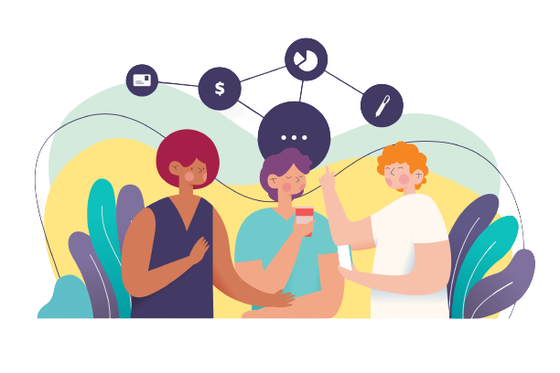
01
SOCIAL PERCEPTION

Slide 7
WHAT IS
SOCIAL PERCEPTION?
Social perception refers to the process through which individuals interpret, understand, and make sense of the social world and the people in it.

Slide 8




HOW INDIVIDUALS PERCEIVE, INTERPRET, AND MAKE SENSE OF SOCIAL INFORMATION:
Interpretation based on
personal experiences, cultural
norms, and social background.
These interpretations and
judgements then influence their
social interactions and relationships.
Observing and interpreting social clues such as expressions, body language, tone of voice.

Slide 9


02
ATTITUDE

Slide 10

Attitude in social psychology refers to a person’s evaluation, beliefs, feelings, and predisposition towards a particular object, person, group, idea, or situation.
It reflects an individual's overall positive or negative stance, influencing their behaviour, perceptions, and interactions in various social contexts.

Slide 11
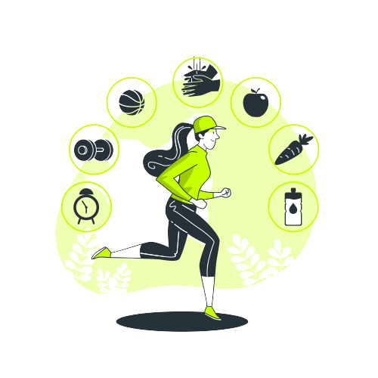

ROLE OF ATTITUDE IN SHAPING BEHAVIOUR
Environmental Conservation:
Attitude: Someone holds a strong pro-environmental attitude, believing in the importance of conserving resources.
Behaviour: They actively participate in recycling, reducing waste, and using eco-friendly products.
Health-related Behaviour:
Attitude: A person has a positive attitude towards regular exercise and healthy eating.
Behaviour: They consistently engage in physical activity and make nutritious food choices.

Slide 12
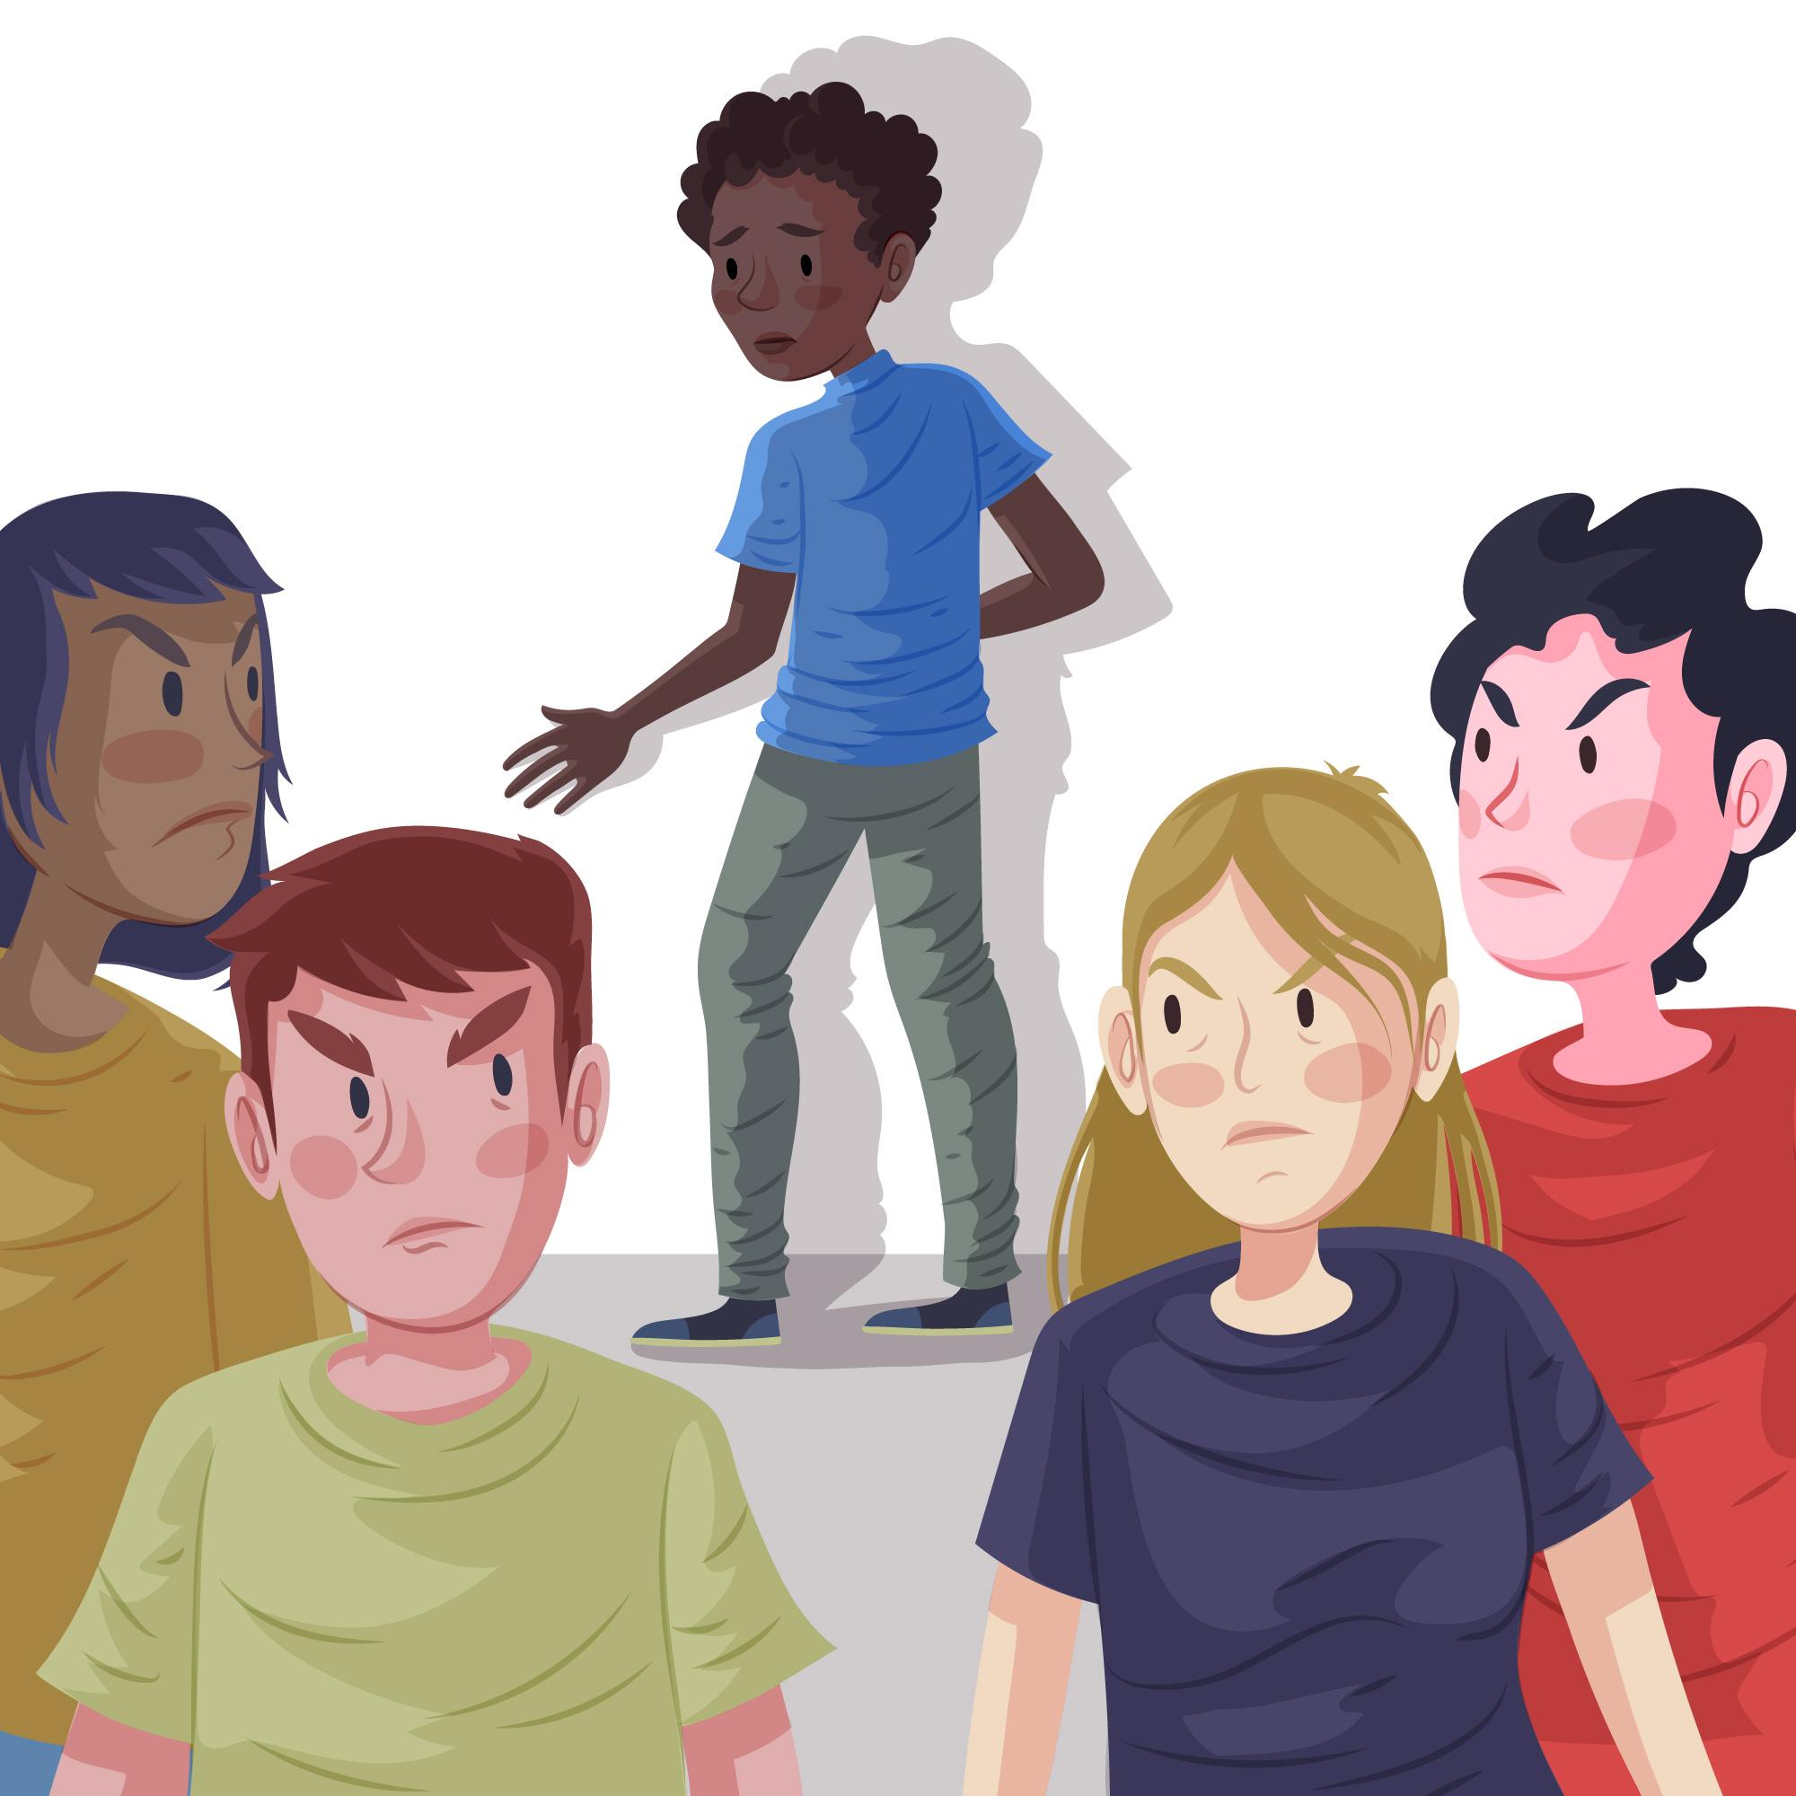

ROLE OF ATTITUDE IN SHAPING BEHAVIOUR
Risky Behavior:
Attitude: An individual has a carefree and adventurous attitude towards risky activities.
Behaviour: They may engage in activities like extreme sports without much consideration for safety.
Prejudice and Discrimination:
Attitude: A person possesses negative attitudes towards a certain racial or ethnic group.
Behaviour: They may avoid interacting with members of that group or display discriminatory behaviour.

Slide 13
03
SOCIAL INFLUENCE

Slide 14

Social influence in social psychology refers to the process through which individuals' thoughts, feelings, or behaviors are influenced by the presence, actions, or opinions of others.
WHAT IS
SOCIAL INFLUENCE?

Slide 15
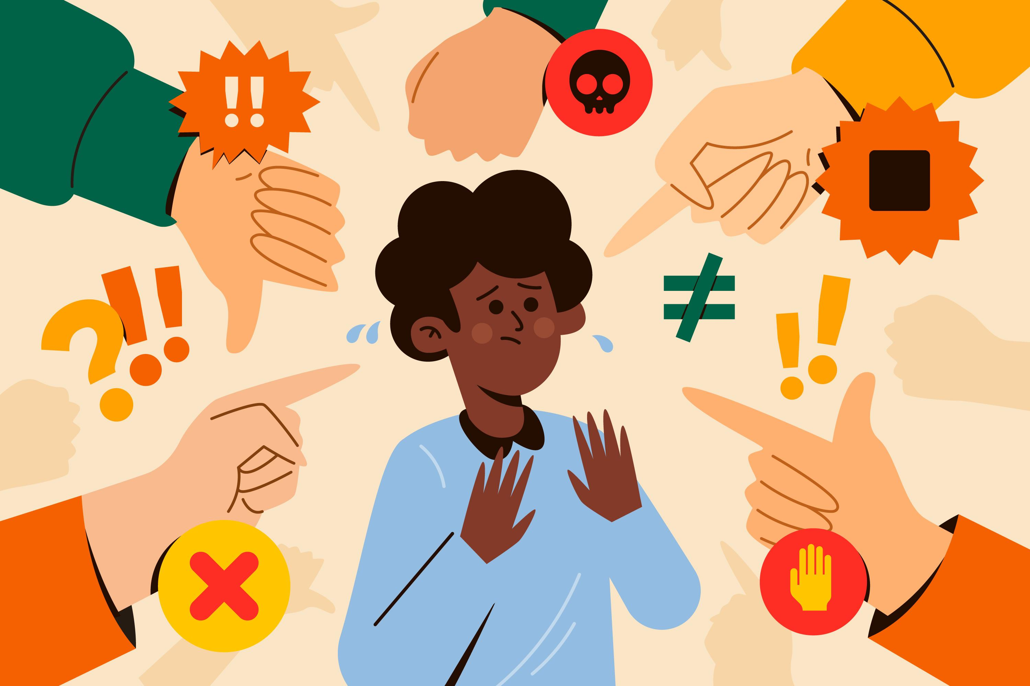
PREJUDICE AND DISCRIMINATION
04

Slide 16

Socialization Categorization Social Identity
Fear and Threat Cognitive Biases Social Norms
Intergroup Conflict Media Influence Historical/Cultural Factors
ORIGIN OF
PREJUDICE AND DISCRIMINATION

Slide 17



Ways to Reduce
PREJUDICE AND DISCRIMINATION
Education and Awareness:
Media Representation:
Open Dialogue:
Promote education about diverse cultures, histories, and perspectives to challenge stereotypes and broaden understanding.
Support media content that promotes tolerance and inclusivity.
Create safe spaces for open dialogue where individuals can discuss their experiences and address misunderstandings.

Slide 18

INTERPERSONAL
RELATIONSHIPS
05

Slide 19
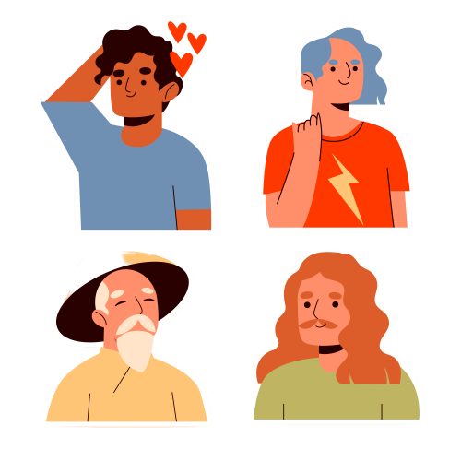
Interpersonal relationships in social psychology refer to the connections, interactions, and bonds formed between individuals.
These relationships play a crucial role in shaping our thoughts, emotions, behaviors, and overall well-being.
INTERPERSONAL RELATIONSHIPS
These relationships play a crucial role in shaping our thoughts, emotions, behaviors, and overall well-being.

Slide 20
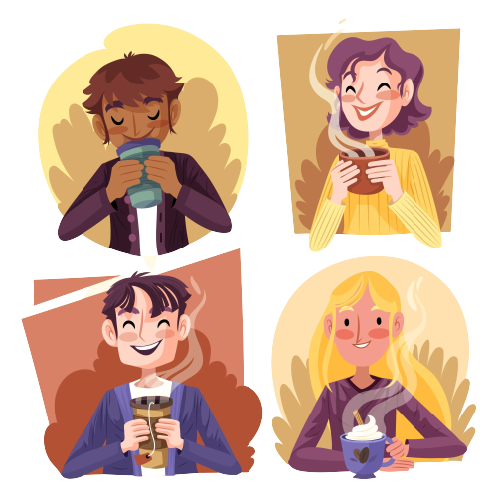
ASPECTS OF INTERPERSONAL RELATIONSHIPS
Attraction and Relationships Formation
Interpersonal Communication
Interdependence and Cooperation
Conflict and Resolution
Social Influence in Relationships

Slide 21


AGGRESSION
06

Slide 22
CAUSES AND CONSEQUENCES OF AGGRESSION
CAUSES
Biological Factors
Environmental Triggers
Social Provocation
Cognitive Factors
CONSEQUENCES
Harm to Others
Social Rejection
Legal Consequences
Cycle of Violence

Slide 23

PREVENTION AND INTERVENTION
01.
02.
03.
Conflict Resolution Techniques
Anger Management
Positive Communication Skills

Slide 24
THANK
YOU!

