Slide 1
Name : Dr. Sanjib Pramanik
Name of the College : Durga College, Raipur (C.G.), India
Name of the Faculty : Arts
Designation : Assistant Professor, Department of Geography
Topic : Use of Internet in Geography
Date : 27/02/2024

Slide 2
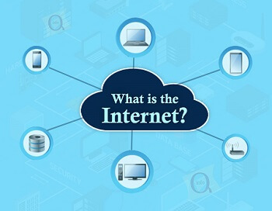
INTRODUCTION
The Internet is a vast network that connects computers all over the world.
Through the Internet, people can share information and communicate from anywhere with an Internet connection.

Slide 3
What is a Domain?
A domain is a network of computers and devices that are controlled by one set authority and have specific guidelines.
More specifically, a domain is controlled by one particular company that has its own internet presence and IP address.
The domain is labeled by its domain name, such as www.wikipedia.com.
the maximum length a domain name can be is 63 characters and the minimum length can be one character.
Examples of popular domain names are “youtube.com”, “irs.gov”, and “tiktok.com” etc.

Slide 4
What is a domain name?
A domain name is a string of text that maps to an alphanumeric IP address, used to access a website from client software.
In plain English, a domain name is the text that a user types into a browser window to reach a particular website. For instance, the domain name for Google is ‘google.com’.

Slide 5
What does a domain look like?
A domain typically consists of two or three words separated by dots. For example, blog.hubspot.com is a domain.
A domain is one part of a complete web address, or URL. A URL typically consists of a protocol, domain name, and path. For example, the URL of this blog post is:
https://blog.hubspot.com/service/what-is-a-domain.
domain name
It’s made up of the following parts:
https://blog.hubspot.com/website/what-is-a-domain
Sub domain
Top-level domain
Path
Protocol
Second-level domain
Subdirectory

Slide 6
The Parts of a Domain Name
1. Second-Level Domain (SLD)
The second-level domain is the unique identifier for your website. It’s the part of your domain that comes before “.com” or another extension.
If you’re building a website for your business, consider buying a domain that reflects your business’s name. This will make it easier for people to find your website without needing to spend a lot of time scouring Google for it. For instance, hubspot.com’s second-level domain is “hubspot”.
2. Top-Level Domain (TLD)
The top-level domain is the extension, or the part of your domain that comes after your second-level domain.
It specifies what type of entity your organization registers as on the internet. For example, HubSpot’s top-level domain is “.com” since we’re a commercial entity in the United States.
Parts
Second-Level Domain (SLD)
Top-Level Domain (TLD)

Slide 7
Types of Domain
Top-Level Domains (gTLD)
Country Code Top-Level Domains (ccTLD)
Internationalized Country Code Top-Level Domains (IDN ccTLD)
1. TOP-Level Generic Domain
.com : The .com domain extension in a URL stands for "commercial." It's the most widely recognized and commonly used top-level domain (TLD).
.net : . net is a top-level domain, also known as a TLD. Derived from the word network, it was originally developed for companies involved in networking technology.
.edu : Edu domain was originally intended for educational institutions anywhere in the world.
.mil : The . mil top level domain is reserved exclusively for United State Department of Defense organizations.
.int : This domain is a specialized domain offering registrations solely to intergovernmental organisations.
.gov : . gov is one of the original six top-level domains, defined in RFC 920. Though “originally intended for any kind of government office or agency”, only U.S.-based government entities may register .
.org : The . org domain extension in a website URL stands for "organization." Originally intended for non-profit organizations.
.info
2. Country Code Top-Level Domains (ccTLD)
These two-letter TLDs refer to specific geographical locations. Here are the most common ones:
.cn (China)
.ru (Russia)
.de (Germany)
.br (Brazil)
.au (Australia)
.uk (United Kingdom)
.nl (Netherlands)
3. Internationalized Country Code Top-Level Domains (IDN ccTLD)
These are domains that can be displayed in non-Latin character sets (e.g. Chinese).

Slide 8
Who manages domain names?
Domain names are all managed by domain registries, which delegate the reservation of domain names to registrars.
Anyone who wants to create a website can register a domain name with a registrar, and there are currently over 300 million registered domain names.

Slide 9
What is the difference between a domain name and a URL?
The uniform resource locator (URL) is a string of information providing the complete address of the web page on the internet.
Whereas domain name is a part of URL which is user – friendly from of IP address.
For example, in the URL ‘https://cloudflare.com/learning/’, ‘cloudflare.com’ is the domain name, while ‘https’ is the protocol and ‘/learning/’ is the path to a specific page on the website.

Slide 10
Available Services on internet
World Wide Web (www): The World Wide Web is a system of interlinked hypertext documents that are accessed through the internet. It is the most popular and widely used internet tool today. It allows users to access information, conduct research, purchase products, and interact with others through various websites.
E-mail: An email is a tool that allows users to send and receive messages electronically. It is one of the oldest and most widely used internet tools. Email is used for personal and professional communication, as well as for marketing and advertising purposes. It is an efficient and cost-effective way to communicate with others over long distances.
Telnet: Telnet is a protocol that allows users to access and manage remote computers over the internet. It is commonly used by system administrators to manage servers and network devices. Telnet allows users to execute commands and perform administrative tasks on remote computers without physically being present.
Gopher: Gopher is a protocol that allows users to access and search for information on the internet. It was popular in the early days of the internet but has since been replaced by the World Wide Web. Gopher is still used by some users for specific purposes, such as accessing library catalogs and scientific databases.
Internet Messaging: Internet messaging refers to the use of messaging apps and platforms to communicate with others over the internet. Some popular internet messaging platforms include WhatsApp, Facebook Messenger, and Signal. Internet messaging is used for personal and professional communication, as well as for marketing and advertising purposes.
Video Conferencing: Video conferencing allows users to communicate with others in real time using video and audio technology. It is commonly used for remote meetings, interviews, and job interviews. Video conferencing has become increasingly popular in recent years due to the COVID-19 pandemic and the rise of remote work.
File Transfer Protocol (FTP): FTP is a protocol that allows users to transfer files between computers over the internet. It is commonly used by web developers to upload and download files to and from web servers. FTP is also used for file sharing and collaboration purposes.
Voice over Internet Protocol (VOIP): VOIP is a technology that allows users to make voice and video calls over the internet. It is commonly used for personal and professional communication, as well as for customer service and support purposes. VOIP is an efficient and cost-effective way to communicate with others over long distances.
Hypertext Transfer Protocol (HTTP): HTTP is a protocol that allows web browsers to communicate with web servers. It is used to request and receive web pages and other resources from web servers. HTTP is the foundation of the World Wide Web and is essential for accessing and using websites.
Simple Mail Transfer Protocol (SMTP): SMTP is a protocol that is used to send and receive email messages over the internet.
Chat Programs: Chat programs are tools that allow users to communicate with others in real-time using text, audio, and video technology. Some popular chat programs include WhatsApp, Facebook Messenger, and Slack. Chat programs are used for personal and professional communication, as well as for collaboration and project management purposes.

Slide 11
Essential computer hardware and software for internet
Hardware
Microprocessor: memory power of minimum i486.
RAM: memory power of minimum 32 megabyte.
Hard Disc: memory power of minimum 200 megabyte.
Monitor: Colour monitor with MPEG display card.
Multimedia Kit: CD, DVD ROM drive, speaker and mike.
Modem: minimum 56 kb/s.
Point Device: Scroll mouse.
Software
Operating System: windows 95, windows 8 or any other web browser.
Internet Browser: Internet Explore, Google Chrome or any other internet browser.
Internet Connection: internet connection or telephone network like BSNL, MTNL, Reliance, Airtel etc.

Slide 12
Internet Tools
Browser: programme like Picture, Tex, Music, Graphics etc.
Search engine: with the help of search engine we have to go another website and to find fruitful information.
Social networking site: facebook, twitter, orkut etc.

Slide 13
History and development of the Internet
1958 – Founding of the ARPA
In this year, the Advanced Research Projects Agency Network was founded.
This organisation was made up of some 200 scientists and its aim was to create direct communications between computers.
1967 – ARPANET is born
This year saw the first connection between computers at Stanford and UCLA. ARPANET was a computer network that brought together the best ideas from teams at the Massachusetts Institute of Technology (MIT), the National Physics Laboratory (NPL) and the Rand Corporation (RC).
1980 – HTML language, URL and HTTP
Tim Berners-Lee joined the European Organisation for Nuclear Research (CERN) that year as a software engineer. In 1989 he presented a solution to the problems of data loss thanks to a distributed hypertext system.
By 1990, Berners-Lee had developed three technologies: HTML, URLs and the hypertext transfer protocol HTTP.
1982 – First virus
Although there were earlier virus cases, the virus created by Rich Skrenta is considered the first. The 15-year-old student programmed the so-called Elk Cloner for the Apple II, the first computer virus to have a real spread.
Today, Rich is a Silicon Valley entrepreneur who created the web search engine Blekko.
1994 – The first search engine and the first online shops
The first full-text search engine was WebCrawler. Unlike its predecessors, it allowed users to perform a keyword search on any website. In addition, Yahoo!, Excite, Infoseek, Inktomi, Northern Light and Altavista were also launched that year.
Although the first online sales are said to have taken place on the Net Market service, in reality it was not until 1994 that the first online shops, including Amazon and eBay, were launched.

Slide 14
Cont…
1996 – Google
Larry Page and Sergey Brin launched today’s quintessential search engine: Google. The initial project was called BackRub, as that was the name of the technology they used.
Google based the operation of its search engine on the relevance of the contents of each web page for the users themselves. In other words, it prioritised those results that users considered most relevant to a specific topic. To do so, it patented its famous PageRank, a series of algorithms that assess the relevance of a website by assigning it a score from 0 to 10.
2004 – Social networks
The 21st century began with the creation of Wikipedia, Safari, MySpace, LinkedIn, Skype and WordPress. However, it was not until 2004 that Facebook, Vimeo, Flickr and Gmail appeared.
2005 – YouTube
2006 – Twitter
2008 – Google Chrome
2010 – Instagram and Pinterest
2011 – Snapchat
2016 – TikTok
Present
In Spain alone, there are currently 40.7 million social network users, equivalent to 87.1% of the Spanish population. In addition, 44 million use the Internet daily for an average of 6 hours.

Slide 15
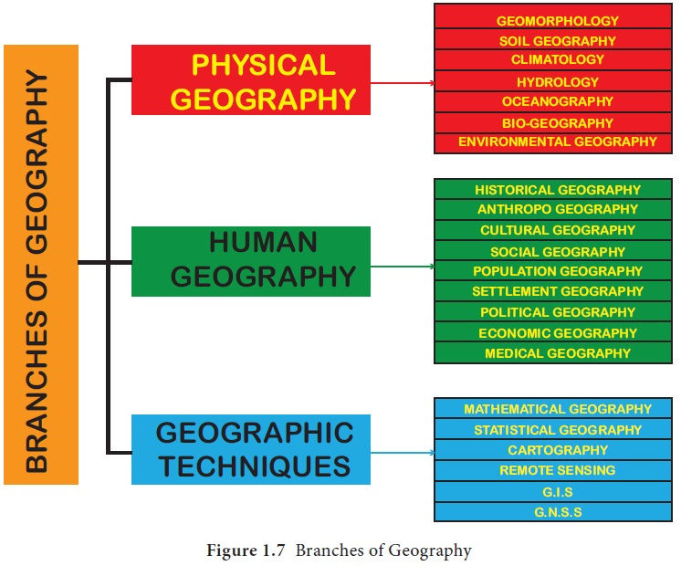
the branches of geography and Use of internet

Slide 16
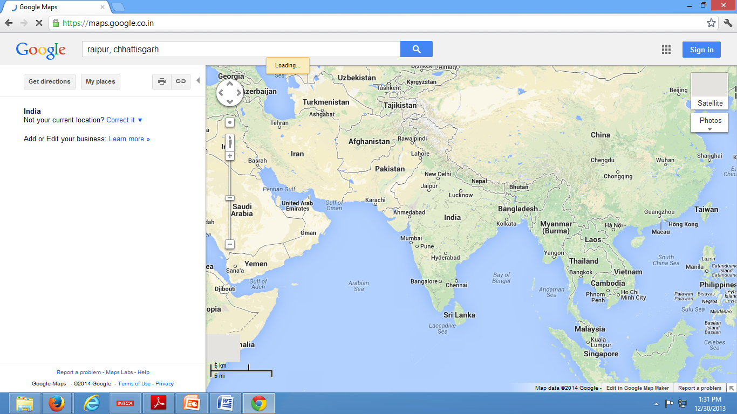
Geomorphology
DEM (Digital Elevation Model)

Slide 17
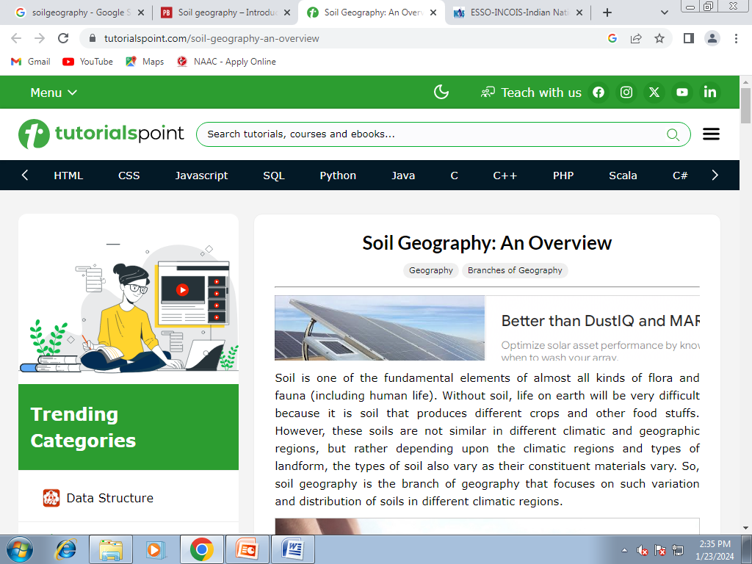
Soil Geography
https://www.tutorialspoint.com/soil-geography-an-overview

Slide 18
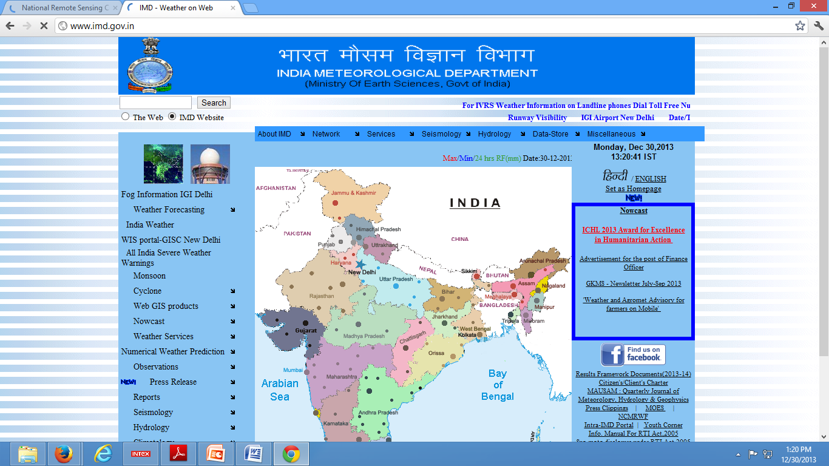
Climatology
www.imd.gov.in

Slide 19
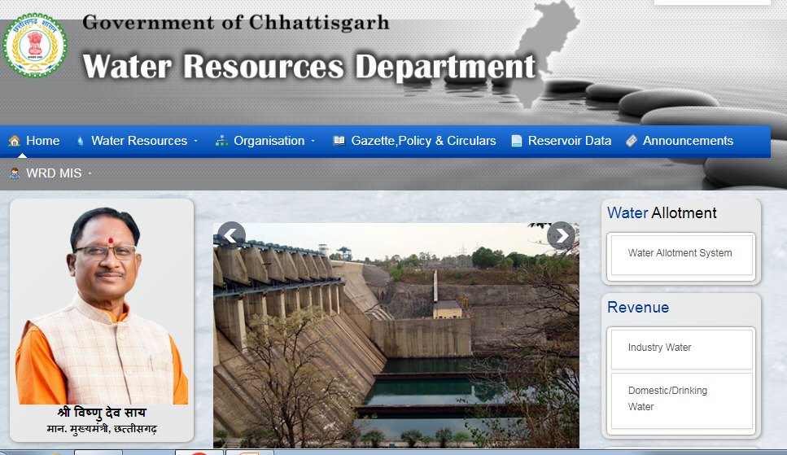
Hydrology
www.cgwrd.in

Slide 20
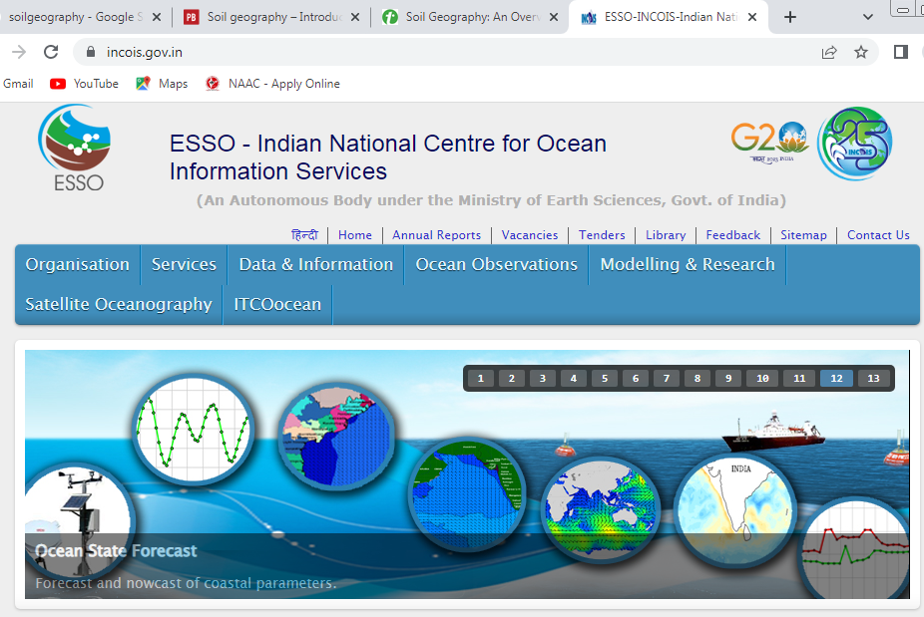
Oceanography
www.incois.gov.in

Slide 21
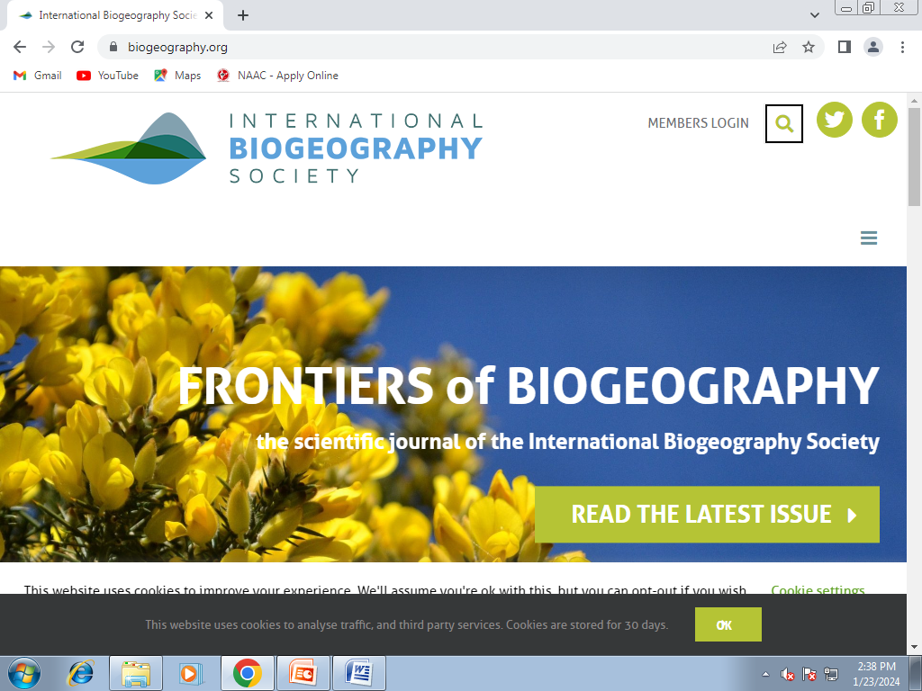
Bio-geography
www.biogeography.org

Slide 22
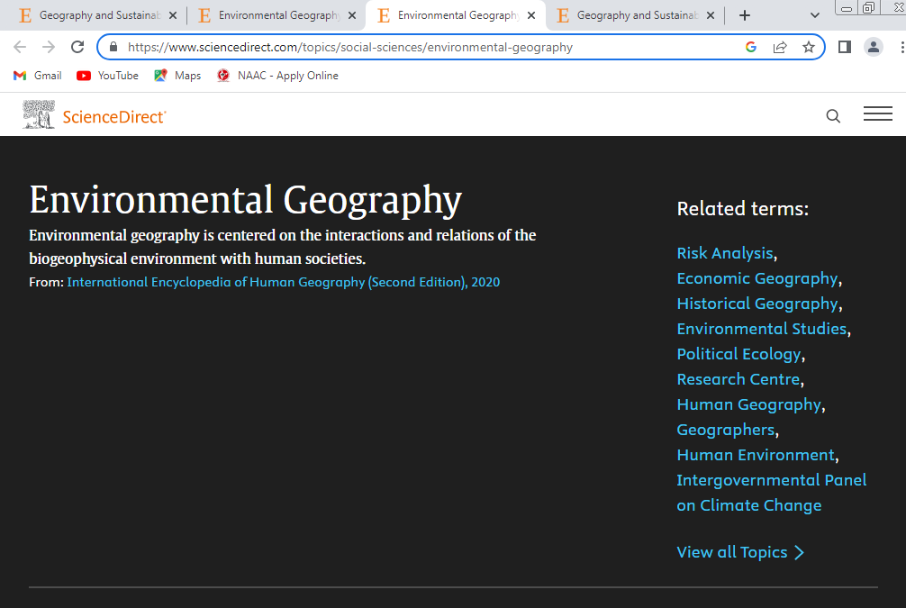
Environmental geography
https://www.sciencedirect.com/topics/social-sciences/environmental-geography

Slide 23
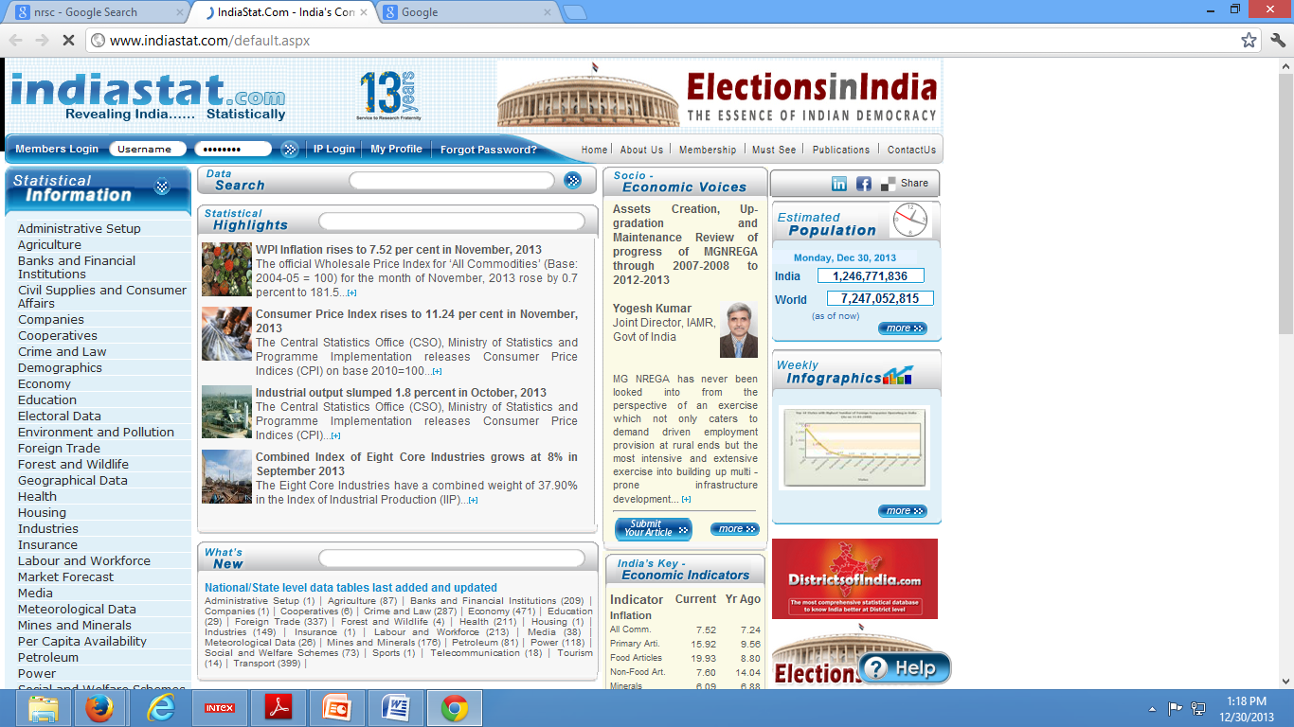
Socio-economical Geography
www.indiastat.com

Slide 24
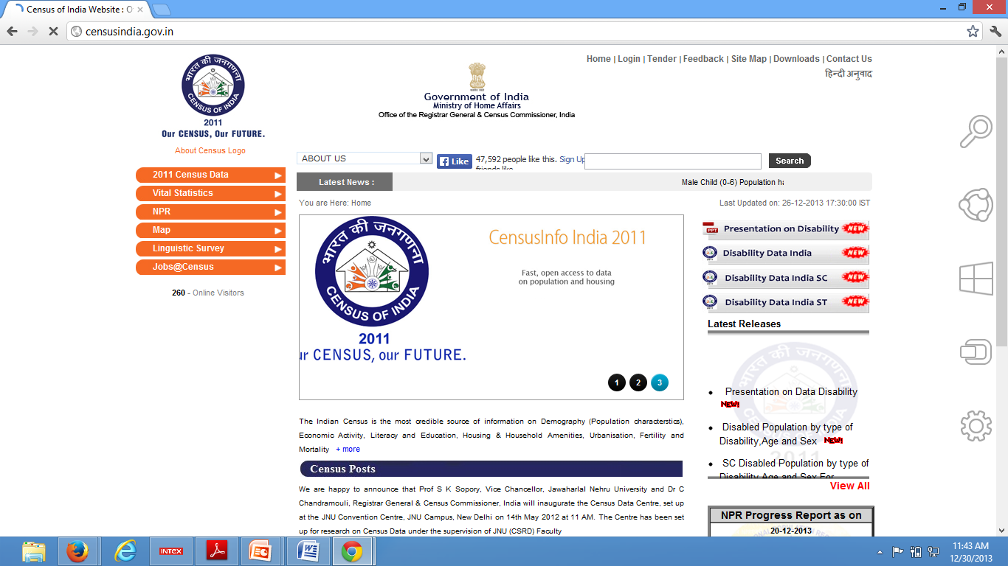
Population Geography
www.censusindia.gov.in

Slide 25
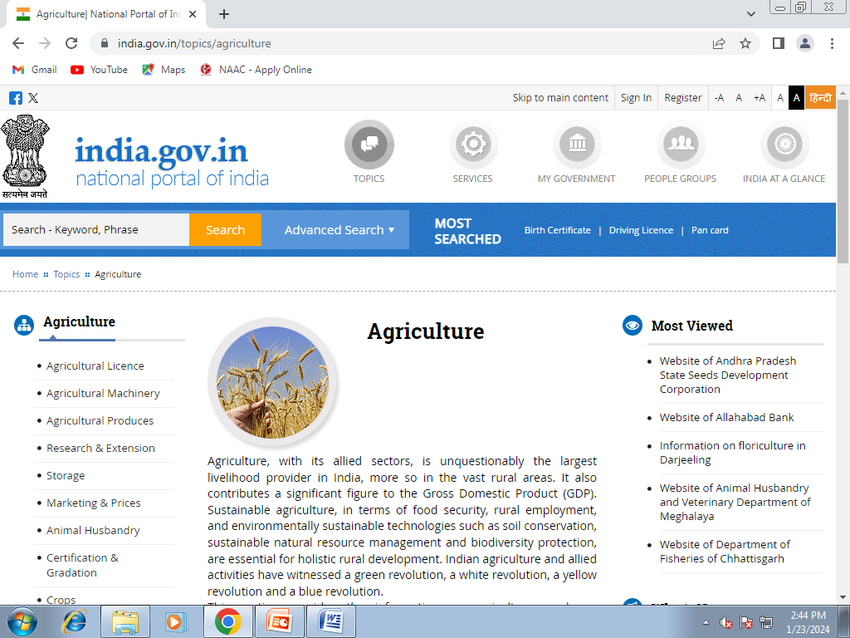
Agriculture geography
https://www.india.gov.in/topics/agriculture

Slide 26
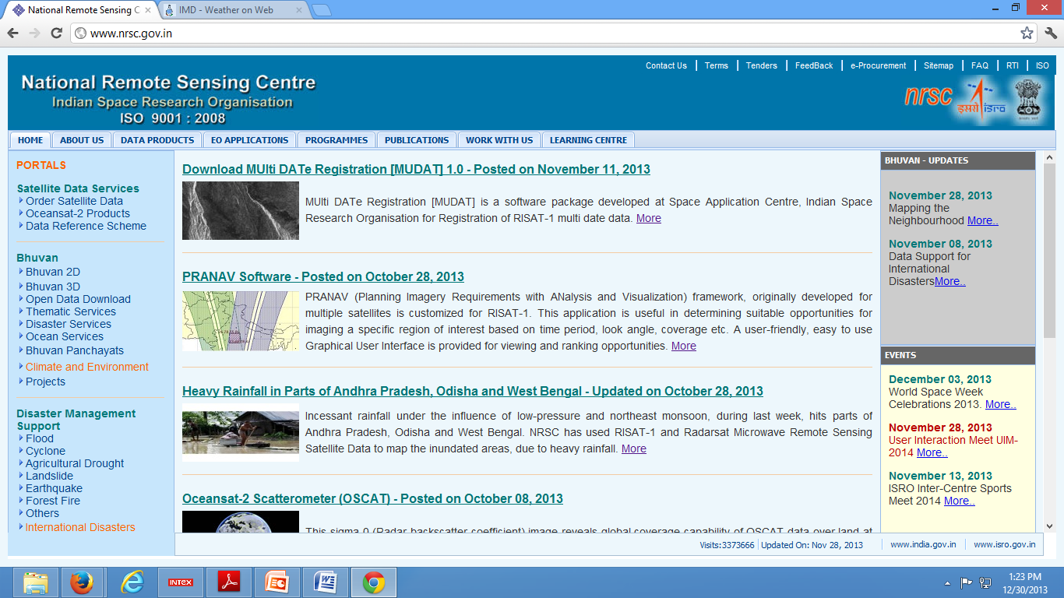
Remote sensing
www.nrsc.gov.in

Slide 27
Use of internet in geographical research
Use of Internet in Geographical Research
Research Journal
PPT
E-Book
World Level Article
E-content of the Topic/Subject
Research Components/Materials

Slide 28
Important of internet in geography
Quick search of information.
Very easy way to receiving and sending messages through internet.
To know the information of production and distribution.
To save time.
Very effective and more cheapest way to displaying map.
Earth is a dynamic so the socio-economical as well as physical facts and figures are changing very first. We have know this changing facts by internet.

Slide 29
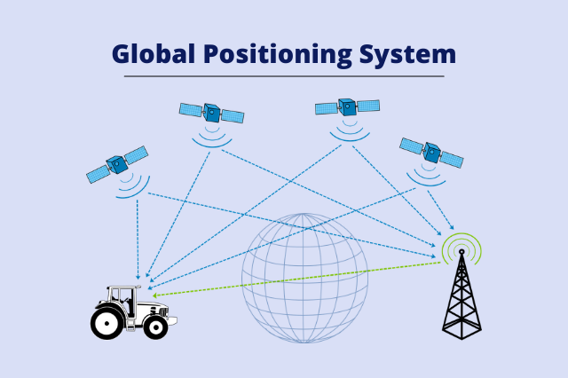
Future of geography on internet
The core assumption of Internet geography is that the location of servers, websites, data, services, and infrastructure is key to understand the development and the dynamics of the Internet. Among the topics covered by this discipline, of particular importance are information geography and digital divides.
The Global Spatial Data Infrastructure Association
GSDI’s final contribution to its mission ‘to advance geo-information best practices, knowledge sharing and capacity building for the improved sharing and applications of geographic information’ was the transfer of its residual funds to the United Nations Global Geospatial Information Management program.
Until recently, maps (usually in paper form) have been a mainstay for a wide variety of applications and decision-making. This is changing as more spatially referenced data and information on a wider variety of topics or themes (e.g., population, land use, economic transactions, hydrology, agriculture, climate, soils) are being produced, stored, transferred, manipulated, and analyzed in digital form.
India has, over the past years, produced a rich “base” of map information through systematic topographic surveys, geological surveys, soil surveys, cadastral surveys, various natural resources inventory programmes and the use of the remote sensing images. Further, with the availability of precision, high-resolution satellite images, data enabling by the organisation of Geographical Information System (GIS), combined with the Global Positioning System (GPS), the accuracy and information content of these spatial datasets or maps is extremely high.
Examples of GPS uses
Global Positioning System applications generally fall into 5 major categories:
Location – determining a position
Navigation – getting from one location to another
Tracking – monitoring object or personal movement
Mapping – creating maps of the world
Timing – bringing precise timing to the world

Slide 30
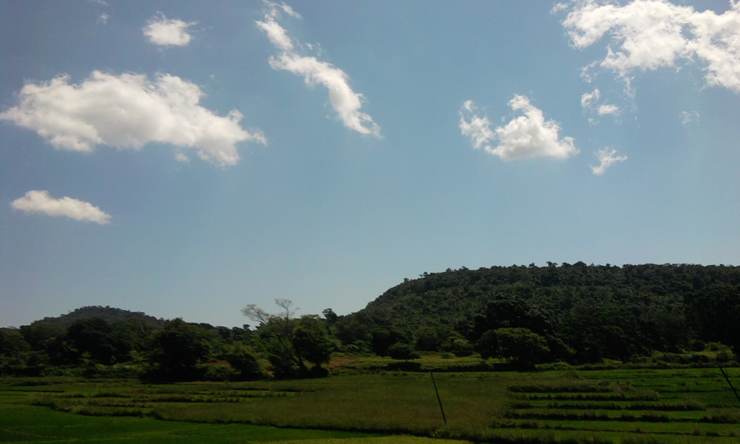
THANKS

