Slide 1
Durga mahavidyalaya
Dr vaseemuddin
Assistant professor
Department of commerce
Cost account topic-methods of wages payment
मजदूरी भुगतान की विधियां

Slide 2
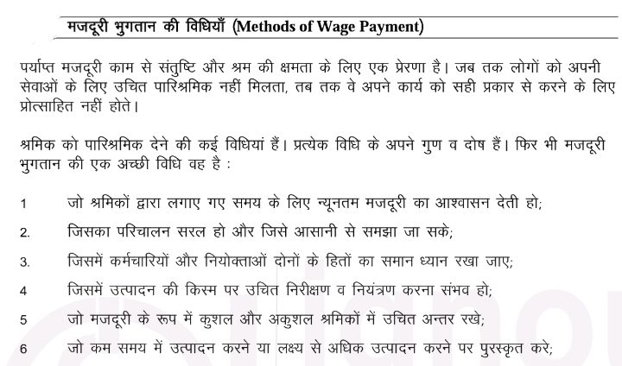

Slide 3
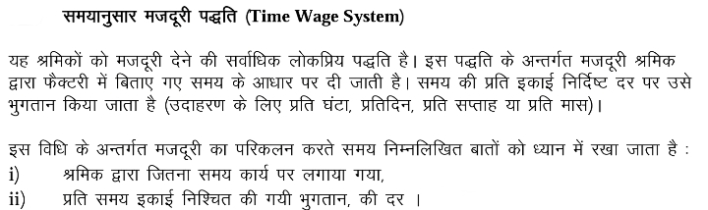
Wages= time taken*rate per hour

Slide 4
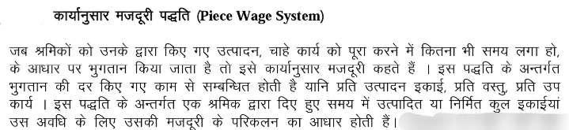
Wages=total unit produced*rate per unit

Slide 5
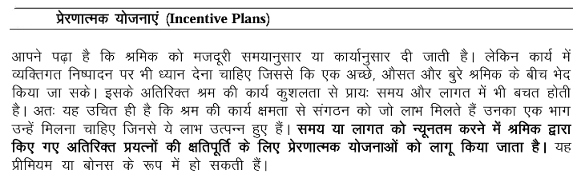

Slide 6
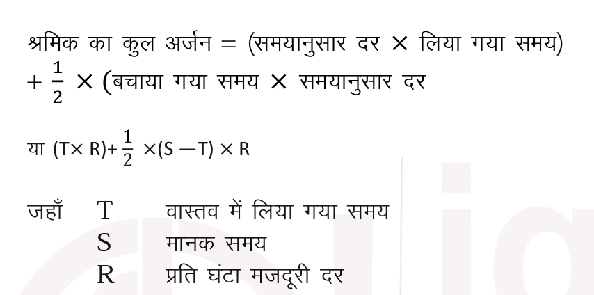
हेल्से प्रीमियम प्लान

Slide 7
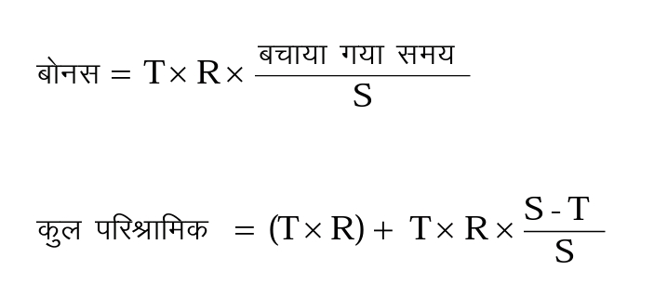
रोवन प्रीमियम प्लान

Slide 8
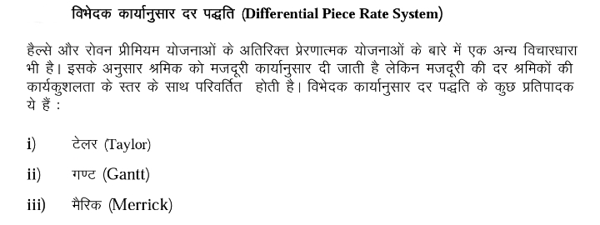

Slide 9
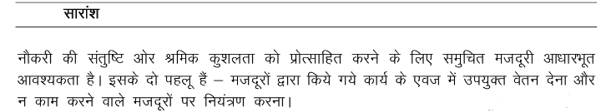
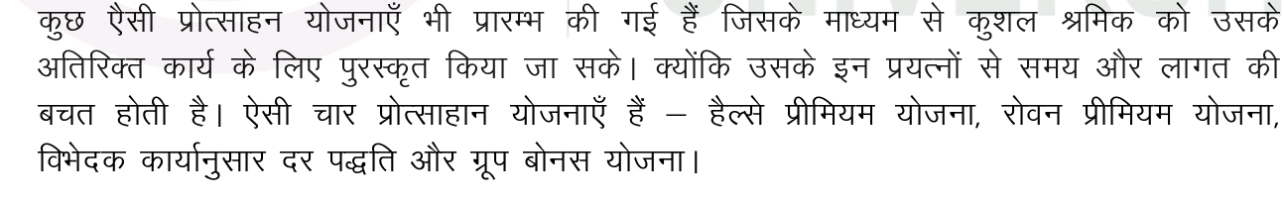

Slide 10
Thank You

