Slide 1

Name : Dr .Purnima Shukla
Name of the College: Durga College, Raipur (C.G.), India
Name of the Faculty: Arts
Designation : H.O.D. , Department of Geography
Topic : Practical Geography
Date : 12/07/2023

Slide 2
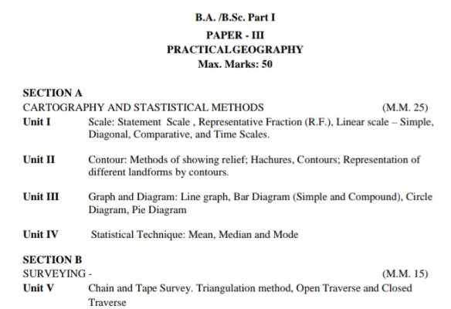

Slide 3
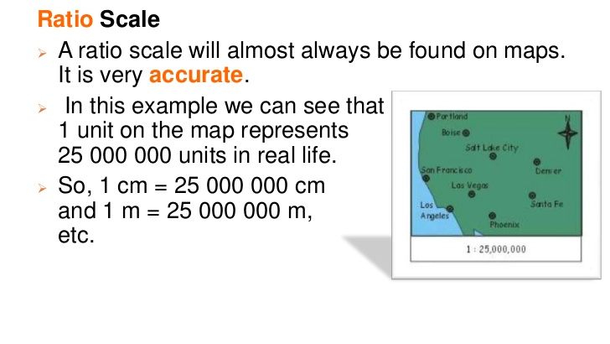
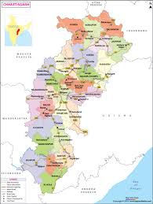
UNIT- 1
3cm

Slide 4
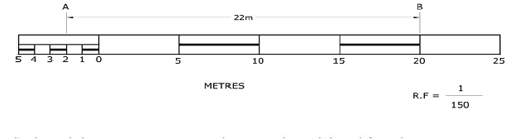
Scale
There are at least three ways in which this relationship can be expressed. These are:
Statement of Scale
2. Representative Fraction (R. F.)
3. Graphical Scale

Slide 5
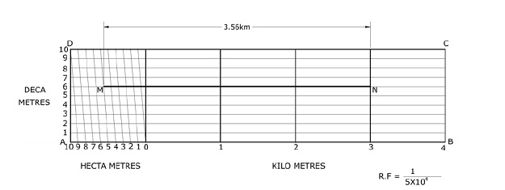
Daigonal Scale

Slide 6
Question 2(ii).
Give one example each of statement of scale in Metric and English system.
Answer:
Metric System of Measurement
1 km = 1000 Metres
1 Metre = 100 Centimetres
1 Centimetre = 10 Millimetres
English System of Measurement
1 Mile = 8 Furlongs
1 Furlong = 220 Yards
1 Yard = 3 feet
1 Foot = 12 Inches.

Slide 7
Question 1(i).
Which one of the following methods of scale is a universal method?
(a) Simple Statement
(b) Representative Fraction
(c) Graphical Scale
(d) None of the above
Answer:
(b) Representative fraction

Slide 8
Question 1(ii).
Map distance in a scale is also known as:
(a) Numerator
(b) Denominator
(c) Statement of Scale
(d) Representative Fraction
Answer:
(a) Numerator

Slide 9
Question 1(iii).
‘Numerator’ in scale represents:
(a) Ground distance
(b) Map distance
(c) Both the distances
(d) None of the above
Answer:
(a) Ground Distance

Slide 10

. Convert the given Statement of Scale into Representative Fraction (R. F.).
Question 3(i)
5 cm represents 10 km
Answer:
Representative Fraction
Distance on Map = 5 cm
Distance on Ground = 10 km
Representative Fraction
= 510
= 12 km or 2,00,000
Therefore representative fraction
= 1 : 2,00,000 cm

Slide 11
Question 3(ii).
2 inches represents 4 miles
Answer:
Representative Fraction
2 inches = 4 miles
therefore, 1 inch = 2 miles (63,360 × 2)
1 inch on map = 1,26,720 inches on ground.
Therefore representative fraction
= 1:1,26, 720

Slide 12
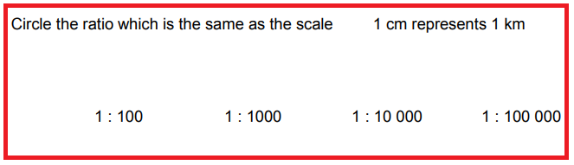
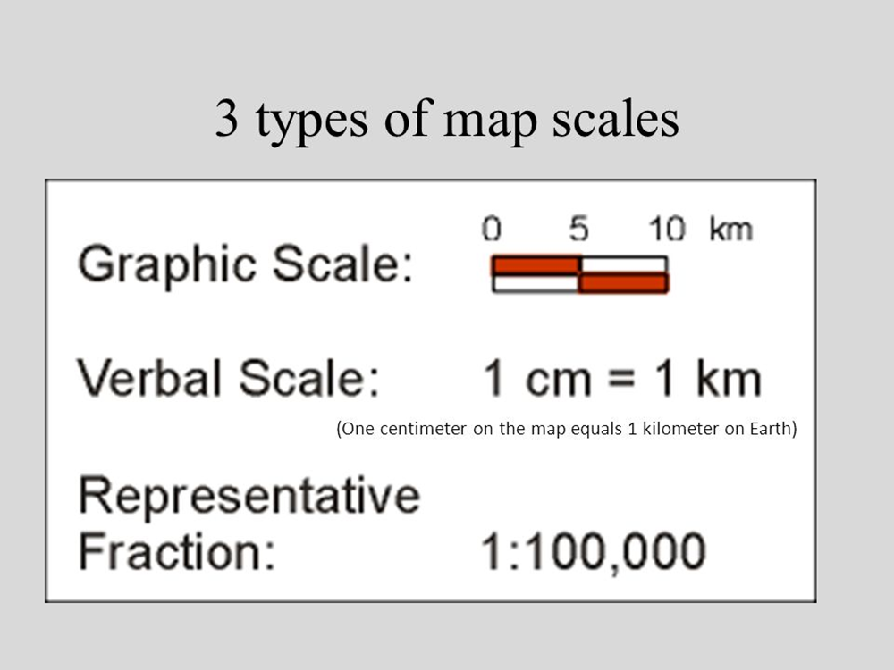

Slide 13
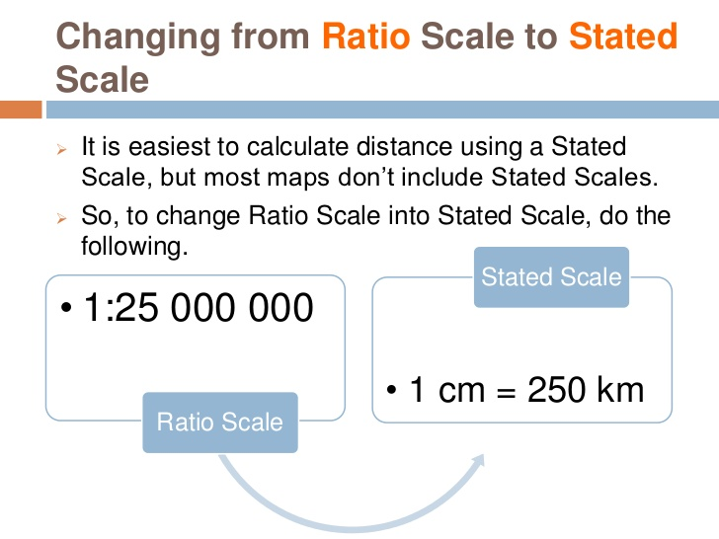

Slide 14
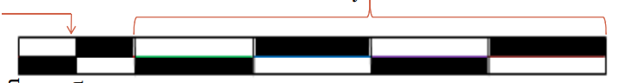
Simple scale

Slide 15
1 cm = 10 km --------- scale
1: 200 ---------- scale

Slide 16
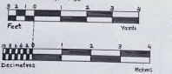
Comparative scale

Slide 17
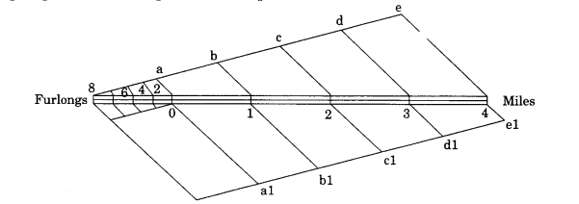

Slide 18
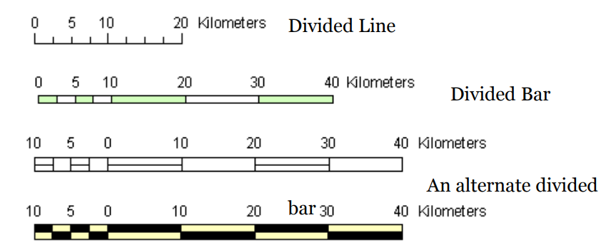

Slide 19
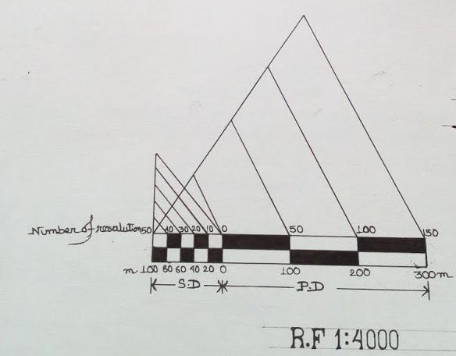
Daigonal Scale

Slide 20
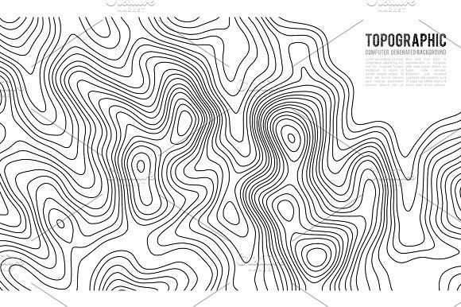
UNIT - 2
CONTOUR METHOD OF SHOWING RELIEF

Slide 21
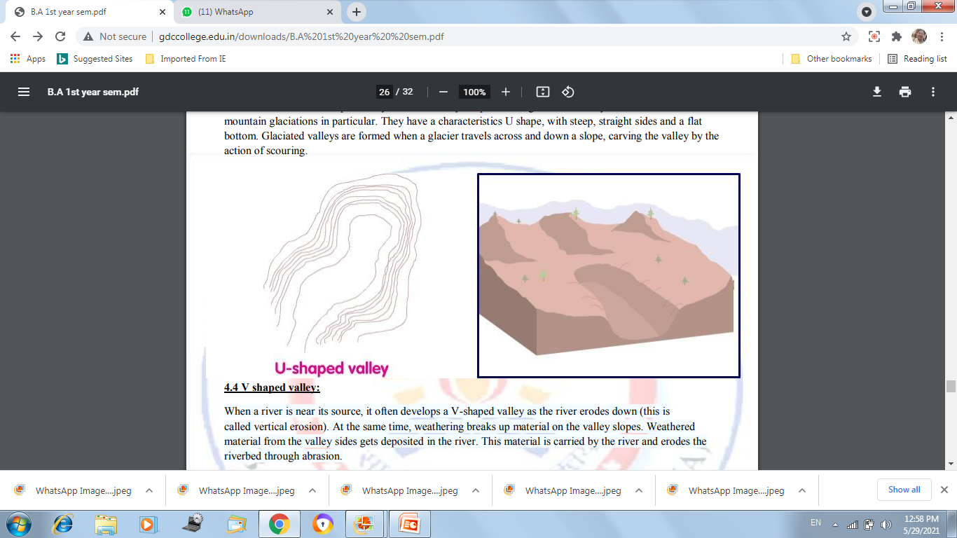
LANDFORMS

Slide 22
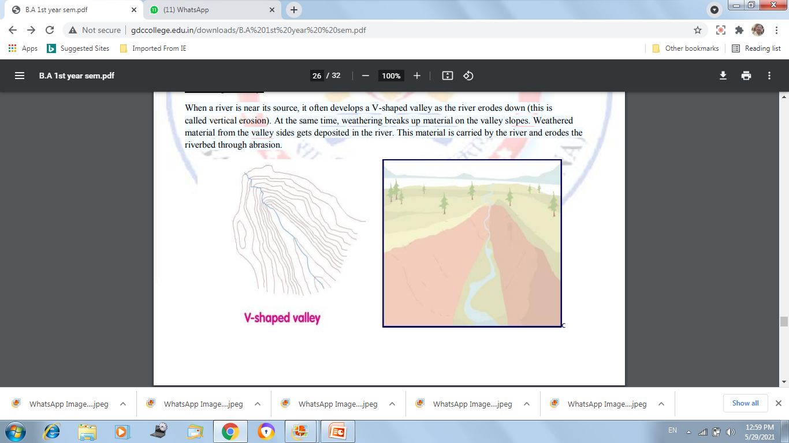
LANDFORMS

Slide 23
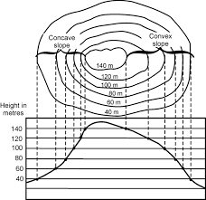
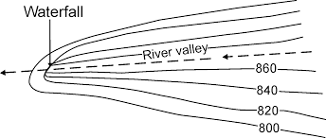
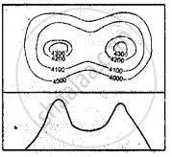
LANDFORMS

Slide 24
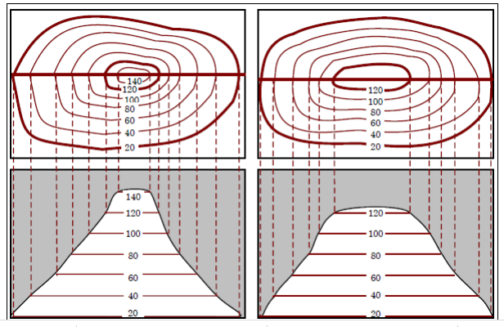
LANDFORMS OF RELIEF

Slide 25


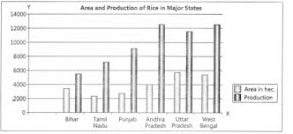
UNIT - 3

Slide 26

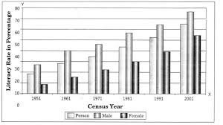

Slide 27

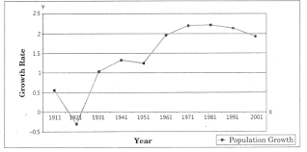

Slide 28
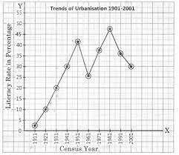

Slide 29
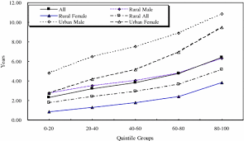

Slide 30

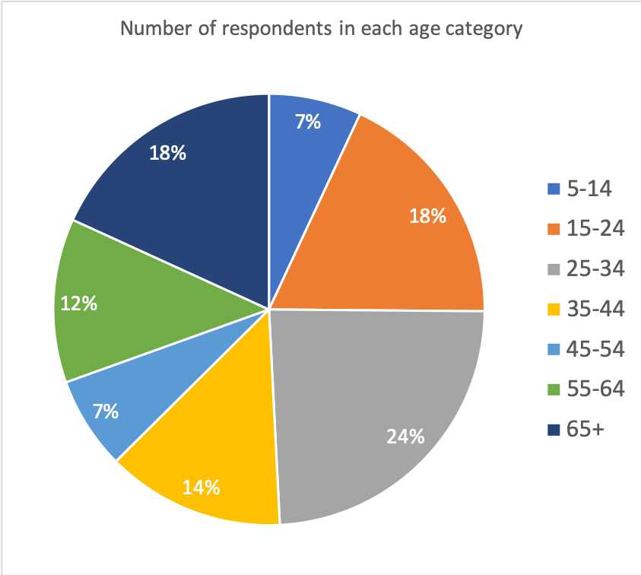

Slide 31

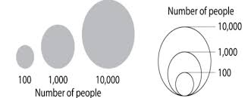

Slide 32
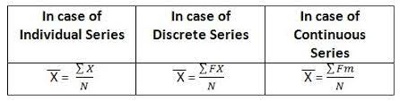
UNIT – 4
STATISTICS

Slide 33
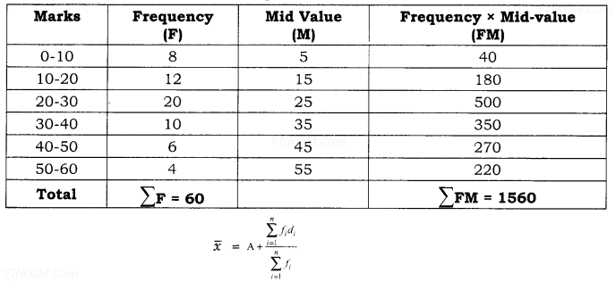
MEAN

Slide 34
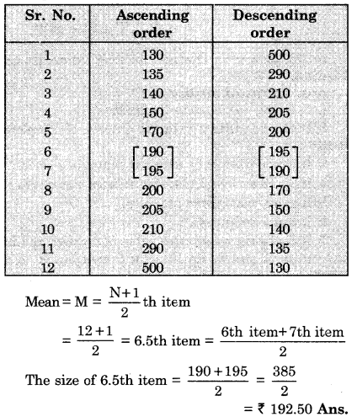
MEDIAN

Slide 35
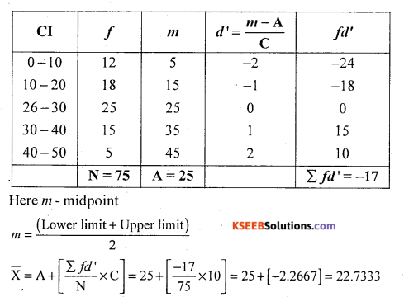
MEAN

Slide 36
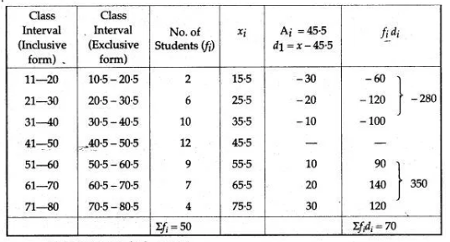
MEAN

Slide 37
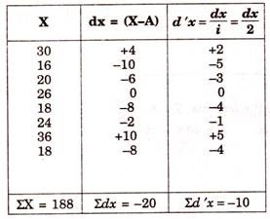
MEAN

Slide 38
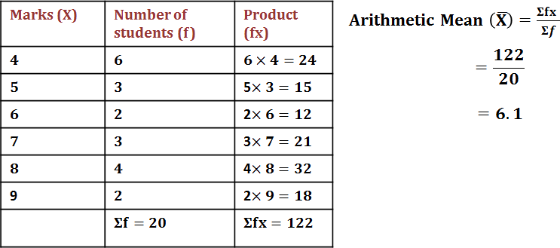
MEAN

Slide 39

UNIT - 5
Instruments used for chain surveying:
The various instruments used in chain surveying are as follows.
ü chain
ü arrows
ü pegs
ü ranging rods
ü offset rods
ü plumb bob
Trough Compass

Slide 40
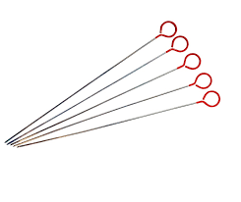
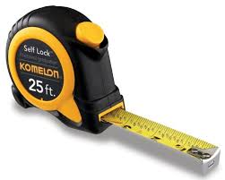
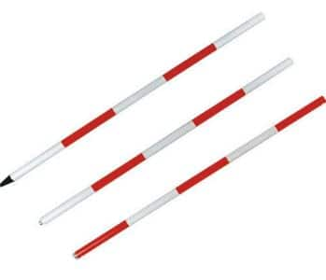
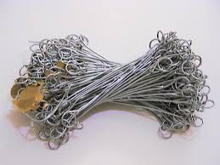
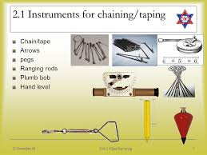
Arrows
SURVEYING
Ranging rods
Chain
plumb bob

Slide 41
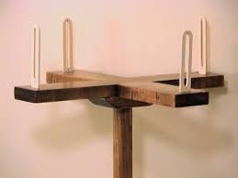
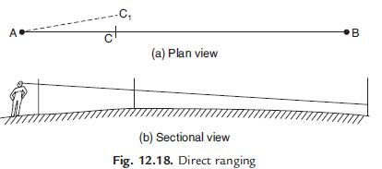
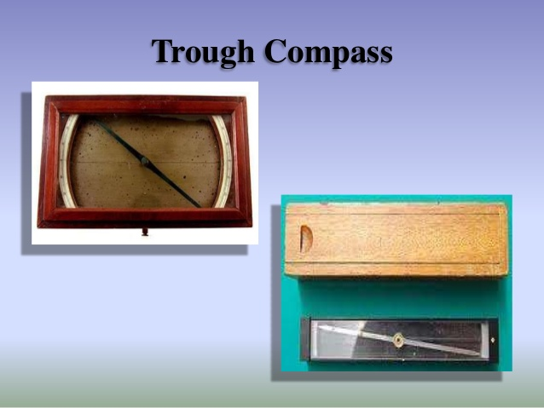
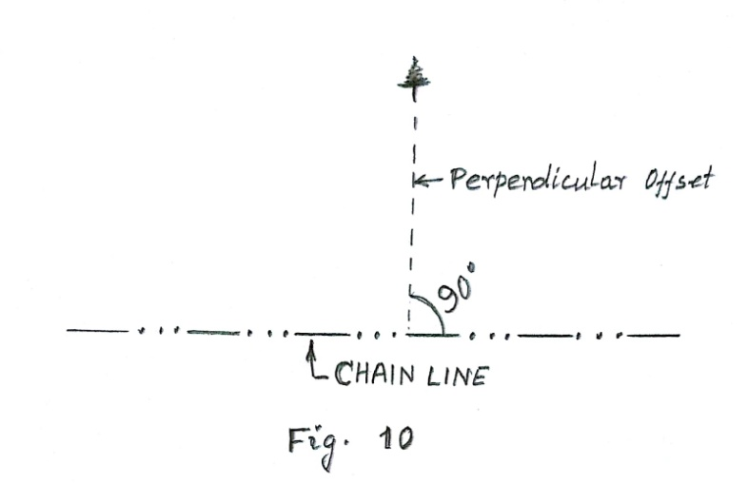
Offset

Slide 42
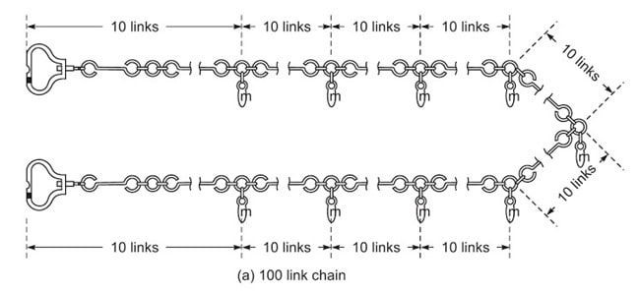

Slide 43
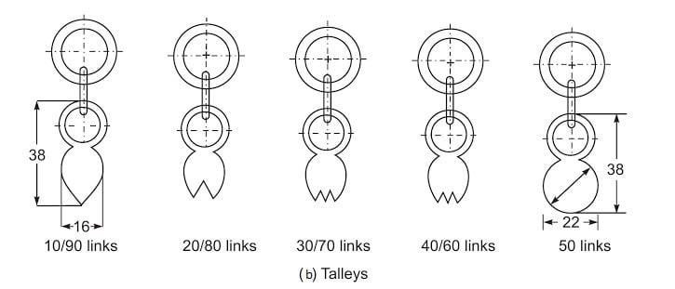

Slide 44
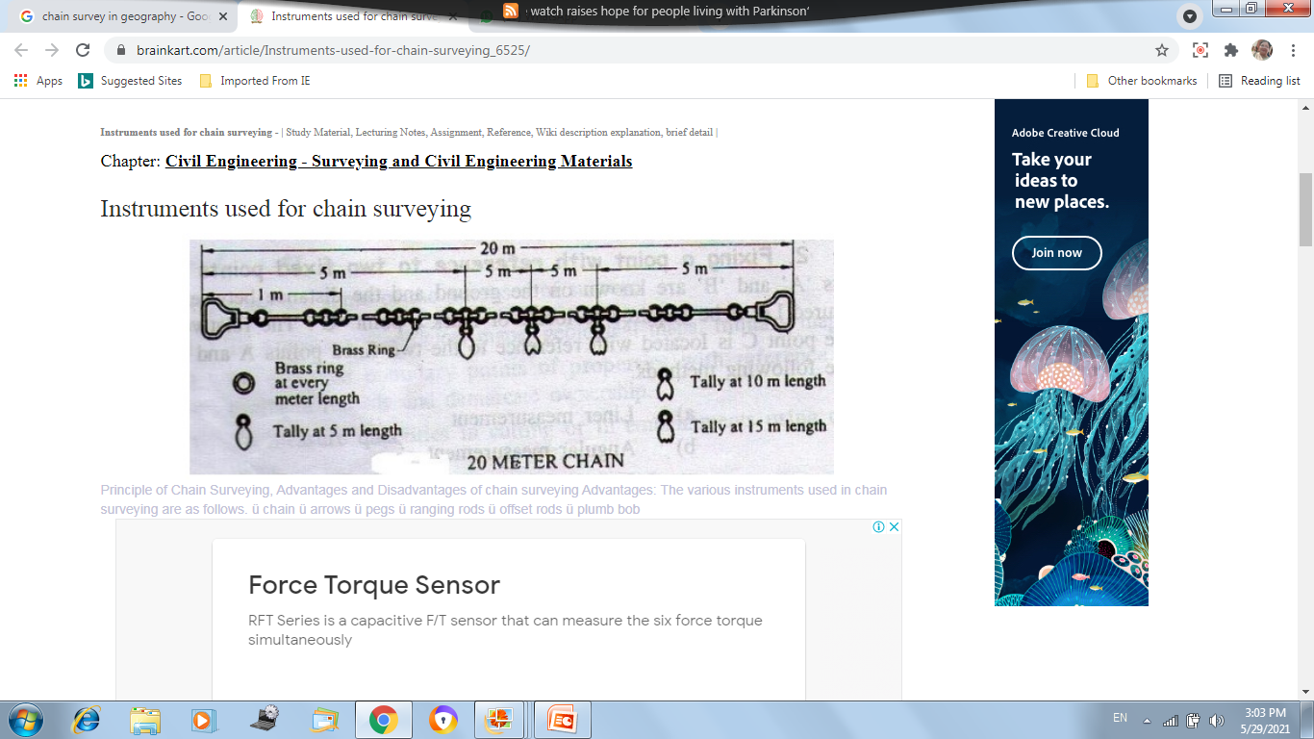

Slide 45
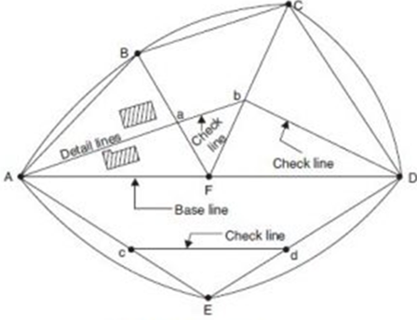
SURVEYING

Slide 46
SURVEYING
ROAD

Slide 47
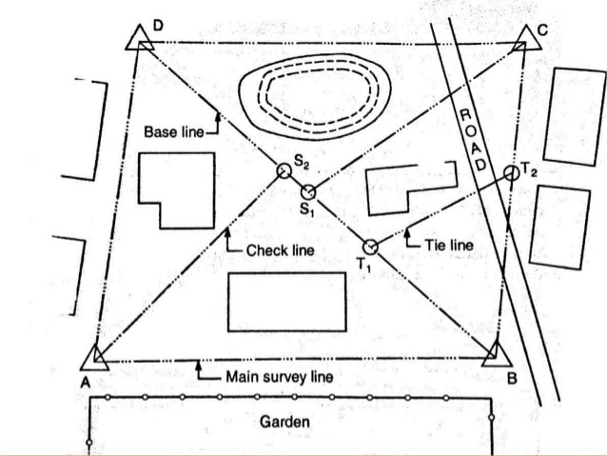
SURVEYING

Slide 48
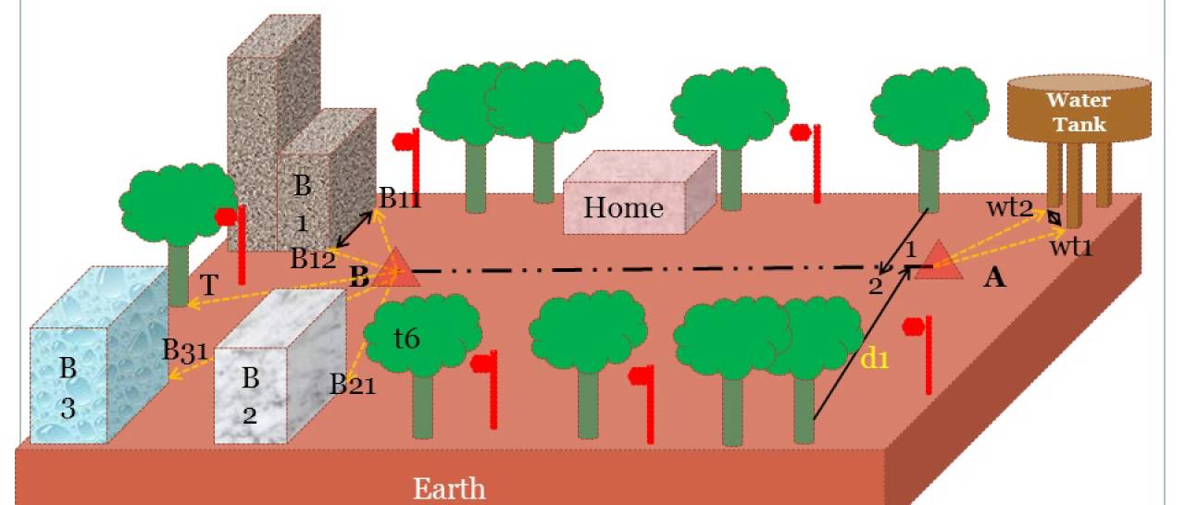
SURVEYING

Slide 49
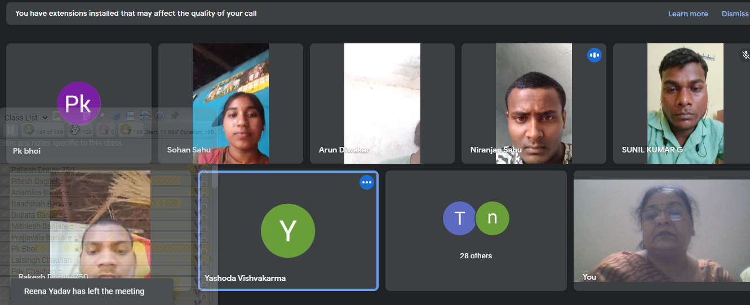
THANK YOU

