Slide 1
Durga mahavidyalaya
Department of commerce
Dr vaseemuddin management accounting
Topic-types of ratio

Slide 2
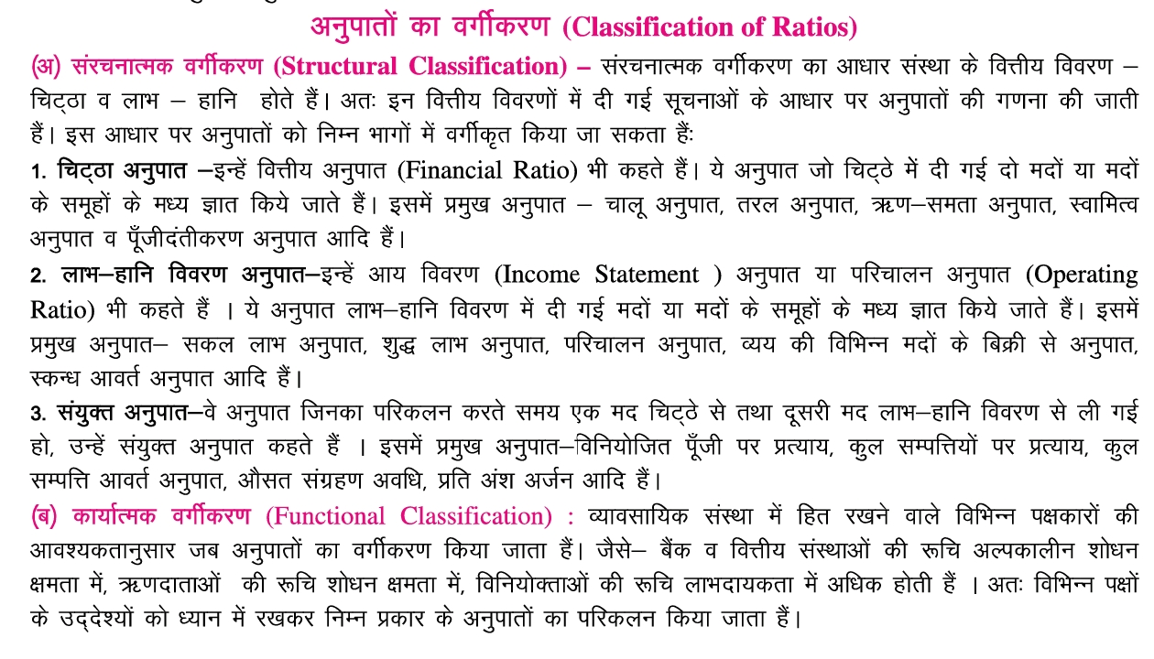

Slide 3
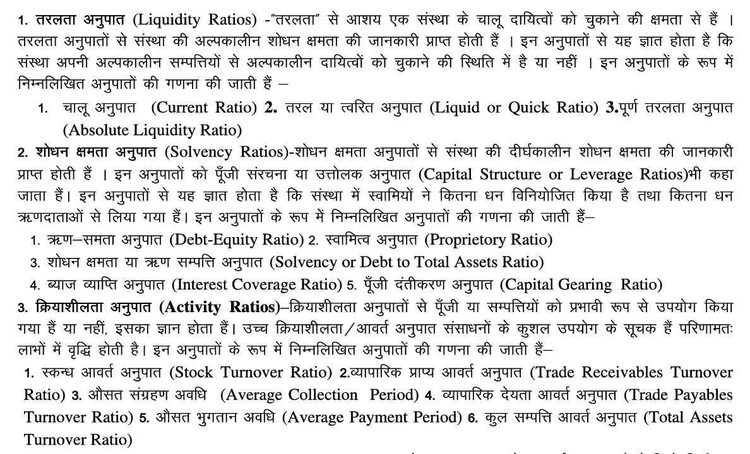

Slide 4


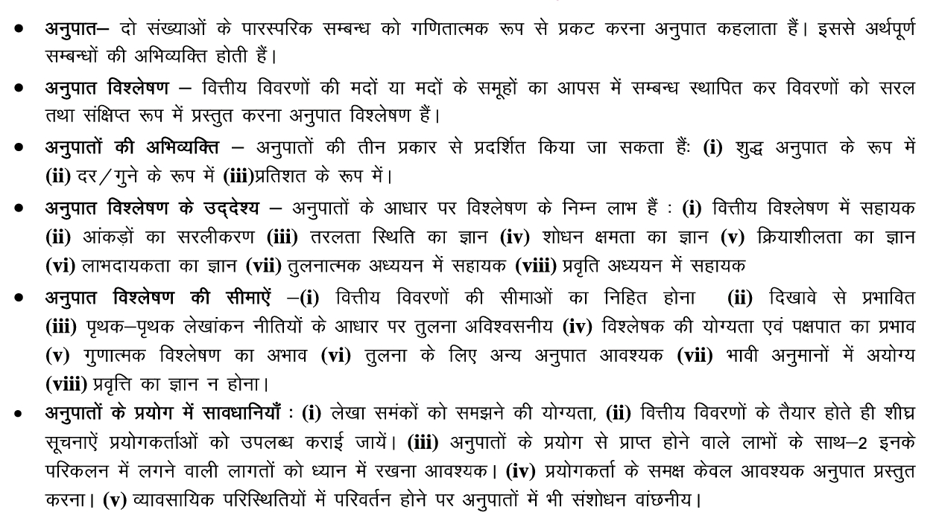

Slide 5




Slide 6
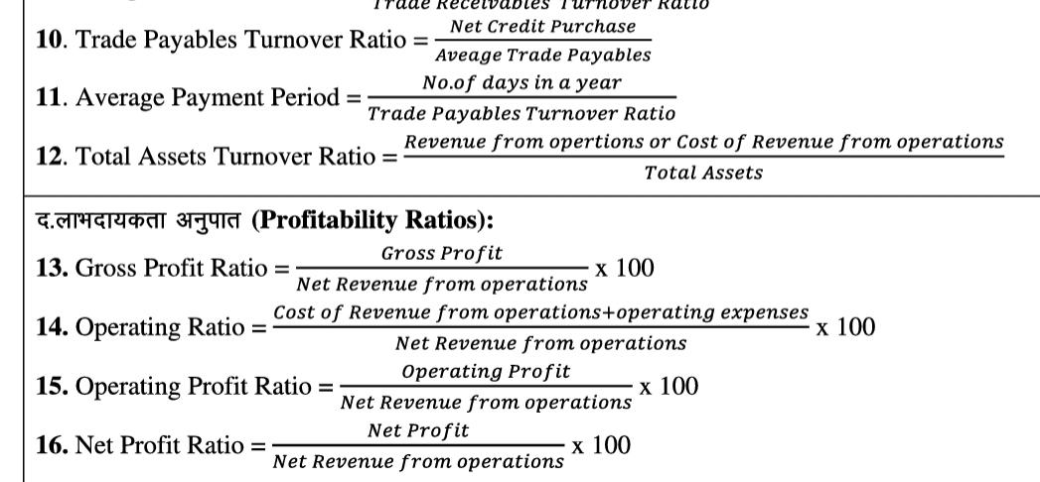


Slide 7
Thank you

